Slide 1
Reviewing IRB Reviewers’ Comments
In Cayuse

Slide 2
How to use this tutorial
This tutorial is for Investigators (PIs and co-PIs) who have recently submitted an IRB protocol application and have received notification that they need to review the IRB reviewer’s comments, provide clarifications, and make changes.
Screen shots here may not look exactly the same as what you see on your computer. The rendition varies with the size of your screen.
Equivalent terms include: researcher = investigator; study = protocol = application
Use your keyboard’s left/right/up/down arrow (or your mouse/trackpad scroll or the spacebar) to move through the PowerPoint. Instructions are animated.

Slide 3
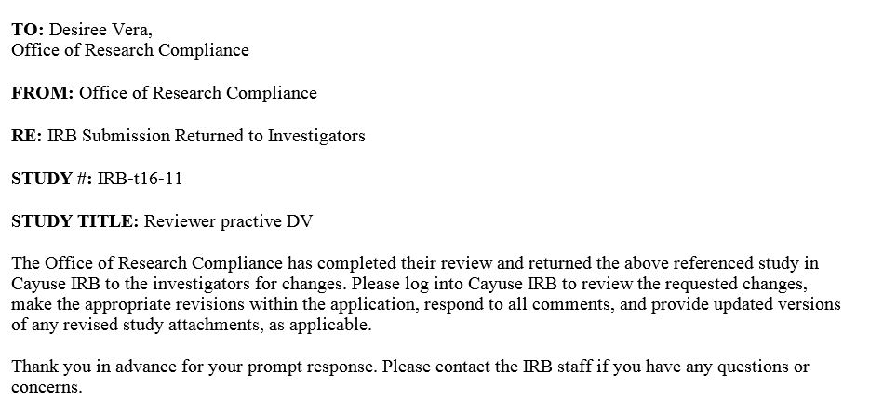
1. You should have received an email notification such as this, notifying you that your protocol has been returned to you for edits.
2. Log into Cayuse:
https://chapman.cayuse424.com

Slide 4
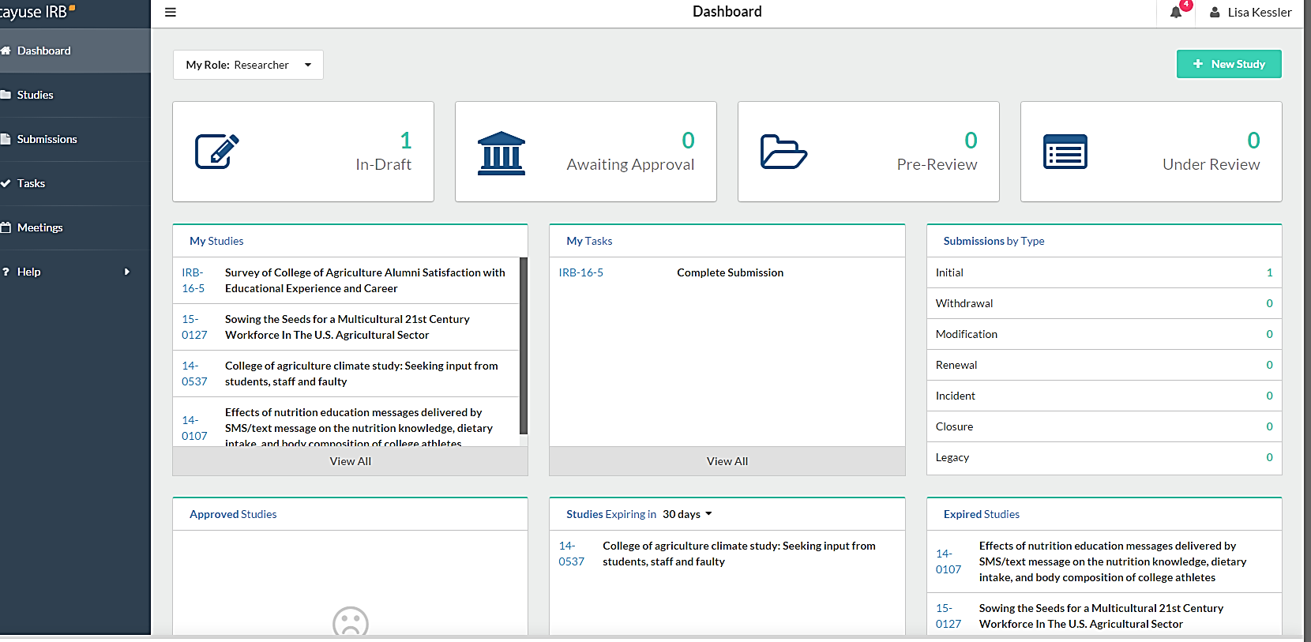
2. Or here
1. When you log in to your Cayuse account, you’ll be taken to your Dashboard. You can see that you need to work on a submission here.

Slide 5
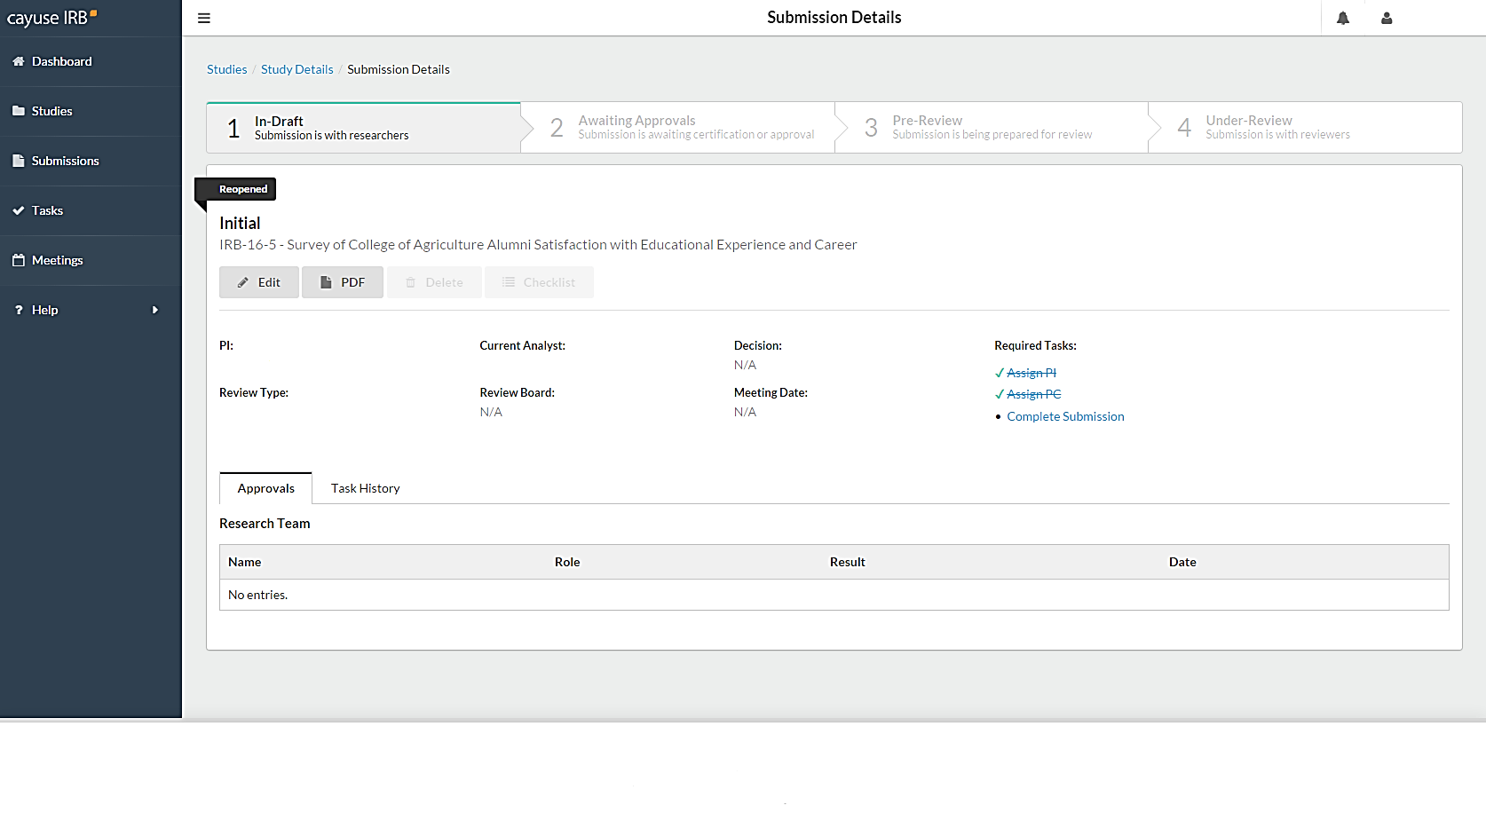
1. Once you have selected the study you need to revise, you’ll be taken to the study’s “Study Details” page.
3. Or this
2. You can enter the protocol by selecting this.

Slide 6
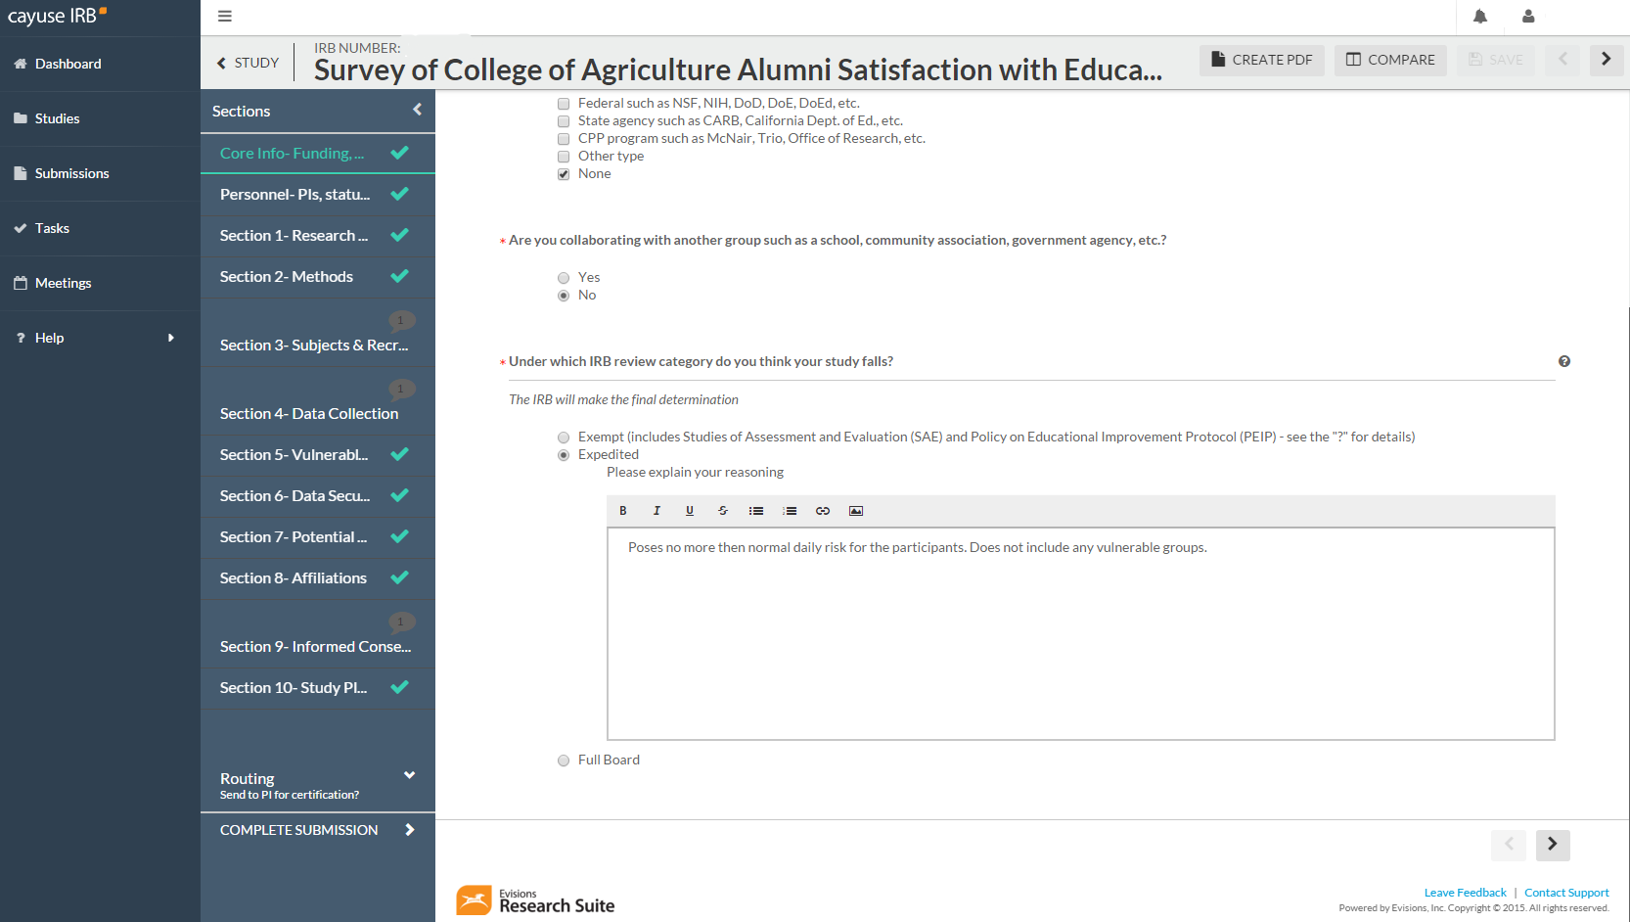
1. Once you have entered the protocol, you can see where the reviewer has made comments.
2. Select the protocol section with the comment you want to address.

Slide 7
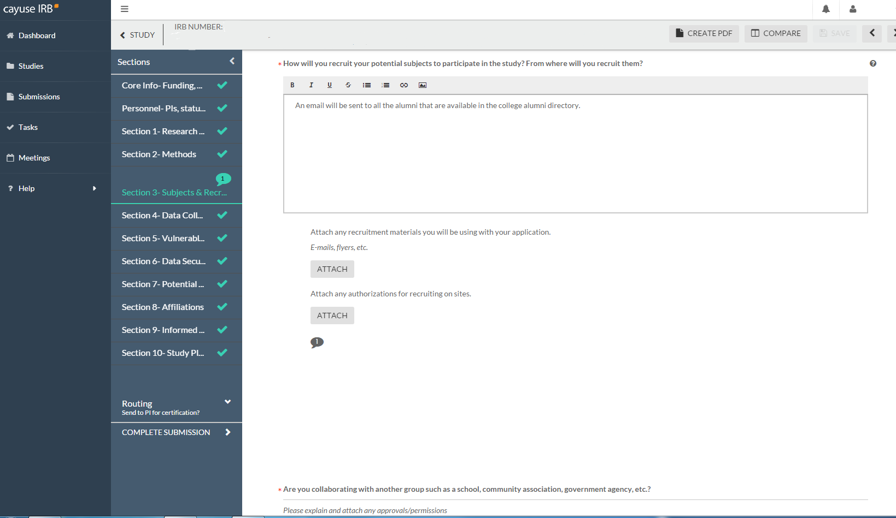
1. Now that you have selected the section with the comment(s), scroll through to find this (see red arrow).
2. Click on the speech bubble to expand the comment.

Slide 8
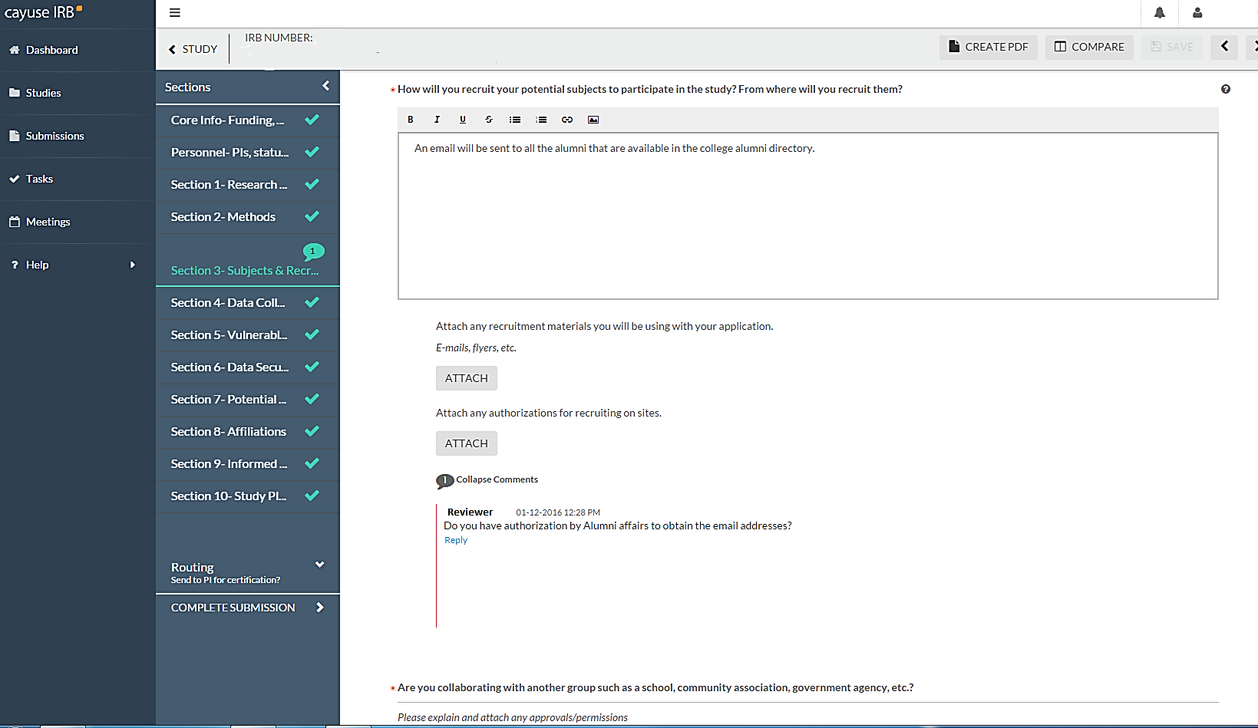
2. Make sure to update your answer in the text box as well!
1. The Reviewer’s comment is now visible. You can reply to the comment with your answer/action.

Slide 9
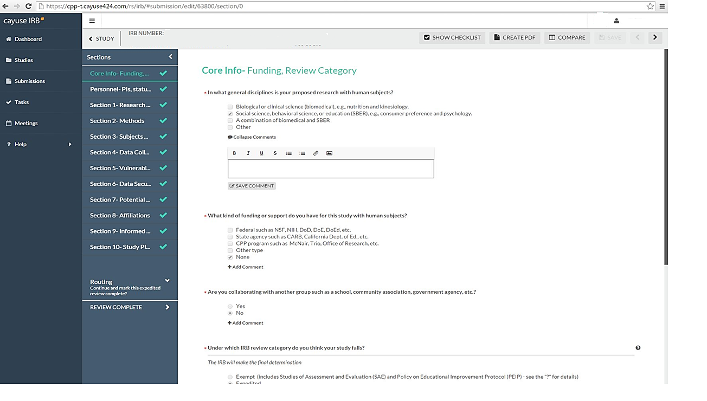
1. Once you click on “reply”, this comment box opens.
2. You can see that you have several options such as Bold, Italics, Bullet Points, Attachments, and Strikeout (red arrow).
4. You NEED to “save comment” every time!
3. When making changes to your answers, please make sure to Bold the new information so that the reviewers can easily see the changes.

Slide 10
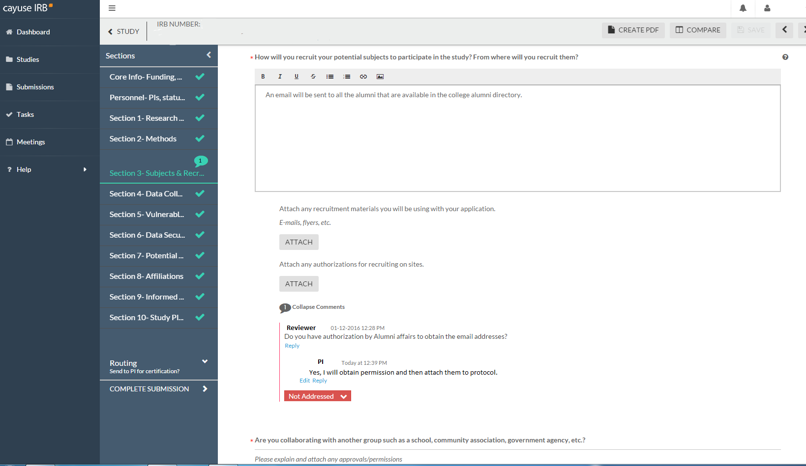
1. Once you have made the comment and clicked on “Save Comment”, the comment section will look like this.
2. You can see that you now have this “Not Addressed” box. The default for this is “Not Addressed” so you must change this if you have addressed the reviewer’s comment. If you do not, you cannot move the protocol forward to submission.
3. To change this status, click on the down arrow and select “Addressed”.

Slide 11
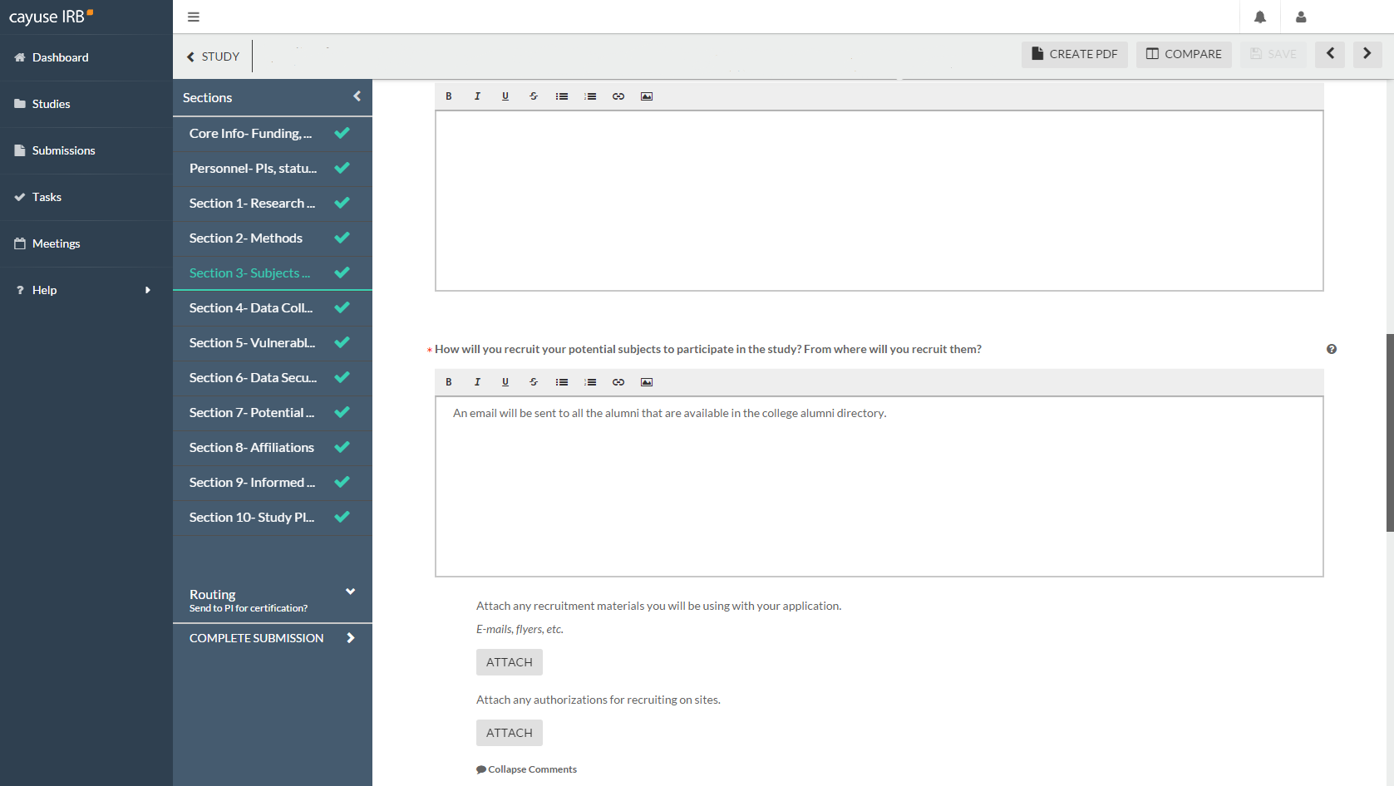
1. Once you have reviewed and “Addressed” all of the reviewer’s comments, you should have checkmarks on all of your protocol sections. You cannot move forward until this happens.
2. Once you are ready, click on this to move the protocol forward. You will need to certify again.

Slide 12
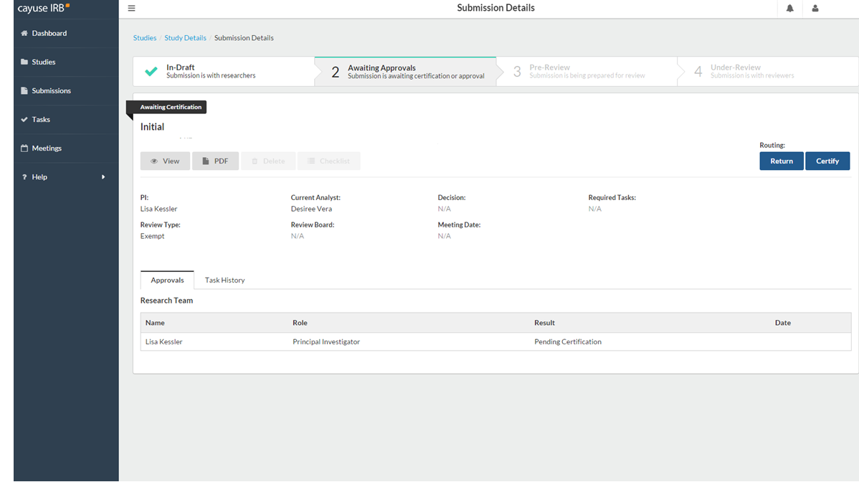
Only the PI needs to re-certify.

Slide 13
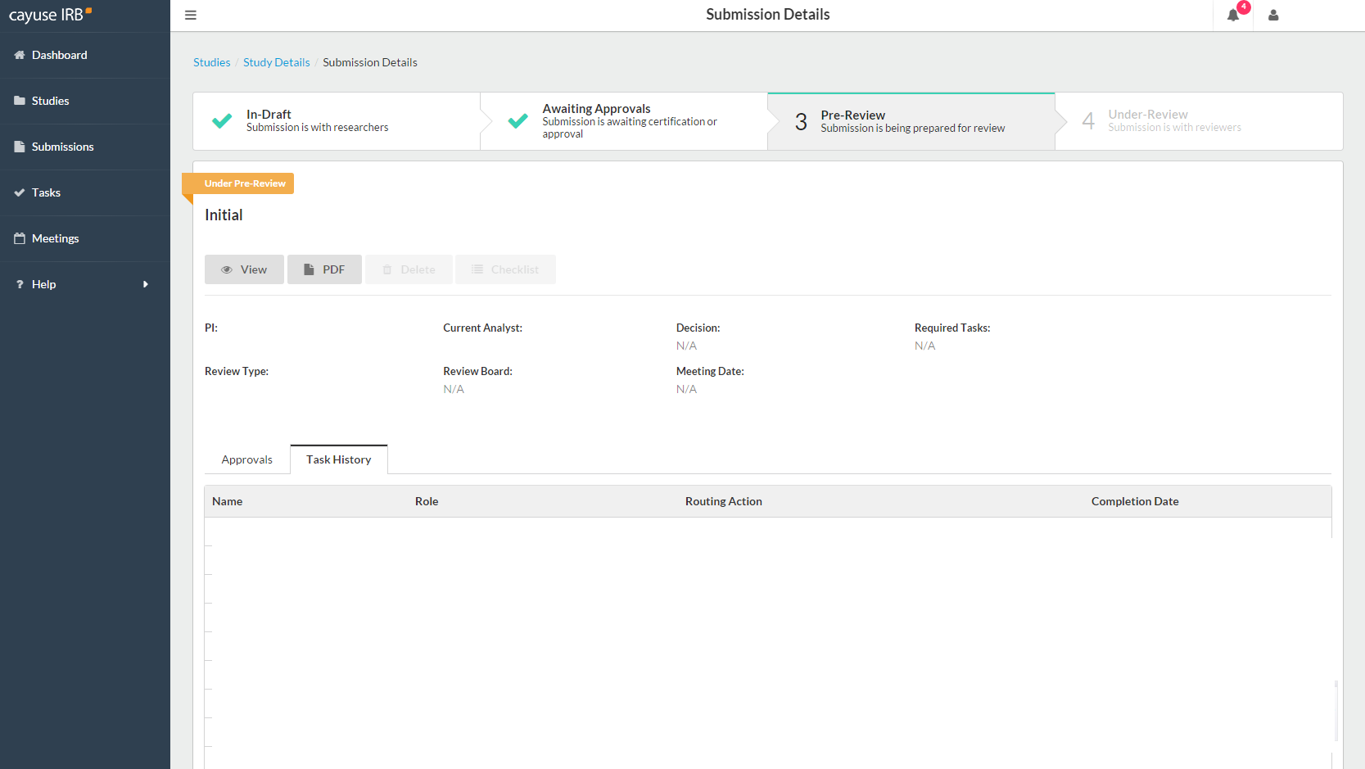
With this change in status, you know that the protocol has been resubmitted to the IRB office.

Slide 14
If you have issues or questions, please contact the IRB Office at irb@chapman.edu or (714) 628-2833.
For IRB Consent Templates and Forms, visit https://www.chapman.edu/research/integrity/irb/forms-and-instructions.aspx
Please let us know if you find any issues (e.g., typos, unclear questions), as this is a new system. Thank you.

