Slide 1
How Organizational Approvers Certify or Return Submissions in Cayuse IRB

Slide 2
Introduction
This tutorial is for Chairs and Deans who have been tasked with providing organizational approval of a study submission.
In the Cayuse IRB system, “Organizational Approval” does not take the place of IRB approval. Organizational Approval is also called “certifying” the submission and is the equivalent of signing the assurance and signature page from the old paper applications.
Use your keyboard’s left/right/up/down arrow (or your mouse/trackpad scroll or the spacebar) to move through this PowerPoint.

Slide 3
1. You, a department Chair or Dean, has received an email notification similar to this.
2. Click the link within the email to log into Cayuse.
TO: Chair/ Dean
FROM: IRB Office
DATE: Jan 25, 2016 2:30 PM PST
RE: Initial Submission Requires your Certification
STUDY #: 17H-000
STUDY TITLE: Study Title
PI: Name
The submission for the above referenced study has been completed by the research team and now requires your organizational approval. Please log into Cayuse IRB [URL]; review and certify this submission.
Contact the principal investigator with any questions or concerns regarding this submission. Contact the IRB staff with any questions relating to Cayuse IRB. The study cannot be forwarded to the Institutional Review Board (IRB) Office for review and approval until you have completed this certification.
Thank you in advance for your immediate attention to this matter.

Slide 4
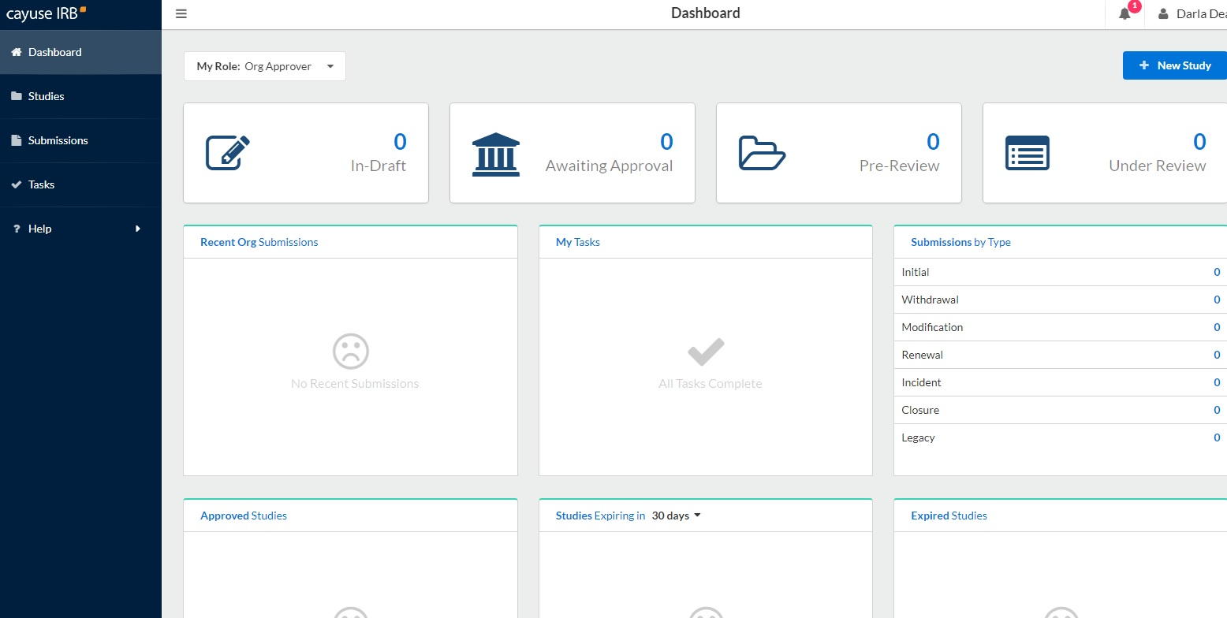
Once you are logged into Cayuse, go to your Dashboard.
Change your role to “Org Approver.”
3. Under “My Tasks,” you will see studies you have been asked to review and certify. Click on the study you wish to review.

Slide 5
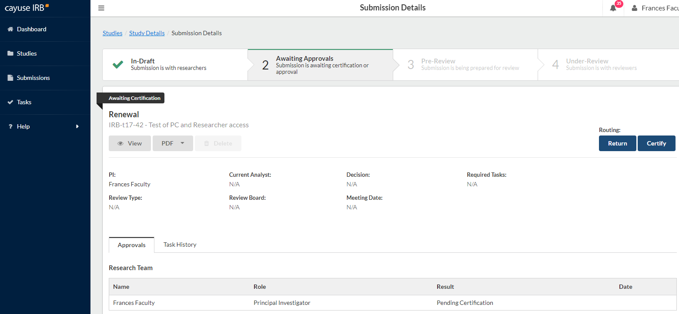
*ATTN: If the researchers of the study do not belong to your department and you were incorrectly assigned as the researchers’ department Chair/ Dean, select “Return” and notify the IRB office at irb@chapman.edu.
2. After viewing the submission/ study history, choose either “Certify” or “Return.”
“Certify” indicates that you have reviewed the submission and approve for the submission be sent to the IRB office for review.
“Return” indicates that you reviewed but reject the submission. Thus, the submission will not be sent to the IRB office and will instead be returned back to the researcher.
After clicking on the study, you will be taken to the study’s Submission Details. Click “View” to view the submission.
*If you have been asked to certify a renewal or modification, you can view the study submission history by clicking: “Study Details” → “Submissions” → “Legacy” or “Initial.”
Office of Research INTEGRITY-2017

Slide 6
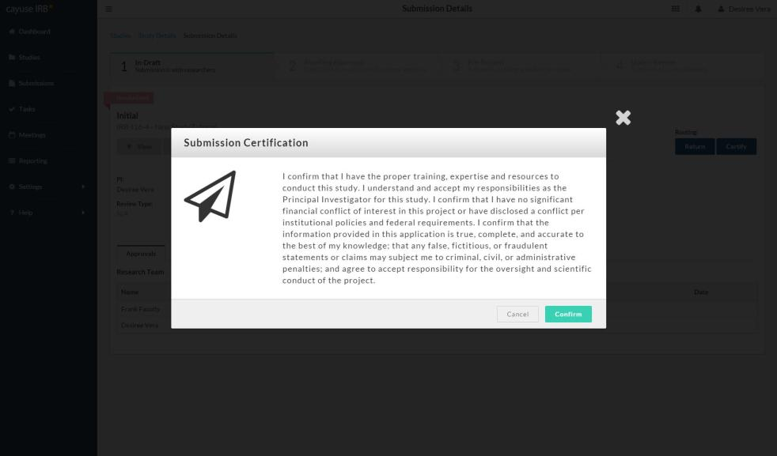
If choosing to Certify, read the Submission Certification message that appears and select “Confirm” if you agree.
After selecting confirm, your task of providing organizational approval is complete!
The submission will then be sent to the IRB office for review.
I acknowledge as Organizational Approver that a faculty member, staff, or student from my department is engaged in this research study.

Slide 7
Please contact the IRB office at irb@chapman.edu or (714) 278-2833 if you have any issues or questions.
Visit the Chapman IRB webpage for more information on Cayuse IRB:
https://www.chapman.edu/research/integrity/irb/cayuse-irb.aspx
As this is a new IRB system, please let us know if you see any issues (typos, unclear questions, etc.).
Thank you!

