Slide 1




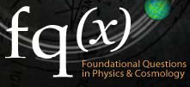
Institute for Quantum Studies
Co-Directors: Yakir Aharonov and Jeff Tollaksen
Courtesy Thaller

Slide 2
Quantum physics is the most successful scientific theory in history and governs the microworld of atoms
In the 20th century, it led to discoveries that now make up more than one-half of the US GNP, such as computers
There is now a revolutionary new potential: ultra-powerful computers, unbreakable codes to protect communications, etc
NIST: “America’s future prosperity and economic security may rely in part on [quantum science] to accomplish feats in physics, information science, and mathematics that are impossible with today’s technology.”
“Much like the way computers of today greatly improved our quality of life, quantum computers of the future will solve problems beyond our current imagination.”

Slide 3
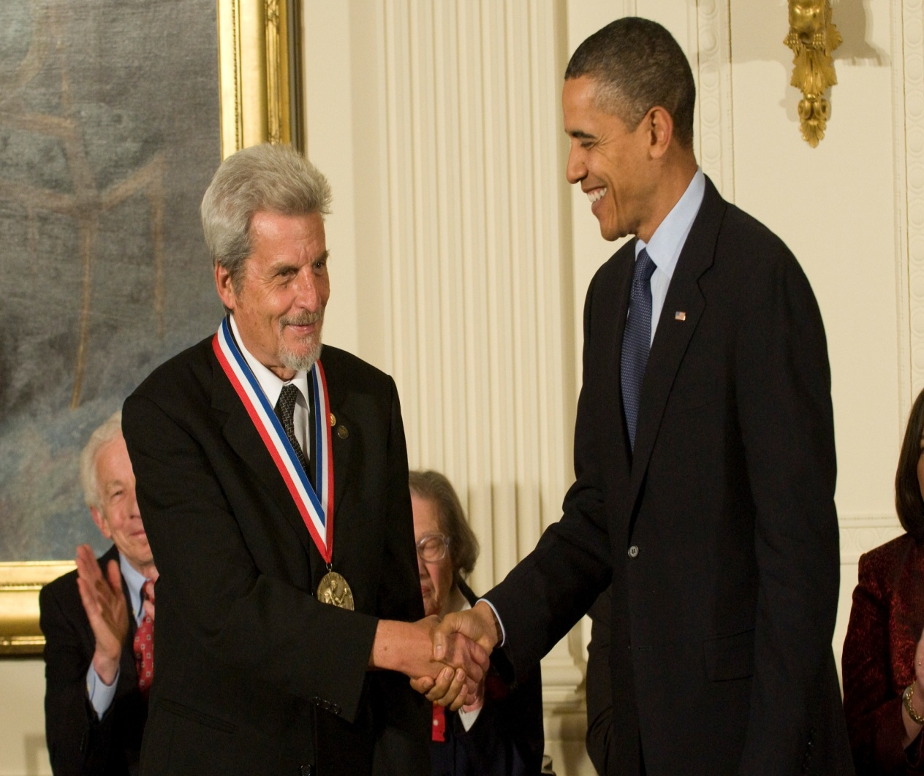
2010 National Medal of Science
Obama: “…one of the most influential figures in modern physics.”

Slide 4
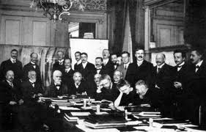
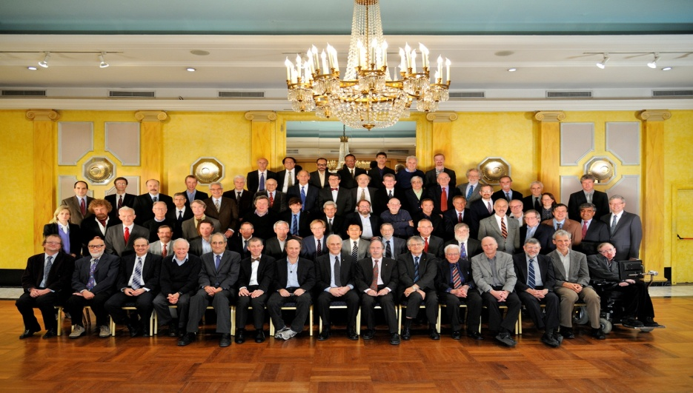
Recently, the 100th anniversary of the most important scientific conference was celebrated.
The organizer, David Gross was interested in the status of the questions raised at the first Solvay conference 100 years ago.
In particular, physicists knew very well in 1911 how to use quantum theory to calculate certain physical quantities with great precision
But, the theory was so intuitively bizarre that nobody knew what the theory meant! Incredibly, those very questions asked in 1911, remained largely open even to this day
The next revolution concerns the “meaning” of the theory, towards many proclaim that Aharonov and group are making significant breakthroughs

Slide 5
The mission of the Institute for quantum studies is:
to attract to the Center the top scientists in the world and to stimulate collaborations and synergy and
to communicate the relevance and importance of Quantum Studies to the broader public through a lecture series and other outreach efforts and
to provide a focal point for institutions, state and national governments, and industry around the world for the advancement (and funding) of the foundations and applications of Quantum Mechanics

Slide 6
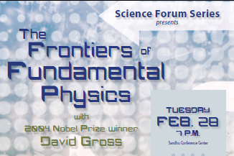
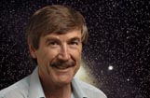
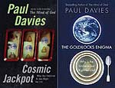










Popular lecture series attracting top figures to campus
Public outreach
Paul Davies
  over 20 popular books
  TV series: The Big Questions and Cradle of Life
  winner of the 1995 Templeton Prize, the 2001 Kelvin Medal, and the 2002 Faraday Prize

Slide 7
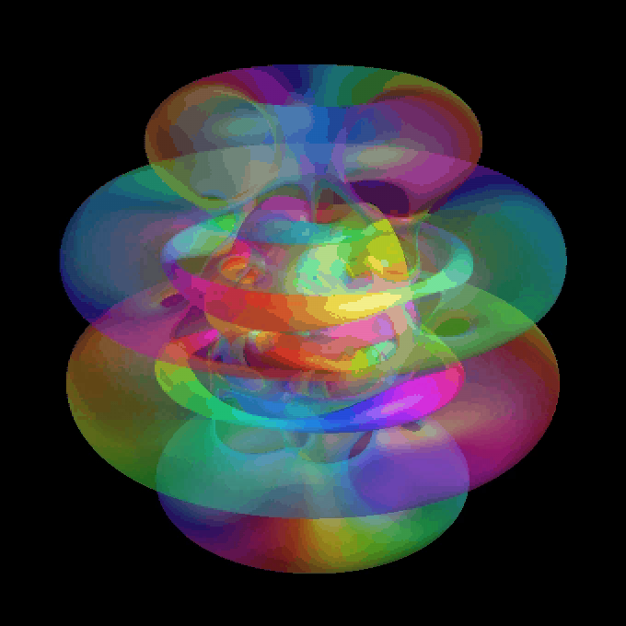
Time in quantum mechanics: 2 mysteries
Nonlocality
How can a single particle be at 2 places at the same time?

Slide 8
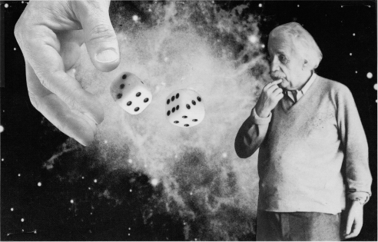
Time in quantum mechanics: 2 mysteries
Nonlocality
How can a single particle be at 2 places at the same time?
Indeterminancy
Einstein: “God does
not play dice.”

Slide 9
Indeterminancy: playing dice
1st atom decays in 1 min
2nd atom (identical to 1st atom) decays in 1 hour
There was no difference between them in the beginning, but they behave differently later

Slide 10
Boundary conditions: classical vs quantum
Classical (dependent):
.
(X,P) _{fin}
(X,P) _{init}
Quantum (independent):
.

Slide 11
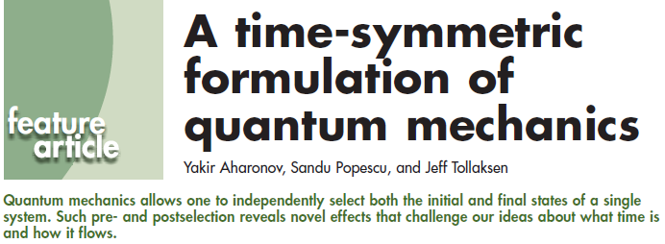
Physics Today, November 2010

Slide 12
Time-Symmetric formulation of QM (TSQM)
To be useful and interesting, any re-formulation of QM should meet several criteria, for example:
TSQM is consistent with standard QM
TSQM brings out features in QM that were missed before (e.g. weak values)
TSQM lead to simplifications in calculations and stimulated discoveries in other fields
TSQM suggests generalizations of QM

Slide 13
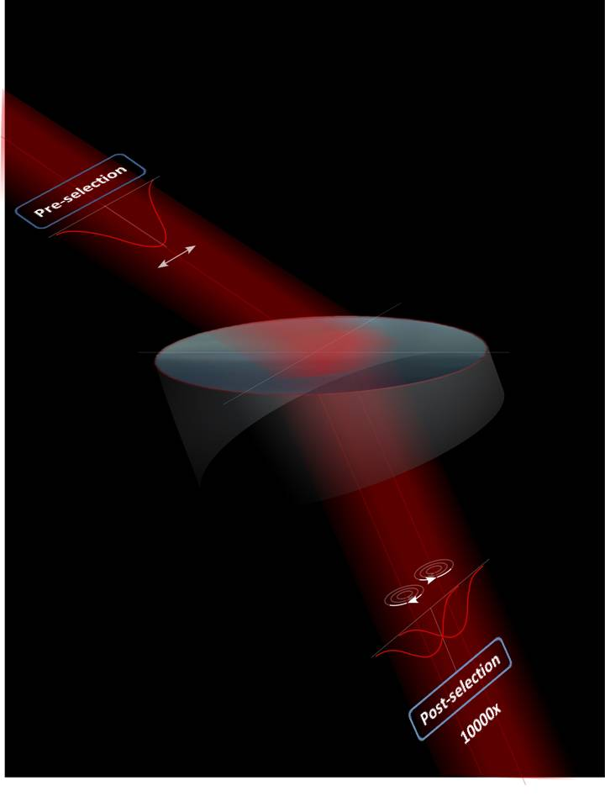
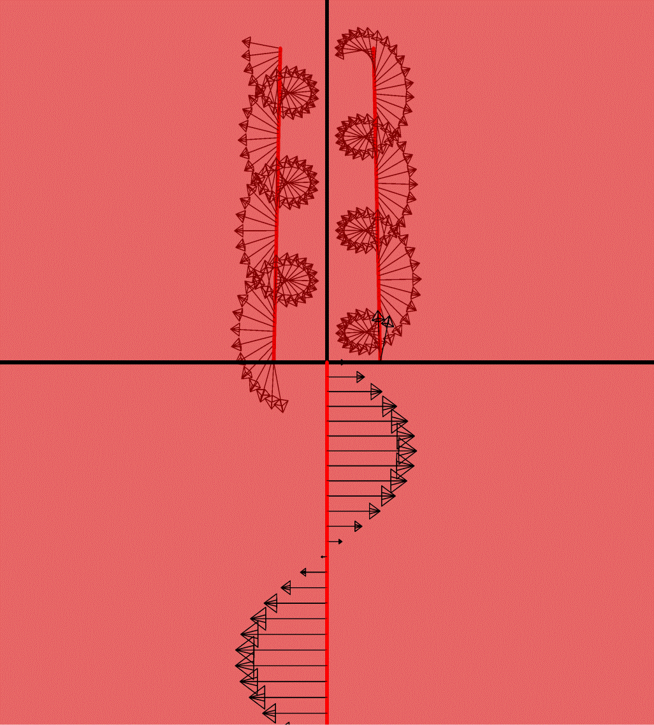
New paradigm for amplifying signals (AAV effect)
  Enhanced sensitivity by 10⁴ (Hosten, Kwiat, Science 2/8/08)
Courtesy Hosten, Kwiat

Slide 14
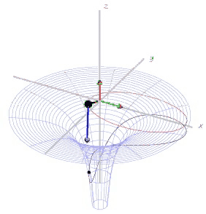
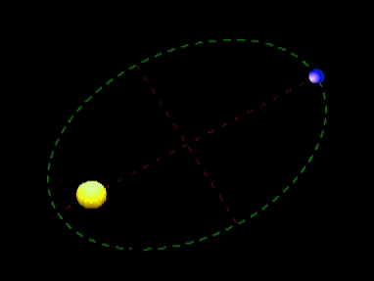
Newton’s laws: local equations of motion
In classical physics, the force has to act in the same place where the particle is

Slide 15
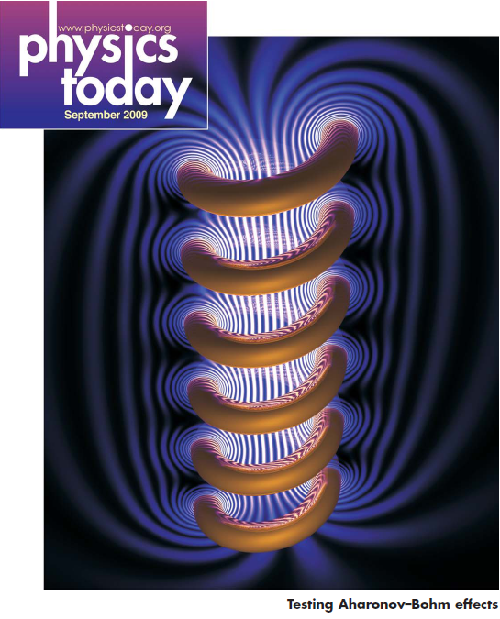
“Testing Aharonov-Bohm effects”
Notes:
Add one stage, where the photon goes only from the left

Slide 16
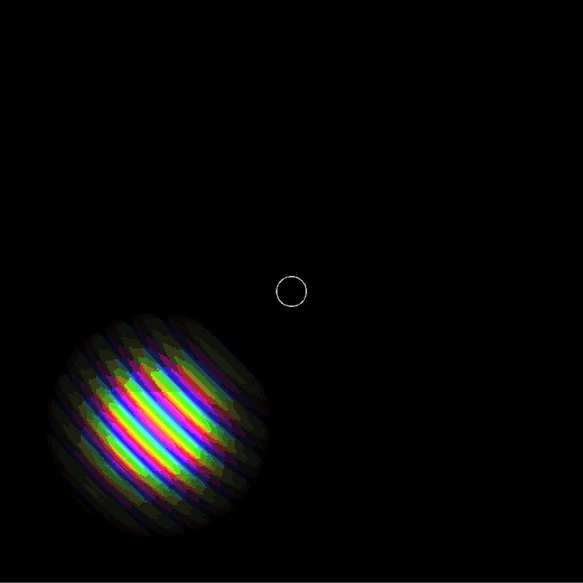
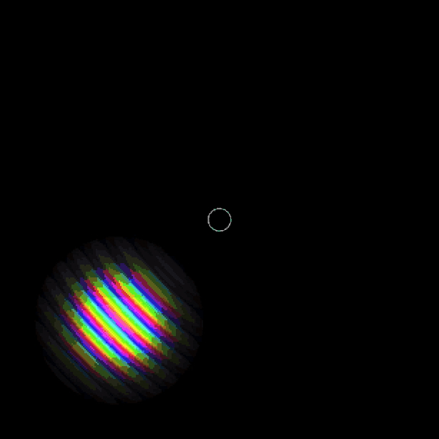
Bell-inequality violations follow from the Hilbert-space structure of quantum mechanics; they are purely kinematic
Aharonov-Bohm effect demonstrates dynamical non-locality , i.e. in the quantum equations of motion
Nonlocality: kinematic vs. dynamic
Courtesy Thaller

