Slide 1


Faculty Training
Wilkinson College of Arts, Humanities, and Social Sciences

Slide 2



WHAT WE’LL COVER
Advising Overview
Understanding Degree Requirements
Policies
Additional Resources
Q&A

Slide 3
Advising Overview

Slide 4

Wilkinson College Student Success Team
Academic Advisor
Faculty Advisors
Peer Advisors
Global Education Advisor
Career Advisor
Notes:
PROGRAM ADVISOR
Major/minor specific advising (tracks, options, and requirements)
Four-year major plan
Major/GE integration
Study abroad major approvals
Major specific substitutions
Post graduate planning
Transfer courses for the major
Approve permission number requests
Overriding prerequisite/corequisites
FACULTY MENTORING
Personalized academic mentoring
Postgraduate planning- Graduate/Professional
Support for Interdisciplinary programs and self-designed majors/minors
SPECIALIZED ADVISING
Study Abroad
University Honors
Pre-law
Pre-med/health
Professional Development and Internships
Disability Services
Tutoring, Learning, and Testing Center (process tutoring)
Promising Futures Program
Secondary-school career path advising

Slide 5
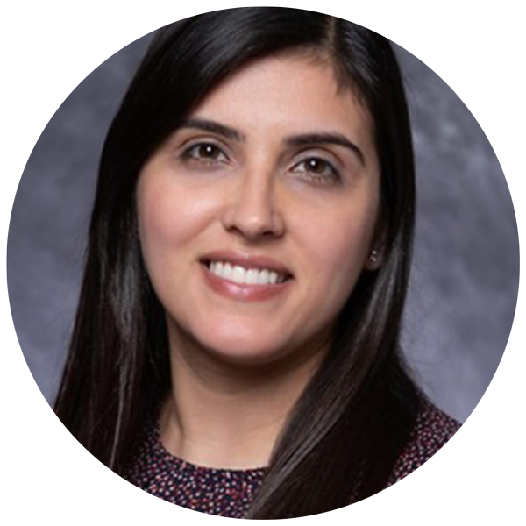
Wilkinson Academic Advisor:
Maggie Sandoval
New Student Advising
  AP, IB, Transfer credits, placement exam
Major/minor Advising
Study Abroad Advising (after being accepted to a program)
Graduation Review (Program evaluation interpretation)
General Education Advising: Schedule, academic policies, transfer credit, and petitions.
Provide advising workshops for first year students
Probation Advising
Location: Roosevelt Hall Dean’s Suite Room 102
Notes:
Academic Advisor
Review their Program Evaluation and all undergraduate requirements
Complete a graduation review
General Education advising
Confirm that the student is “on track”
Discuss the possibility of changing or adding another major/minor and still graduate on time
Opinion themed inquiry vs minor
Discuss difficulties that are impacting the progress in their courses
General registration questions
Discuss Pass/No Pass grading option
Discuss withdrawing from a class

Slide 6

Faculty Advisor
Major/minor specific advising (tracks, options, and requirements)
Mentorship based on student interest or future goals
Major/GE integration
Study abroad major approvals
Major specific substitutions
Post graduate planning
Transfer courses for the major
    Overriding prerequisite/corequisites
    Approve permission number requests (Chair)

Slide 7
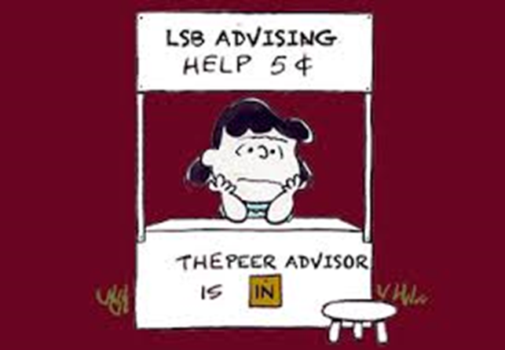
Peer Advising
Peer Advisors Can…
Advise on how to apply to majors/minors
Provide knowledge about policies and procedures
(Ex. P/NP, adding after the deadline, etc.)
Make referrals to campus resources
Answer general inquiries via email
Help with class schedule and create 4 year plans
Peer Advisors Cannot….
Give out personal information (phone number)
Make major/minor substitutions
Evaluate transfer work
Review study abroad courses
Deal with Student complaints (these should be forwarded to the Department Chair immediately)

Slide 8
Understanding the Degree Requirements

Slide 9

Degree Requirements
120 credits to graduate
Mixture of general education
  One required DEI course.
Major-specific coursework.
Must add one of the following:
  Second major.
  Minor.
  Declare a Themed Inquiry.

Slide 10
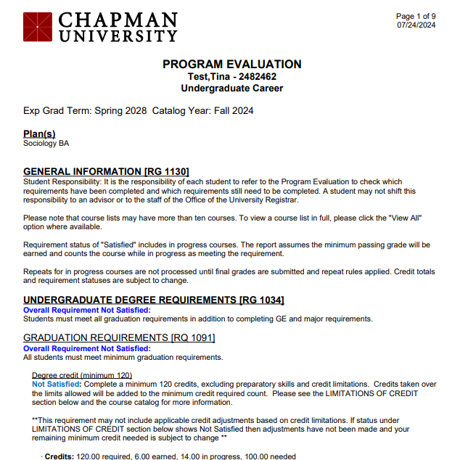
Program Evaluation
Lists overall credit requirements
  120 credits to graduate
  48 residency requirement
  42 upper division requirement
  Math 100
  DEI
List all General Education (GE) Requirements
List all major/minor/themed inquiry courses required for degree completion
Notes:
Primary tool for tracking degree progress
List overall graduation requirements
Have questions about program evaluation?
Faculty program advisor – major/minor related questions
Academic Advisor - questions on GE & overall graduation requirements

Slide 11
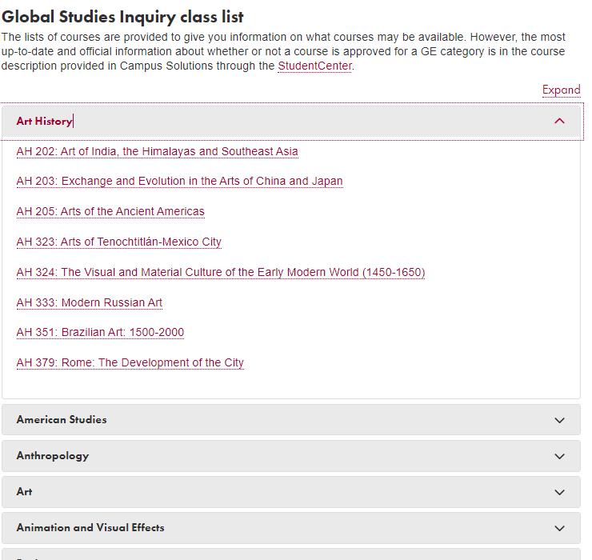
General Education (GE) Courses
  General Education Requirements
    Lists all courses approved to meet a GE requirement.
    Divided by GE requirement and then by subject.
Notes:
Primary tool for tracking degree progress
List overall graduation requirements
Have questions about program evaluation?
Faculty program advisor – major/minor related questions
Academic Advisor - questions on GE & overall graduation requirements

Slide 12
Sample Degree Plan
Requirement | Credits Needed (120 Total)
General Education coursework | 39 credits
BA in Political Science coursework | 42 credits
English Minor coursework | 18 credits
TOTAL CREDITS | 99 credits
With the remaining 21 credits you can take additional “free electives”, add another minor or second major, etc.
Some courses may count for both your General Education, major or minor coursework.

Slide 13
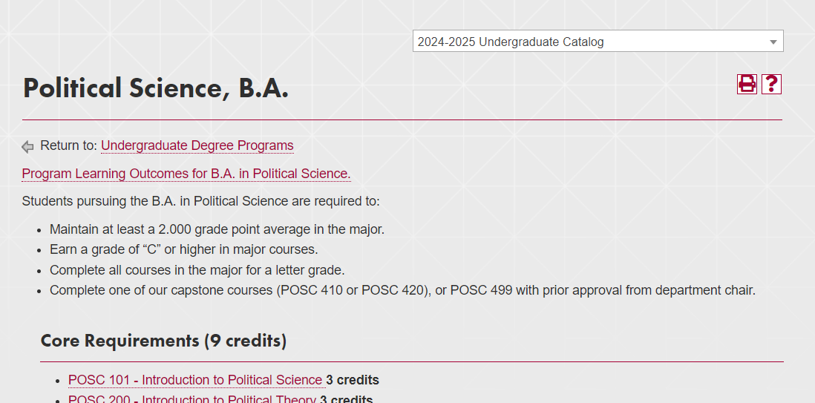
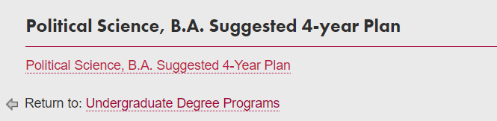
University Catalog
  Undergraduate Degree Programs
    All majors and minors offered at Chapman.
  4 year plans are available in the University Catalog as of Fall 2024. This catalog is only applicable for Incoming first year students
  Suggested 4 year plans for students under the 2023 catalog are available HERE.
  **Make sure to select the correct catalog year on the top right-hand corner.
Notes:
The University Catalog has suggested 4 year plan for the major. Along with the Program Eval this can also be a resource for students to review which courses they have completed and what requirements they have remaining.

Slide 14
Policies

Slide 15
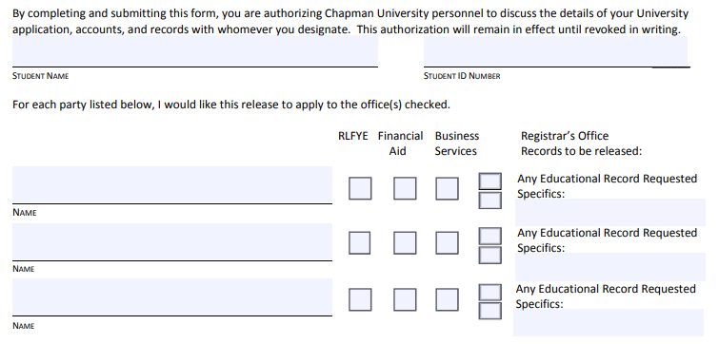
FERPA
The Family Educational Rights and Privacy Act (FERPA) affords student certain rights with respect to their education records.
Students must provide written consent if they would like Chapman University to share information with parents, spouses, or any other person or groups of persons.
    .
Notes:
We have a lot more policies than these but these are the most common you might encounter from students.
We have a handout that walks students through the process of transferring courses so they can definitely be directed to us if they need additional guidance. TES is a website students can use to check if a course is transferable

Slide 16
Course Load
12 credits per semester is a full-time course load.
Students can take 18 credits max per semester (at Chapman and elsewhere).
Can enroll in max of 21 credits if student has 3.0 GPA
  If enrolled at Chapman over 18 credits, an additional cost per credit is applied.
    .

Slide 17
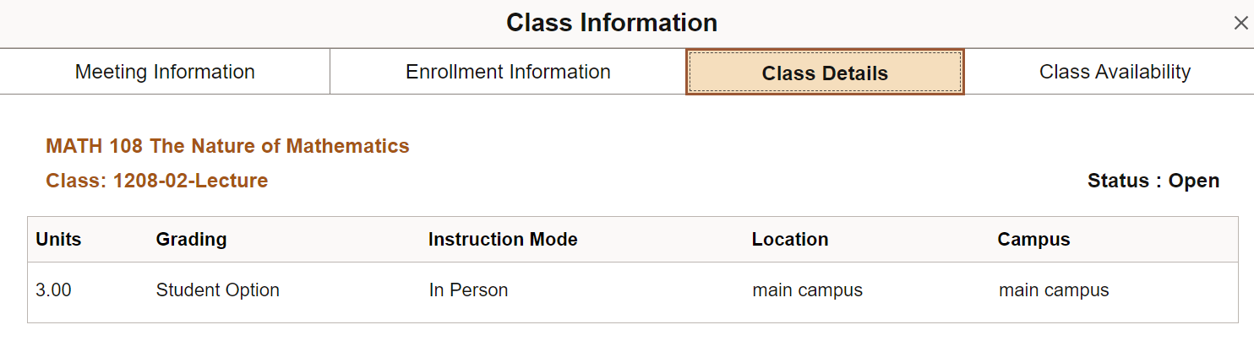
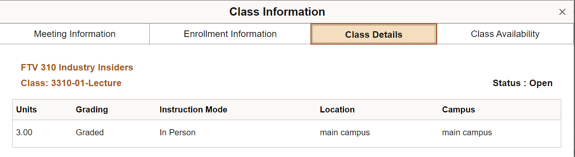
Pass/No Pass Policy
Student can only take 6 Pass/No Pass credits per academic year (e.g., Fall 2024 and Summer 2025).
  Courses set to P/NP do not count e.g.: MATH 100
Most majors & minors require graded courses.
Course must state “Student Option” if P/NP is allowed.

Slide 18
Policy for Sharing Credits
Major
Themed Inquiry
GE’s
Minor
GE’s
Major
9 credits
6
credits
GE’s
You can share 9 credits with your Major & GEs.
You can share 6 credits with your Minor & GEs.
You cannot share themed inquiry credits with your Major/Major discipline and GEs.
You can share credits between two majors and a major & minor, but you must meet the unique credit verification.

Slide 19
Additional Resources

Slide 20
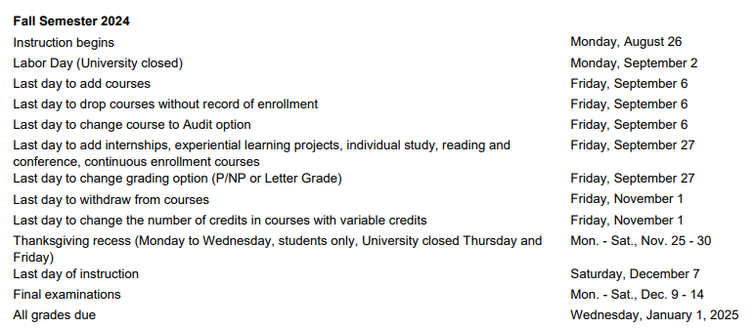
Academic Calendar
Important Dates:
Last day to add/drop
Last day to add independent study/internship
Last day to change to P/NP option
Last day to withdraw
Academic Calendar differs from the Business Office’s Tuition Reimbursement Calendar
Notes:
I highlighted important deadlines that students usually need to be reminded of. I also wanted to point out the Academic Calendar and the Tuition and reimbursement calendar are different. Sometimes students ask us these questions and even if they can drop until Sept 6th without record of enrollment does not mean the student will receive a full reimbursement. I usually refer students to speak with the Business Office for confirmation.

Slide 21
Campus Resources
Tutoring and Learning Center
Academic mentoring, tutoring and supplemental instruction, Writing Center, and Testing
Career and Professional Development
Internships, resume building, mock interviews
Center for Global Education
Study abroad, semester at sea, exchange student support, International student services
globaled@chapman.edu
Registrar’s Office
Transcripts, add/drop forms, change of major forms, academic forms
registrar@chapman.edu
Academic Calendar
Semester start and end dates, Add/Drop dates, Withdrawal dates, University holidays
Academic Catalog
Majors and minors offered, degree requirements, course descriptions, prerequisites, academic policies

Slide 22
SOS Reports
Student Outreach and Support Report: Miguel Calderon, Case Manager mcalderon@chapman.edu
Submit a Student Outreach and Support Referral
Counseling Services
Individual counseling, family counseling, workshops
spcs@chapman.edu
Dean of Students
Support classroom experiences, provide engaging learning experiences outside of the classroom, assist with questions about or difficulties in your Chapman experience
dos@chapman.edu

Slide 23

YOU
QUESTIONS
DO
HAVE?
WHAT

