Slide 1
How to prepare a proposal for creative work
Dr. Kelli Fuery
kfuery@chapman.edu

Slide 2
Proposal essentials
There are two main elements in a successful proposal that seeks to conduct creative work:
    Context
    Justification
The other VERY important thing is that you must tailor your application for CUE as the grant funding body.
This is a proposal, not a project outline, or pitch, or bid for creative producers. It is a statement that should justify your project and its academic significance.
A proposal must:
Briefly state what the project is
State why it is important (Context)
Include the reason for doing it, supported by scholarly evidence (Justification)
State the intended outcome

Slide 3
Context for project
Creative/Scholarly – Even though your project may be entirely creative-based or creative-led, it must establish a framework of relevance for your project.
Write why you want to do this project, but only in such a way that your work addresses previous creative activity the relates to the topic. No personal journey information needed. No love of creativity required.
In their letters of recommendation, faculty mentors must refer to this context and activity. Tell them to do this, especially if they are creative faculty. Give them your proposal as a guide.
A CUE reviewer will need to see how the proposed project came about and that they can speak to the scholarly frame.
Common mistakes:
No scholarly/creative framework for context
Very weak faculty letters of recommendation.

Slide 4
Example of previous creative application
Statement of Intent:
“I will be studying short format experimental filmmaking of the 1930s-70s, specifically during the Dada Art movement in an effort to create films that speak to relevant cultural issues of today. The purpose of the work is for myself to gain confidence in working with the analog film format, and express commentary on modern culture, with the hopes of launching my career in short format film.”
    identifies historical relevance and application (Dadaist film 1930-70s)
    States intention – the form is to highlight socio-cultural issues.

Slide 5
Justify the scope of your project within context
When you have outlined the scholarly framework by including sources as evidence to show the context for your project, – link it your creative work
The proposal must show how your project emerges out of your studies.
Answer the following:
  What is the main question your creative work examines?
  Is their cultural resonance with your project?
  Are you doing something new with form?
  Is this a thought experiement? Is it experimental with form (style), or story, or technology?
IS IT CREATIVE-BASED OR CREATIVE-LED?

Slide 6
Example of Scope
Keeping with the same example:
“The grant would support the funding of 16mm film, so that I may explore the formalities and
aesthetic opportunities of the analog film format. Pairing this with the application of
experimental concepts in the vein of film from the Dada Art movement. My projects would
involve using the Bolex cine camera to shoot short format films, to embrace the limitations of the
soundless camera and frugally utilize 2 ½ minute rolls of film. I will be researching early
independent filmmakers who used these means within the simplicity of their natural environment
to convey themes of grandeur and exploration of the human experience. Then, through
conceptualizing my own ideas and putting them into a practice, I intend to create several short
format films by the Fall, each exhibiting the variety of experimentation and implying the
semiotic approaches of storytelling that I adapt from the Dada artists. My work will aim to
bridge the gap between filmmaking eras, and bring an outdated, yet respectably creative format
of cinema into the 21st century.”
This states highly specific information of what the grant will be used for and why. Is it creative-based or creative-led?

Slide 7
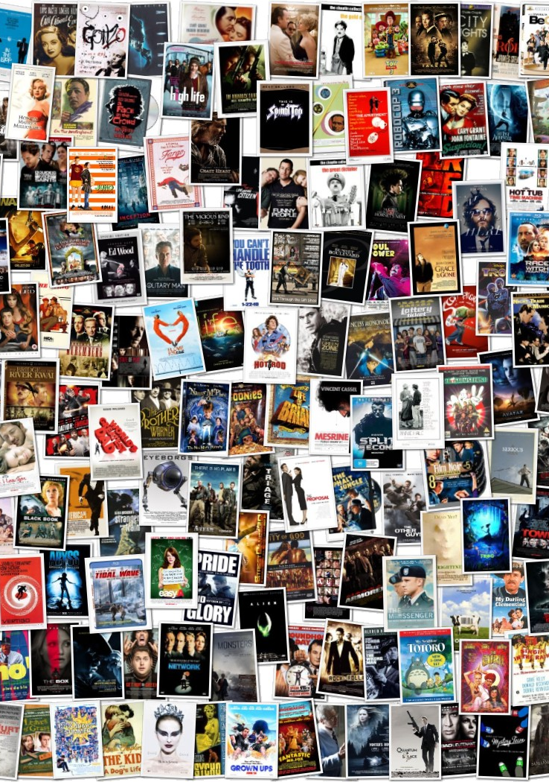
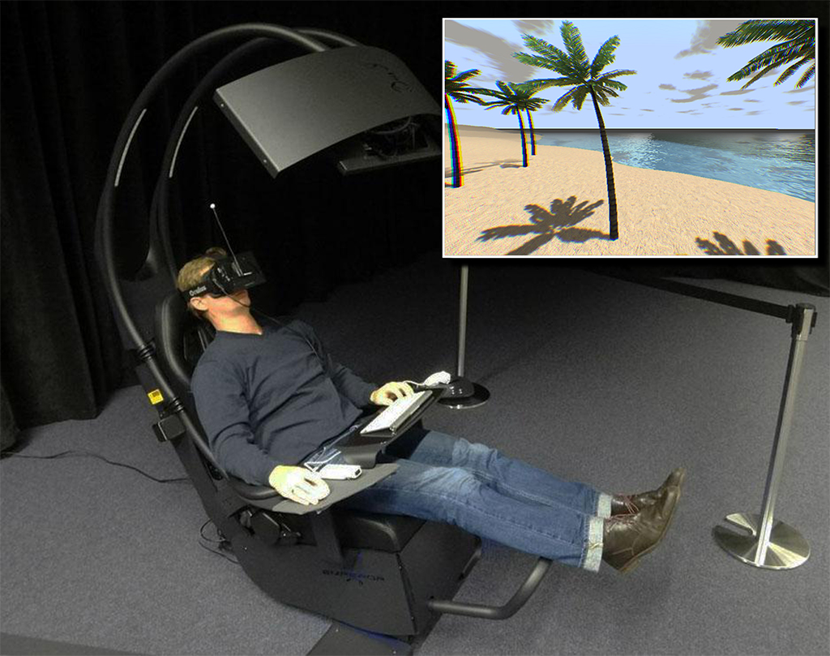
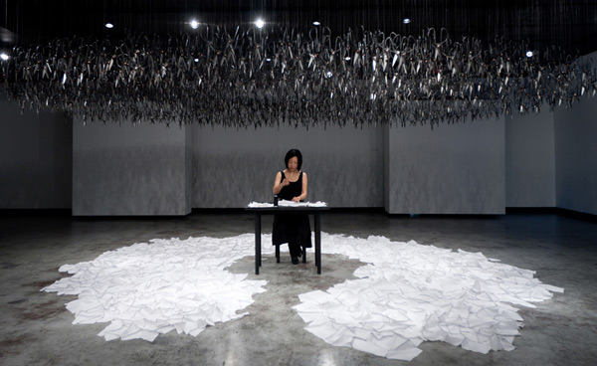
creative-based vs creative-led
What’s the difference?
Creative-based:
  students undertake research in order to gain new knowledge through the means of creative practice (e.g. the technology)
  the outcome is the work produced (VR, film, installation, performance, poem, production design etc.)
  So the practice is a vehicle for what is produced – the outcome

Slide 8
example
Our example student wants film stock to create short films.
Their project intends to experiment with the limits of the medium (Bolex camera) to think about the relationship between creativity, technology and society.
The outcome will be short films.
The experimentation lies in the use of specific film stock and shooting analog film.
It is a creative-based application.

Slide 9
What to include in a Budget for creative-based work
Creative work often requires a lot more money that CUE can fund in its $1000 limit for each grant.
Identify what specific item you want funding and focus on that
Do not ask for the full budget
Do not submit the full budget and hope for a full $1000
Expendable equipment: Stuff you need for the specific project that can’t really be used for any other.
    Costumes?
    Set design?
    Animal handler?
    Translator?
    Film stock?

Slide 10
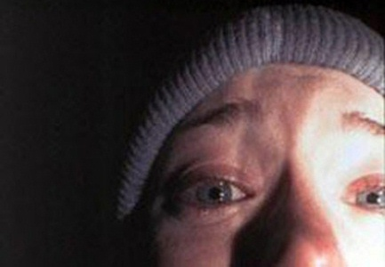
Budget: what can I ask for?
Main budget areas for creative (or practice) based research:
  Equipment - Materials that can be used after your project (in the event College doesn’t have non-expendable materials, such as cameras, etc.)
  Supplies - Material that will be used for your project only. Software, film/photo costs, copying fees OR material for props, set design, costume etc.
  Travel: conference fees, travel associated with moving between locations for research project (quite appropriate for creative-led research).
  Participants: costs for participation with project (performance, professional service). This doesn’t always have to be money. Can be a credit listing in the project; a cost of a print; meals, perhaps contribution to minder on set (if children are in production; handler if animals) etc.
  Miscellaneous: expenses not covered in above - such as rental for equipment not easily accessible (lighting for example; VR tech support)
Budget must be realistic for the scope and reach of the project. Don’t be greedy - be realistic and clear.

Slide 11
Example of budget request and justification
“The grant reward of $1000 will be used for the purchase, developing, and scanning of film. The
film will be bought from Kodak and developed at Fotokem in Los Angeles. I intend to complete
between 5-10 films throughout the summer with the amount of film I can purchase. The Bolex
camera will be available to me through Dodge College ...
Once the groundwork is laid out, the next step is to shoot the project, then send the footage
to Fotokem for develop and scanning.
Much of my investigations will be upon the Dada movement and its
conjunction with the historical realities of the times. I aim spend 1-3 weeks on each project,
depending on the simplicity or complexity of the idea, which will provide me with a feasible
timeline to conceptualize, produce, develop, and edit the final projects.”
The request is simply stated and clearly linked to the project. It isn’t greedy.
The timeline and planning for the project shows authentic creative research strategy.
Reader is left excited about the project.

Slide 12
Summary: what to include in a creative-based proposal
Explain clearly how your project (the outcome) relates to the field of study (whatever it is).
The creative outcome needs to be the emphasis of your grant application so…..
Make the purpose of the work clear and in context (scholarship)
Document your process (include other relevant projects; work with faculty mentors)
Show its critical importance and place within the relevant field
Most student projects will fall into this category.

Slide 13
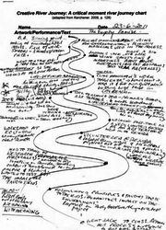
What is creative-led Research
This is slightly different.
Student will focus on the formal aspects of the creative practice/process
This leads to new knowledge about the processes and practices overall.
This is a meta-disciplinary approach.
The creative work is not the primary outcome - but can be an example of the work completed. (Film, script, marketing campaign, painting/sculpture, installation, etc.)
This would be a different method or unique approach that perhaps is not available via usual pathways in your college.

Slide 14
example
This will vary from discipline to discipline – from PRA work to Graphic design, to creative writing and the visual arts.
Put simply, creative-led research typically includes more than one element.
  The creative output (film, story, design etc.)
  A statement – a critical explanation or interpretation of the creative work.
  These 2 parts are not independent from each other but instead work together as pieces of a puzzle.
  (For those who might be interested in this approach see Nicolas Bourriaud’s Relational Aesthetics).
  An example of this is one student hired a hotel gym room and exercised for eight-straight hours to think through the physical commitment to the practice of creativity and the exertion of producing creative work. The result was a short film and thesis discussing relational aesthetics.

Slide 15
Proposal prep
Draft a brief outline of the project before meeting with Faculty.
Project has to be your idea. Faculty mentor facilitates.
Find previous work that indicates the project area - this is always important but especially so for creative projects. This becomes the foundation for your scholarly frame.
Demonstrate the context and reasoning for your research ideas. Linking your project to previous and related works is key.
This makes clear the research possibilities and potential links between faculty mentor and student.

Slide 16
creative or practice based proposal
EXACTLY same standard format as regular ‘academic’ proposal.
Same academic tone and expression.
This is not the place for telling the reviewer about your film or about the content of the project unless it specifically ties to the scholarly frame.
Do not list pictures of your crew with their bios.
Do not list the logline or pitch.

Slide 17
common mistakes
Asks for too much money – very very very common.
Request is not put into context
Tells the story of the project (the content) but does not justify the reason for why grant is needed
Ignores scholarly frame

Slide 18
difference in creative/practice based projects
A Creative Research Proposal should focus on:
  Proving Context - in what ways does your creative media project link with other practice-based works in:
      a) formal ways (aesthetics; genres; authorial; appearance)
      b) conceptual ways (themes; agendas; mission statements; manifestos)
      c) affective issues (the impact of the project on communities)
  Must show history of your work and how it connects to wider field. What is the pathway that led you to your project idea? This cannot be opinion based. It must resonate with creative work already accomplished.
  Go beyond - will this project allow future work to happen? What opportunities will the completion and award of this project potentially open up? What is your intentionality with your practice?

Slide 19
remember:
All parts of the project must reflect your abilities.
Only do what you can do. Grant proposals must be specific & detailed.
The budget must be justified by the research project’s proposal. Costs must be clearly linked to the context and method section (especially with creative projects where there might be an emphasis on experimentation with media/technology and formal aspects).
Budgets too should always be specific - not general. Make sure estimates have been quoted already, or that you have discussed your project with other creatives who have done similar work.

