Slide 1
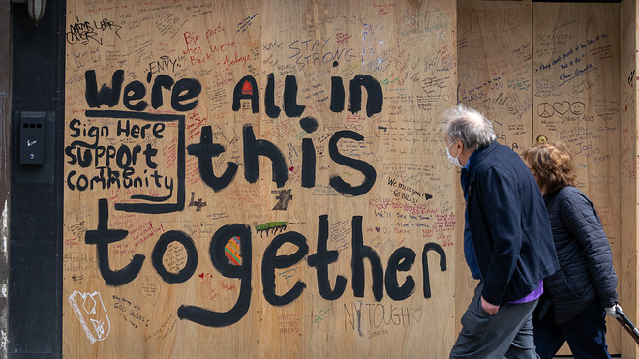
Chapman University spring 2020 national mental health study
David Frederick and Chapman Center for Excellence in Biopsychosocial Approaches to Health (CEBAH) Research Team
Kay Foundation Funded

Slide 2
Is the COVID-19 Pandemic Impacting Mental Health?
Many anecdotes but little data
Massive disruption to economy and daily lives
Many major changes
Mental health effects are speculative
Past research
2008 Recession linked to 2,500 additional U.S. suicides
Natural disasters, epidemics, and chronic stressors harm mental health

Slide 3
Aims and Method
Negative effects of COVID-19
Mental health, physical health, romantic relationships, prejudice and discrimination
National Sample
4,159 Participants from Mechanical Turk
All 50 states
Ages 18-84 (mean 39)
Funding from Kay Family Foundation
Chapman Collaborators: Drs. Glynn, Gruenewald, Pincus, Moors, Jenkins, Smith, Bostean, Robinette, Douglas, Berardi

Slide 4
Perceived Effects of Pandemic

Slide 5
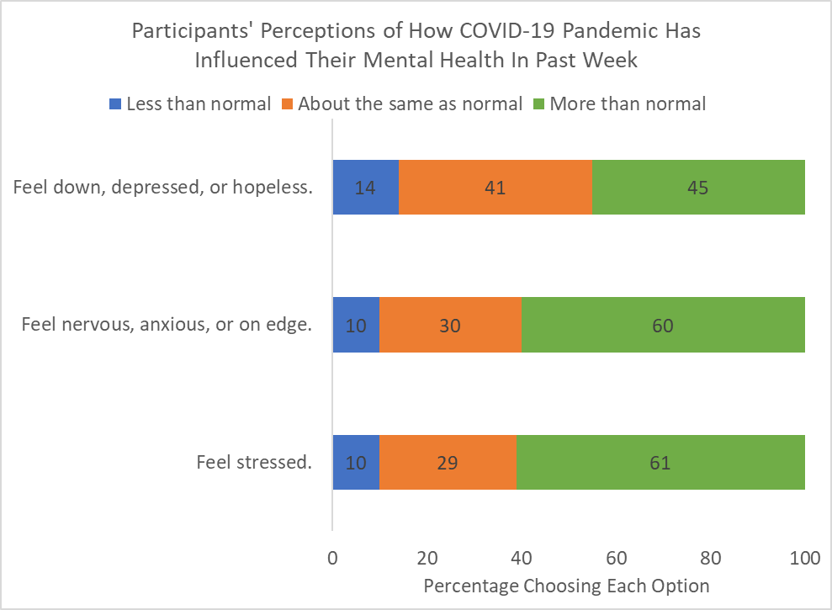
Perceived Effects of Pandemic on Mental Health In Past Week

Slide 6
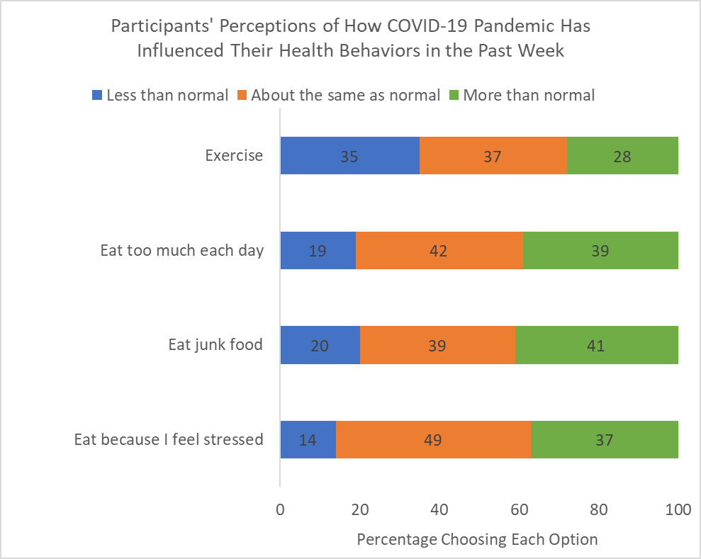
Perceived Effects of Pandemic on Health Behaviors

Slide 7
Being at home more is not linked to poorer mental health. How people respond to it matters.

Slide 8
Correlates of Mental Health
People report poorer mental health (depression, anxiety, loneliness, stress, negative emotions) if:
COVID-19 is more prevalent
Overall prevalence
Know more people with COVID-19
Know people who have died of COVID-19
Lost job due to COVID-19
Negative reactions to staying at home
Unhealthy coping strategies

Slide 9
How are people coping with these stresses?

Slide 10
Negative Coping Behaviors

Slide 11
Most effective positive coping behaviors? (Venting, active coping, emotional support, instrumental support, religion, etc)
Distraction: Most Common

Slide 12
Most effective positive coping behaviors? (Venting, active coping, emotional support, instrumental support, religion, etc)
Distraction: Most Common
Positive Reframing: Most Effective

Slide 13
Effects of pandemic on reports of COVID-linked ethnic prejudice

Slide 14
Measure of perceived COVID-19 Ethnic Prejudice (6 items)

Slide 15
Measure of perceived COVID-19 Ethnic Prejudice (6 items)
Towards you
Rude comments; Felt unwelcome; “Go back to your country;” Physically threatened
Towards family / friend
Rude comments; Felt unwelcome

Slide 16
Specific examples of experiences
My friend who is Asian went to the gas station and a guy told him he should kill himself for causing the pandemic
Man yelled at my friend that she should go back to her country and that she caused the coronavirus
When I was walking my dog I overheard a mother say to her daughter "Let's cross the street. We don't know if that man is from China and has the China virus".

Slide 17
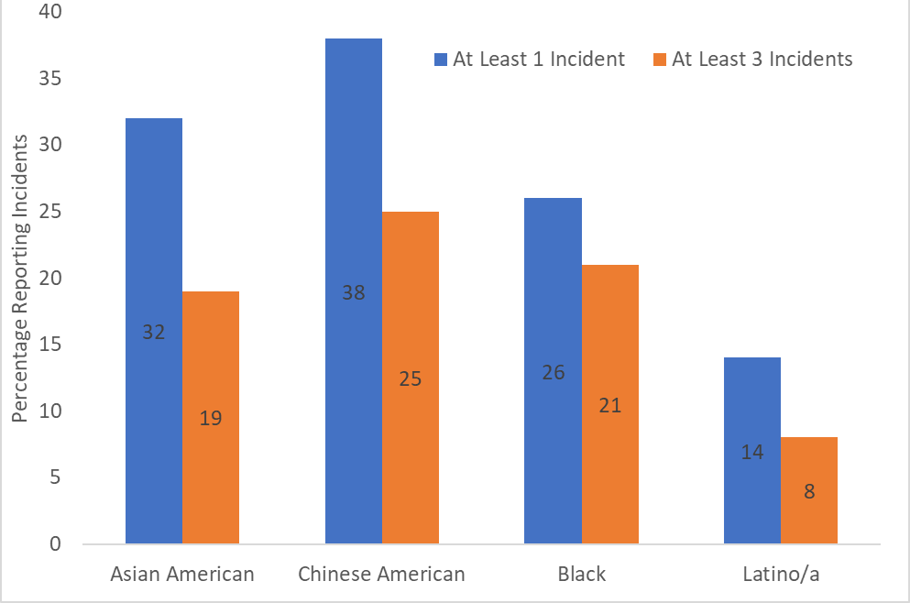
Reports of 1+ and 3+ Incidents

Slide 18
Reports of 1+ and 3+ Incidents

Slide 19
Reports of 1+ and 3+ Incidents

Slide 20
Reports of 1+ and 3+ Incidents

Slide 21
Implications: Focus on mental health
COVID-19 and stay-at-home are not going away
Individual level
Time for coping strategies, exercise and healthy eating
Telehealth mental health services
Google “CDC Mental Health COVID”
Societal
Targeted interventions
https://www.cdc.gov/coronavirus/2019-ncov/daily-life-coping/managing-stress-anxiety.html

