Slide 1
Policy Recommendations
Beyond Feudalism
Joel Kotkin and Marshall Toplansky
July 2020

Slide 2
Key Findings about Neo-Feudalism in California
The vast majority of new jobs pay below the median, and half of those earn under $40,000. California is growing high-end jobs, particularly in business services, more slowly than key competitors such as Texas, Arizona and Utah.
Key blue-collar sectors --- such as construction, manufacturing and logistics --- face extreme regulatory pressures. California no longer produces many upwardly mobile jobs
Housing costs have been driven up by regulatory costs, making homeownership, particularly for millennials, immigrants and minorities, all but unaffordable
California’s education system performs poorly, particularly for minorities and poor people

Slide 3
• 86% of the Jobs Added Were Under The Average Pay • 48% Pay Under $40,000 • Net Loss of Middle-Income Jobs
2018 CA Average
Annual Pay For
All Private Sector
Jobs: $ 78,668

Slide 4
In the Decade from 2008 to 2018 5 Times More Below-Average Paying Jobs Were Created Than Above Average Jobs In California

Slide 5
Above Average Paying, Mid-Skilled Job Creation By State – Percent Change In Past Decade

Slide 6
California’s Largest Areas Are Growing High Paying Jobs Much More Slowly Than Competitors, At Or Below The National Level

Slide 7
Change in House Values Versus Income
MEDIAN MULTIPLE: 1969-2018
Derived from US Census, 1970 & American Community Survey, 2018.

Slide 8
Change In Percent of Population Able To Afford Median- Priced Home In 2018 Compared to 2000
California Regions, Compared to U.S
Source: Derived from NAHB Wells Fargo Housing Opportunity Index

Slide 9
Lowest Homeownership Rates By State - 2018
Source: American Community Survey, U.S. Census Bureau

Slide 10
Net Domestic Migration: California
2010 TO 2018
Derived from Census Bureau Population Estimates 2018

Slide 11
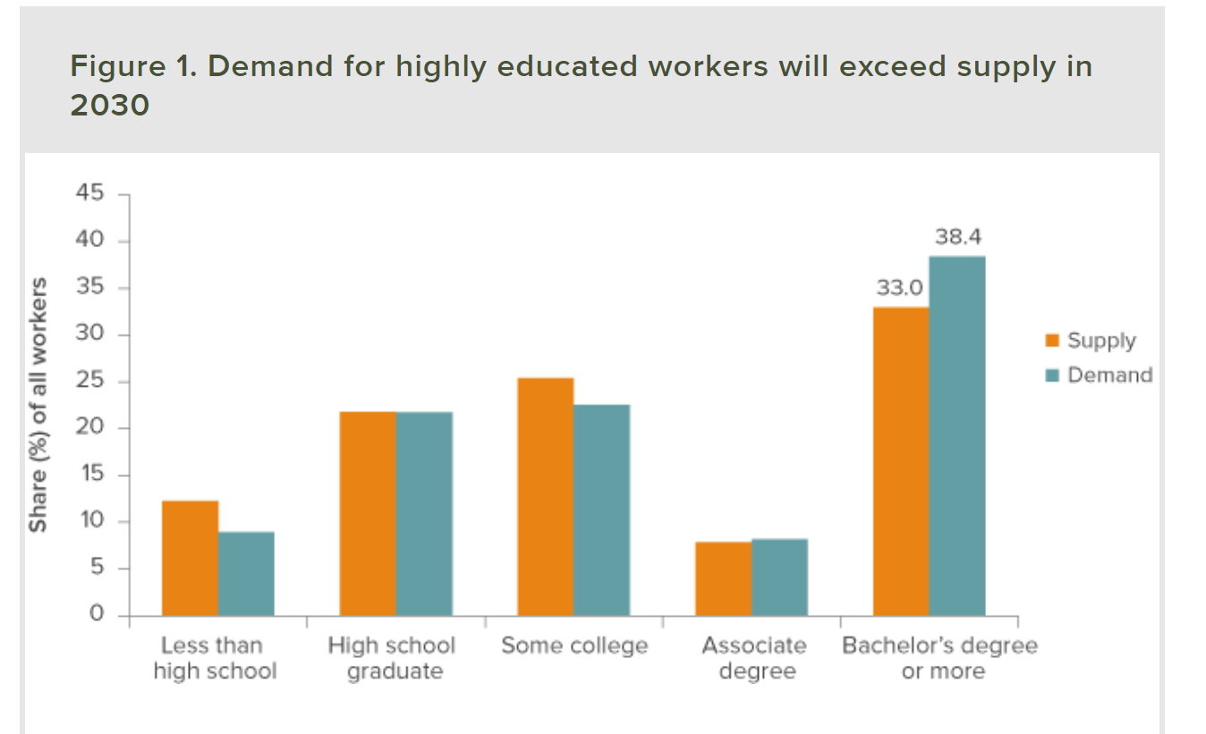
California Needs To Increase The Share Of Workers That Have Bachelors Degree or Higher By 5.4 points To Meet 2030 Demand.
Source: Will California Run Out of College Graduates? Public Policy Institute
Of California, October 2015
https://www.ppic.org/publication/will-california-run-out-of-college-graduates/

Slide 12
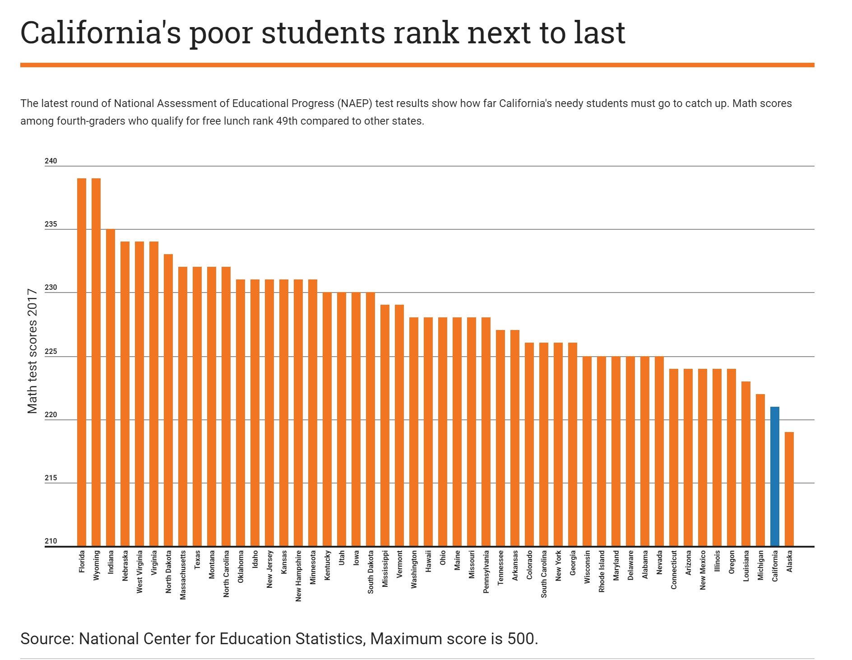

Slide 13
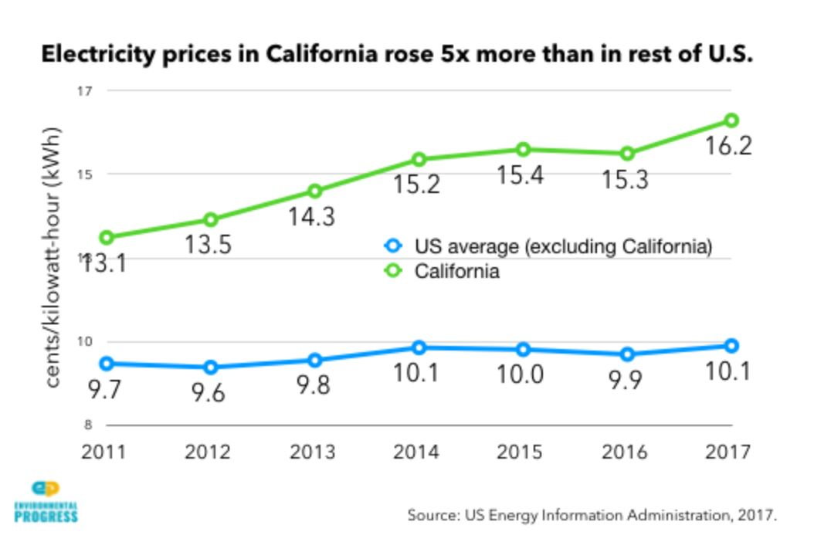
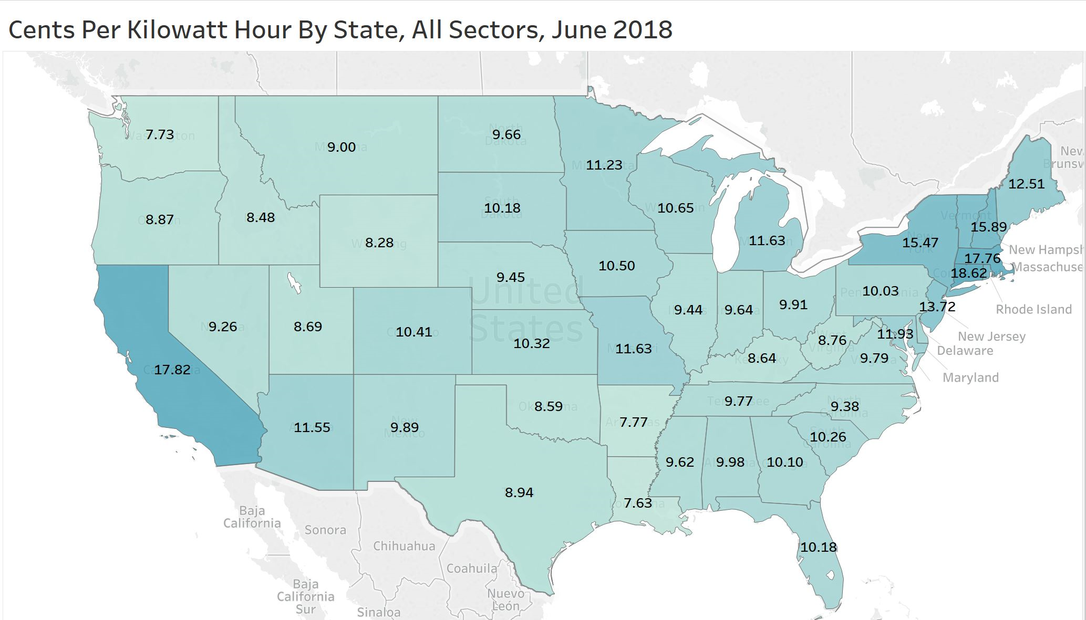
California has the second highest electricity prices in America, behind Connecticut

Slide 14
Implications
We are becoming a highly stratified society that is fundamentally not sustainable
The pandemic and the post-Floyd disorders could make this worse

Slide 15
Areas of Opportunity
California retains leadership in a host of industries: space, entertainment, software, medical technology, international trade
The state can tailor schools to provide skilled workers for these industries as we see in Long Beach
The vast interior of the state has lots of land and opportunity for lower-cost industries and housing
California can meet climate goals by taking advantage of telecommuting, without high costs and economically punishing regulations

Slide 16
Key Policy Changes on Climate and Energy

Slide 17
Paris Accords and State GHG Standards
Stay within the Paris limits, but do not exceed them, and adopt the OECD’s Shared Socioeconomic Pathway 5 (SSP5) recommendations for achieving 2030 GHG goals

Slide 18
Low-Emission Fossil Fuels Play A Role
Develop local fossil fuels for as long as needed, rather than import energy from elsewhere, with an emphasis on lower-emission natural gas and recycled gas

Slide 19
Promote Lower Energy Usage Behaviors
Promote new technologies to reduce GHG emissions, including autonomous vehicle technology, and greater incentives for telecommuting

Slide 20
Invest/Expand New Energy Technologies
Expand other forms of low-emission energy, including hydro-electric and nuclear capacity that is smaller scale, uses newer technology, and is less radioactive.

Slide 21
Move Workplaces Closer To Homes
Develop housing and industry where people can live, thus reducing long commutes and promoting homebased work.
Rethink the current use of Vehicle Miles Travelled (VMT) as the predominant regulatory metric to determine development suitability

Slide 22
Key Policies To Restore Housing Affordability

Slide 23
Inland Housing Opportunity Areas
A Housing Opportunity Area should be established in the San Joaquin and Sacramento Valleys from Shasta County to Kern County; in San Bernardino, Riverside and Imperial counties; and in the Antelope Valley in northern Los Angeles County.
Exempt from regulations, laws and restrictions that impose urban containment (such as Senate Bill 375), as well as select provisions CEQA.
Municipal Utility Districts (MUDs) should be permitted in non-incorporated portions of the Housing Opportunity Area to provide necessary infrastructure efficiently, and to protect existing property owners from the cost of urban expansion.

Slide 24
Encourage New Housing and Rehabilitation of Redundant Spaces
Erroneous California Building Code Standards (Net Zero, etc.) should be rolled back, and city fees should be reformed to lower housing costs.
Tax policies should be changed to encourage cities to expand housing, including on redundant retail space.

Slide 25
Change Local Tax Revenue Sharing
Localities should be allowed to share property taxes from new housing in redeveloped retail areas more equitably with cities and counties, replacing lost sales tax revenue

Slide 26
Key Policies For Addressing Regional Disparities

Slide 27
Make Work More Accessible Within Urban Areas
Provide better transportation infrastructure to facilitate commuting within each region
Establish strong state policies to encourage workers, particularly in inland areas, to work near or at home

Slide 28
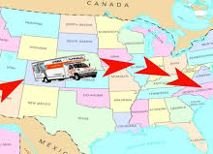
Focus on Keeping Business In State
Encourage industrial and agriculture firms to improve conservation but work closely with them to ensure that they stay in the state rather than take their GHGs elsewhere
Reduce regulatory burdens on interior communities
Provide incentives to encourage locally based firms, notably in tech and business services, to expand to inland areas rather than to go abroad.

Slide 29
Key Policies To Improve California Education

Slide 30
Make Education Relevant to Future Life
Re-emphasize traditional learning and discipline as the best preparation for life in the adult world

Slide 31
Education is Not “One Size Fits All”
Allow for educational diversity, in both charters and regular public schools

Slide 32
Involve Private Industry In Vocational Education
Encourage vocational education in partnership with local industries

Slide 33
Assess Educational Quality More Rigorously
Allow for testing and greater monitoring of educational results

Slide 34
Depoliticize Education
Stop treating education as an opportunity for indoctrination

Slide 35
Thank You
For a complete copy of this report go to: https://www.chapman.edu/communication/_files/beyond-feudalism-web-sm.pdf

