Slide 1
IRB workshop Spring 2024

Slide 2
Agenda
Activities that don’t require IRB approval
  Considerations and guidelines student projects without IRB approval
Exempt, expedited, or full board review?
Recruiting own students to participate in research
Handling audio and video data
Raffles as incentives for research participation

Slide 3
Scholarly activities that don’t require IRB
IRB review is required for projects that meet both the federal (Office for Human Research Protections) definitions of
(1) research and (2) human subjects.
Notes:
To determine if your project requires review, you will need to first determine that your study meets both the federal definitions of (1) research and (2) human subjects.

Slide 4
Scholarly activities that don’t require IRB
Office for Human Research Protections (OHRP) definitions:
Research = systematic investigation, including research development, testing, and evaluation, designed to develop or contribute to generalizable knowledge.
  Systematic: Involves method/plan for gathering information, testing hypotheses
  Generaizable knowledge: Intend to apply findings to population beyond the study participants or otherwise disseminate the findings to develop knowledge beyond the particular study

Slide 5
Scholarly activities that don’t require IRB
Examples of non-research:
  Focus directly on the specific individuals that provide the information: Journalistic activities, biography, literary criticism, legal research
  Public health surveillance activities for public health authorities to monitor and track outbreaks
  Collection and analysis of information or records for a criminal justice agency for activities authorized by law or court order for criminal investigative purposes
  Institutional assessment of a program
  Educational activity for training
Notes:
Examples: Teaching evaluations, university assessment & program evaluation

Slide 6
Scholarly activities that don’t require IRB
Educational activities
  The sole purpose of the research activity is for training students (e.g., teach physiology students how to draw blood/conduct blood cell count; teach research methods students how to conduct ethnography)
  Findings are not shared outside the educational context (e.g., only shared with classmates, course instructor, program evaluation, etc.)

Slide 7
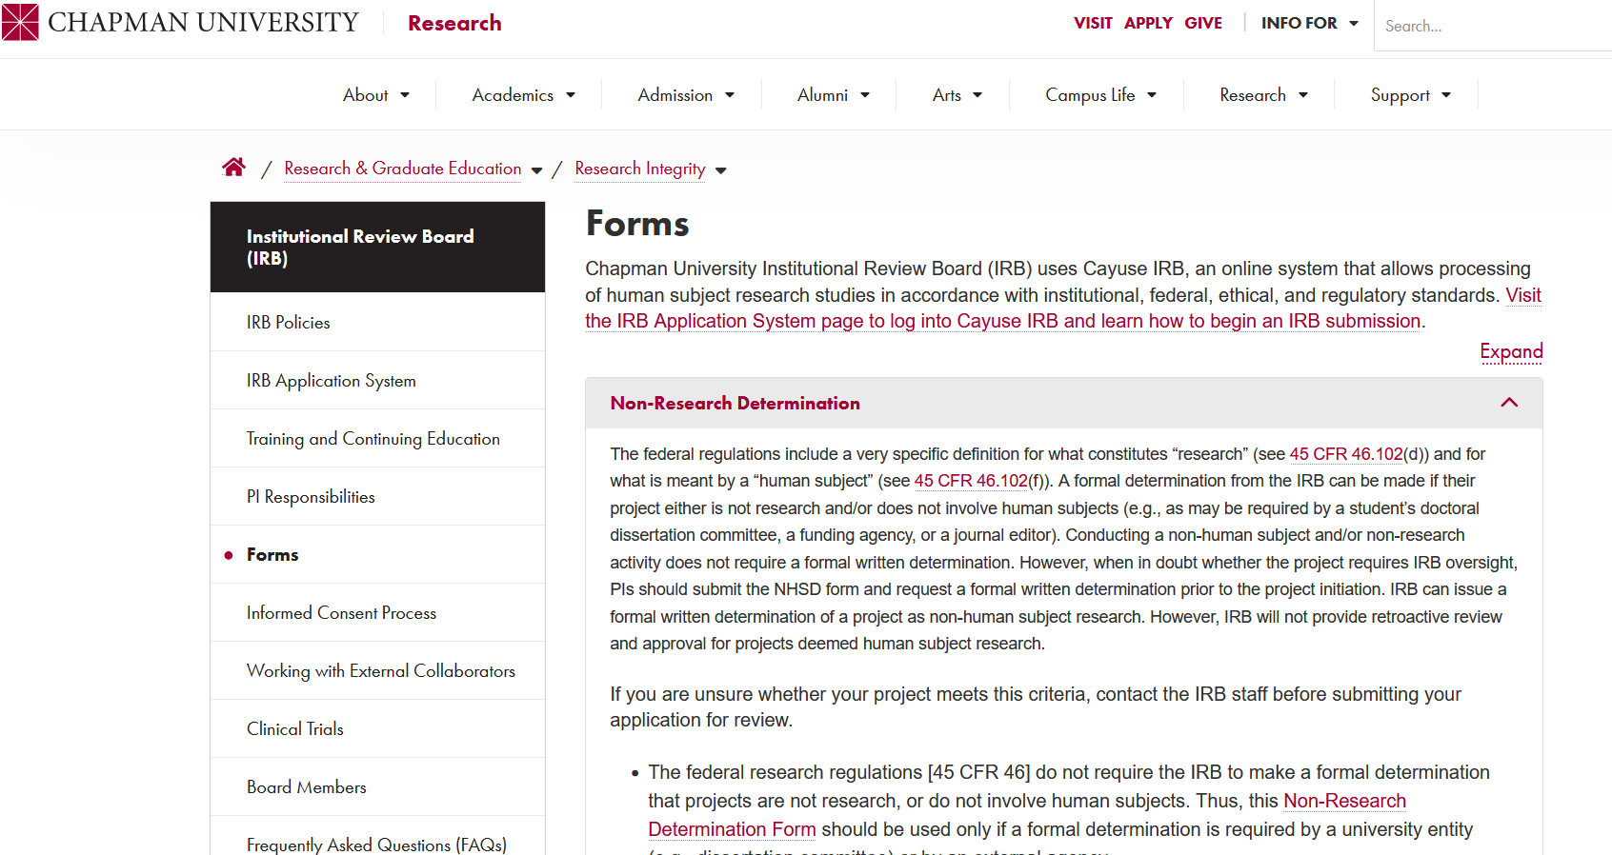
Scholarly activities that don’t require IRB
Non-Human Subject determination
https://www.chapman.edu/research/integrity/irb/forms-and-instructions.aspx
Notes:
Self-determination is OK but you can submit a formal form for approval of NHSD to satisfy publisher’s or granting agency’s requirements
https://www.chapman.edu/research/integrity/irb/forms-and-instructions.aspx

Slide 8
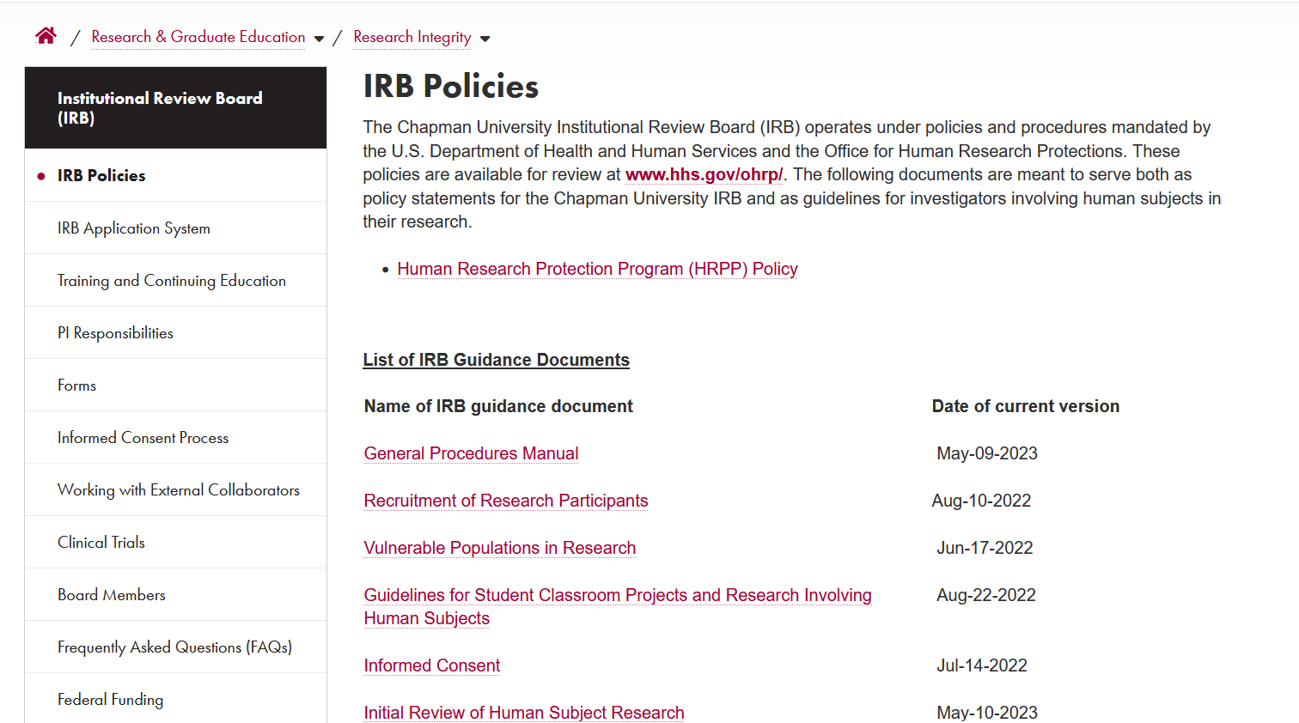
Student project without IRB approval
Use the checklist and student-instructor agreement available here:
  Guidelines for Student Classroom Projects and Research Involving Human Subjects
https://www.chapman.edu/research/integrity/irb/policies.aspx

Slide 9
Student project without IRB approval
Remember:
  Data that have already been collected will NOT receive retroactive IRB approval
  Instructor/student cannot ever publish results (no presentation at the CU student symposium; CU commons; social media).
  Apply the same ethical principles. Take advantage of our templates and forms (e.g., recruitment, consenting)
  Instructor and student sign an agreement (no need to submit it to the IRB)

Slide 10
What type of review?
Exempt
  Category 1– Research in Educational Settings​
  Category 2 – Tests, Surveys, Interviews, Observation of Public Behavior
    Can include verbal and written responses or audiovisual recording​
  Category 3 – Benign Behavioral Intervention
    Can include verbal and written responses or audiovisual recording​
  Category 4 – Secondary Research for which consent is not required​
  Category 5 – Public Benefit/Service Programs​
  Category 6 – Consumer Acceptance
    Taste and food quality​
Notes:
Exempt Category 1– Research in Educational Settings​
Research conducted in established or commonly accepted educational settings involving normal educational practices, such as: (a) research on regular and special education instructional strategies; or (b) research on the effectiveness of, or the comparison among, instructional techniques, curricula, or classroom management methods. (45 CFR §46.104[d][1])​
Exempt Category 2 – Tests, Surveys, Interviews, Observation of Public Behavior ​
Educational tests (cognitive, diagnostic, aptitude, achievement), survey procedures, interview procedures, or observation of public behavior (including visual or auditory recording) if at least one of the following criteria is met: (a) information obtained is recorded in such a manner that the human participants cannot be identified, directly or through identifiers linked to the participants; (b) any disclosure of the human participants' responses outside the research would not reasonably place the participants at risk of criminal or civil liability or be damaging to the participants' financial standing, employability, educational advancement, or reputation; (c) The information obtained is recorded by the investigator in such a manner that the identity of the human subjects can readily be ascertained, directly or through identifiers linked to the subjects, and an IRB conducts a limited IRB review to make the determination required by § 46.111(a)(7).(45 CFR §46.104[d][2])​
(NOTE: Survey and interview research involving children cannot be designated as Exempt from Review. Observation of public behavior research involving children, however, can be designated as Exempt from Review only when the investigator does not participate in the activities being observed.)​
Exempt Category 3 – Benign Behavioral Intervention in conjunction with collection of data through verbal and written responses or audiovisual recording​
Benign behavioral interventions are brief in duration, harmless, painless, not physically invasive, not likely to have a significant adverse lasting impact on the subjects, and the investigator has no reason to think the subjects will find the interventions offensive or embarrassing. This category may apply if at least one of three criteria as in exemption category 2 is met. The use of deception may be eligible for this exemption. (45 CFR §46.104[d][3])​
Exempt Category 4 – Secondary Research for which consent is not required​
Secondary research for which consent is not required: Secondary research uses of identifiable private information or identifiable biospecimens, if at least one of the following criteria is met: (a) The identifiable private information or identifiable biospecimens are publicly available; (b) Information, which may include information about biospecimens, is recorded by the investigator in such a manner that the identity of the human subjects cannot readily be ascertained directly or through identifiers linked to the subjects, the investigator does not contact the subjects, and the investigator will not re-identify subjects; (c) [this subcategory may not be used as Chapman is not a HIPAA-covered entity]; (d) the research is conducted by, or on behalf of, a Federal department or agency using government-generated or government-collected information obtained for non-research activities, and conducted in compliance with 45 CFR 46.104(d)(4)(iv) (45 CFR §46.104[d][4])​
Exempt Category 5 – Public Benefit/Service Programs​
Research and demonstration projects that are conducted or supported by a Federal department or agency, or otherwise subject to the approval of department or agency heads, or the approval of the heads of bureaus or other subordinate agencies that have been delegated authority to conduct the research and demonstration projects, and that are designed to study, evaluate, improve, or otherwise examine: a) public benefit or service programs; b) procedures for obtaining benefits or services under those programs; c) possible changes in or alternatives to those programs or procedures; or d) possible changes in methods or levels of payment for benefits or services under those programs. (45 CFR §46.104[d][5])​
Exempt Category 6 – Consumer Acceptance​
Taste and food quality evaluation and consumer acceptance studies,​

Slide 11
What type of review?
Expedited
  Category 1 - Drugs or devices not needing investigational new drug or device exemptions.​
  Category 2 - Venipuncture blood from ambulatory non-pregnant adults​
  Category 3 - Collection of biological specimens by noninvasive means (hair, excreta, etc.).​
  Category 4 - Recording data from adults by non-invasive clinical procedures (e.g., weight) and moderate exercise by healthy volunteers.​
  Category 5 - Study of existing data, documents, records, or specimens.​
  Category 6 - Study of voice, video, digital, or image recordings
  Category 7 - Research on individual or group characteristics or behavior (including, but not limited to, research on perception, cognition, motivation, identity, language, communication, cultural beliefs or practices, and social behavior) or research employing survey, interview, oral history, focus group, program evaluation, human factors evaluation, or quality assurance methodologies. ​
Notes:
Step IV – Expedited Review Categories – Minimal Risk Studies – Many Chapman Studies Fall into These Categories – create categories documents with examples)​
​
​
Expedited Category 1 - Drugs or devices not needing investigational new drug or device exemptions.​
Expedited Category 2 - Venipuncture blood from ambulatory non-pregnant adults (<2x/wk, <450cc in 8 wks).​
Expedited Category 3 - Collection of biological specimens by noninvasive means (hair, excreta, nail clippings, etc.).​
Expedited Category 4 - Recording data from adults by non-invasive clinical procedures (e.g., weight, height, eye-color) and moderate exercise by healthy volunteers.​
Expedited Category 5 - Study of existing data, documents, records, or specimens.​
Expedited Category 6 - Study of voice, video, digital, or image recordings as the focal point of the research protocol (e.g., investigation of speech defects). Please note any type of recording solely for the purpose of data documentation must have the appropriate safeguards in place to prevent any potential harm that may be a result of a breach in confidentiality. When the appropriate safeguards are present, research using this type of data documentation will fall under the exempt review category.​
Expedited Category 7 - Research on individual or group characteristics or behavior (including, but not limited to, research on perception, cognition, motivation, identity, language, communication, cultural beliefs or practices, and social behavior) or research employing survey, interview, oral history, focus group, program evaluation, human factors evaluation, or quality assurance methodologies. ​

Slide 12
What type of review?
Full Board Reviews – Greater Than Minimal Risk Studies
Notes:
These studies are human subject research that does not fall under the Exempt or Expedited categories.

Slide 13
What type of review?
Collaboration with another institution
  IRB of record and reliance agreements
Notes:
These studies are human subject research that does not fall under the Exempt or Expedited categories.

Slide 14
Recruiting one’s own students
Potential for coercion or appearance of coercion
Always preferable to recruit from another faculty’s class

Slide 15
Recruiting one’s own students
When the nature of the study requires recruitment from one’s own class, minimize potential of coercion:
  Collect data after the semester ends
  Collect data in a manner that makes it clear that the instructor is not aware of the identity of participating students
    Another team member handles recruitment and consenting
    Anonymous/de-identified data collection

Slide 16
Audio and video recording
Consenting
  Include an additional signature box in the consent form
  Detail how the recordings will be used, who can access them, until when are they retained
Notes:
Transcribe, use psydudonmis, redact identifiable information and delete original recordings at the earliest opportunity.

Slide 17
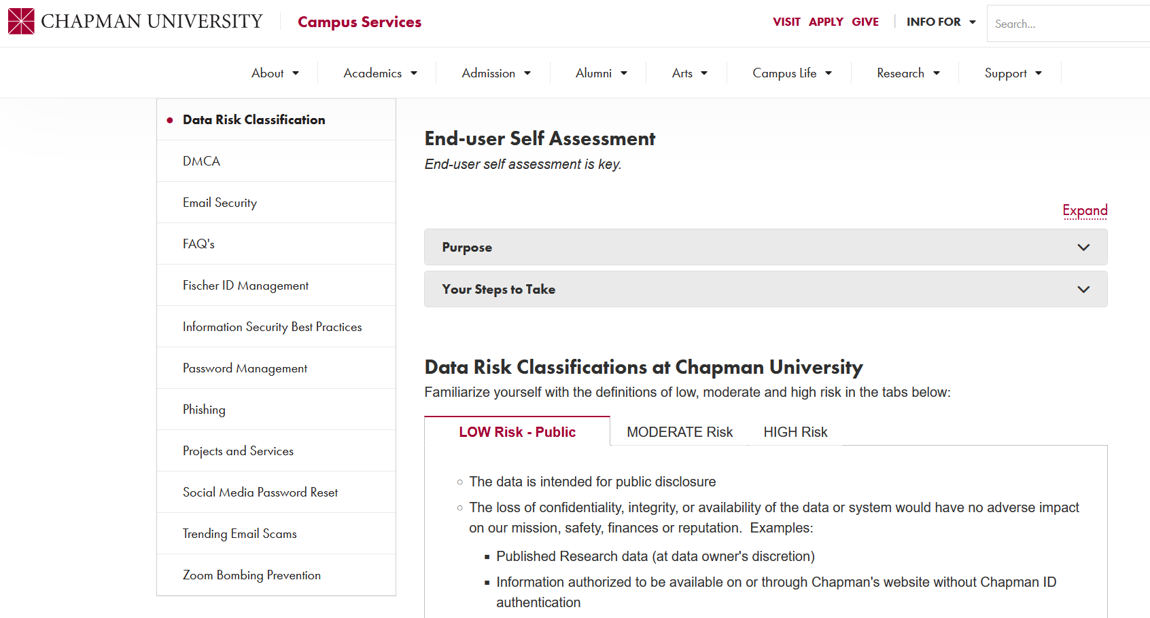
Audio and video recording
Protocol should detail:
  Data storage
    Prefer cloud over portable devices
    Encryption and password protection
  Data retention
    A timeline for de-identification and destruction
  Data sharing
    Share links, not files
Notes:
Transcribe, use psydudonmis, redact identifiable information and delete original recordings at the earliest opportunity.
Prefer OneDrive over Dropbox and Google Drive for more sensitive information
https://www.chapman.edu/campus-services/information-systems/security/data-risk-classification.aspx

Slide 18
Using Raffles as an Incentive
A raffle is governed by lottery laws in CA
Workaround: Participation in the raffle is not connected to solicitations of participation in the study, and this is made clear to all participants
Indicate chances of winning
Notes:
Per the regulations, a raffle does not require registration, if all tickets for a drawing are free, thus make it accessible without being contingent on completing the study.
Chances of winning can depend on the N or the target N.

Slide 19
Thank you!
irb@chapman.edu

