Slide 1
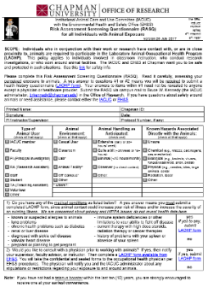
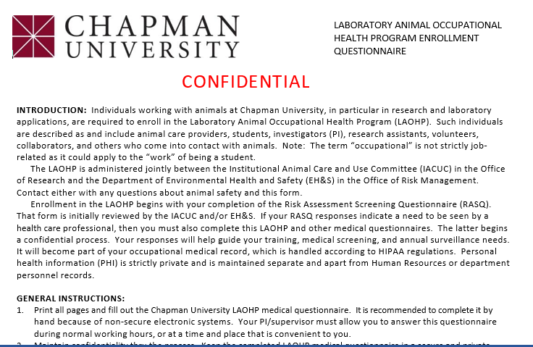
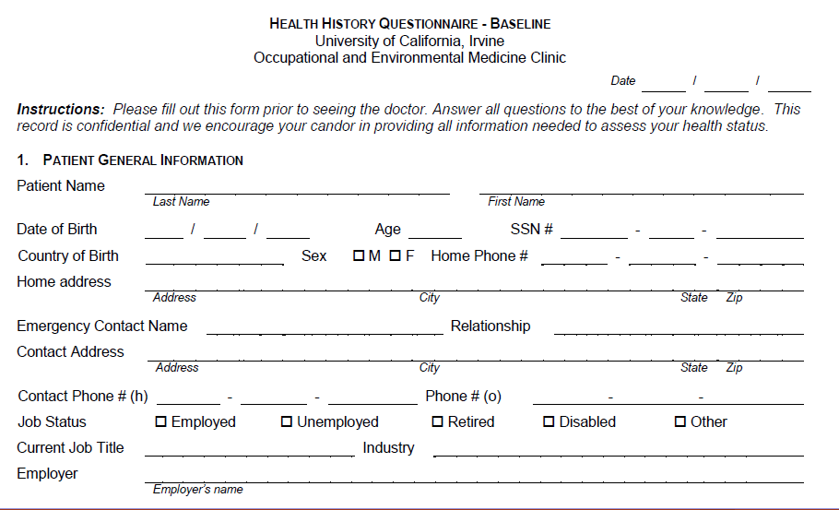
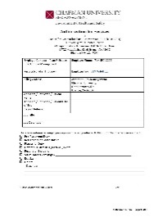
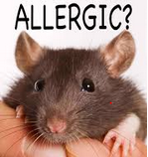
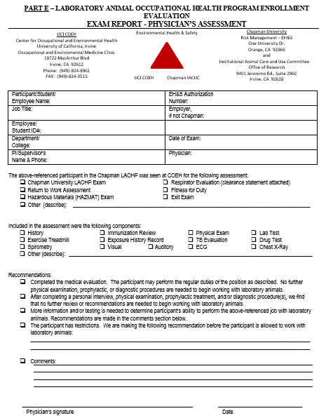
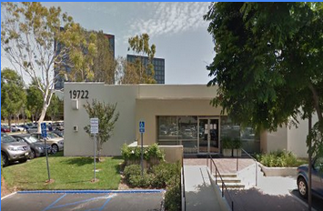
The EH&S and IACUC visualization of the Lab Animal Occupational Health Program (LAOHP) at Chapman
8/30/18
1- Identification
as a potential animal user
3b- Process
continues with
medical histories
3a- Process
begins with the RASQ
Q1 and/or Q2: “yes”
Generally, when coming into contact with live (1) vertebrate animals (mouse, rat, bird, fish, etc.) in research, teaching, or testing.
Complete the self- evaluation of your awareness of risk and exposure. (2)
When there is a health issue, then complete both the CU LAOHP form and UCI HHBQ. Take them with the EH&S authorization to UCI COEH for medical consultation. Receive part E, the physician assessment and
enrollment evaluation. (2)
Q1 and Q2: “no”
RASQ is reviewed by IACUC and/or EH&S; if no concerns, then enrollment is completed and a confirmation is emailed.
Q1 or Q2: “??”
2- Enrollment
into the LAOHP
RASQ is reviewed; when something is unclear, the user is contacted.
All animal users must enroll into the LAOHP, which indicates an understanding of the risks and hazards.
3c- Database
finishes with enrollment in the LAOHP archive
or
To be on a protocol, the animal user must be LAOHP-enrolled, have training, and describe risks.
Renew the RASQ annually or when circumstances change. (3)
Part E, submit to the IACUC and supervisor
UCI COEH
Legend
EH&S – Environmental Health and Safety
OHS and OHSP – Occupational Health and Safety (Program)
IACUC – Institutional Animal Care and Use Committee
RASQ – Risk Assessment Screening Questionnaire
UCI COEH – Center for Occupational and Environmental Health
HHBQ – UCI’s Health History Baseline Questionnaire
PPE – Personal Protective Equipment
PHI – Personal Health Information
HIPPA – Health Insurance Portability and Accountability Act
OOPS! an accident | { | File an incident report. Evaluate worker’s compensation. Review what happened. Mitigation, re-training, new PPE.
Notes (details are available from the IACUC office and EH&S)
1- The OHS of those working with animal products only (in vitro) is addressed by other programs (e.g., the Institutional Biosafety Committee (IBC), blood-borne pathogens training, risk management).
2- The RASQ contains no PHI. The Chapman LAOHP questionnaire and UCI HHBQ are HIPPA-compliant, being paper-based and personally carried to UCI COEH. Do not submit any PHI to Chapman.
3- The database is a confidential archive holding enrollment information: RASQs, Part E PPE and work practice recommendations.

