Slide 1
IRB Application System (Cayuse IRB)
September 13, 2024 workshop

Slide 2
Agenda
Housekeeping rules throughout workshop
Workshop is being recorded
Reserve extensive questions to after end of presentation
What kinds of activities require IRB review
Use of “Non-Research Determination” form
Getting started with protocol application process
Prerequisite human subject research training
Setting up account in Cayuse-Human Ethics/IRB
Walkthrough different protocol submissions
Expedited/full board review
Exempt
Request to rely on an external IRB
Establish recruitment database
Do’s and Don’ts
Q&A

Slide 3
Protocol Application Process – Getting Started
https://www.chapman.edu/research/integrity/irb/cayuse-irb.aspx
Complete the CITI training
Registration CITI Set Up Account Instructions
Training is valid for 3 years
Request the IRB office for a user account in Cayuse IRB (Authentication).
Authentication for new users submit the following information to the IRB office
(first and last name, Chapman email, status, and college and department)
Train yourself to use Cayuse IRB
Review the Cayuse instructions for new applications (.pptx)
To submit an IRB protocol, enter the Cayuse IRB site http://chapman.cayuse424.com/
IRB protocol upkeep (e.g., modification, renewal, closure)
Review the Cayuse instructions for additional submissions (.pptx)

Slide 4
Walkthrough of most common applications in Cayuse

Slide 5
Do’s and Don’ts
Tips for a smoother IRB application and review

Slide 6
Do’s and Don’ts
Start early
Consult the IRB first especially for complicated studies
Allow enough time for review
~ 2 weeks for Exempt, Establish subject recruitment database
Submit 2 weeks prior to monthly full board meetings (every 2nd Monday of month)
Use lay language
Spell out all acronyms upon first use
Be concise
Complete all prompts (i.e., some questions are multi-part)

Slide 7
Do’s and Don’ts
Consult faculty advisor (e.g., which CITI course needed, appropriate expedited/exempt categories, etc.)
Attachments:
Use current versions of Chapman IRB forms (see website)
Upload under the correct section in Cayuse
Use filenames that reflect what the document is for
CITI certificates (e.g., initials of first name, Last name, CITI, exp. Date)
J.SmithCITIexp.31Aug2027, or J.SmithCITI Exp08-31-27

Slide 8
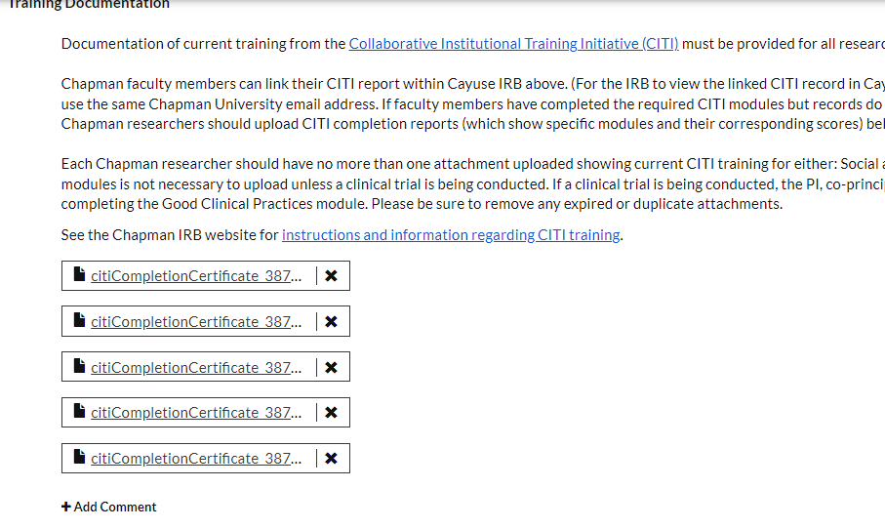
Example:
Avoid:

Slide 9
Do’s and Don’ts
Align content throughout application
Proofread!
Especially subject-facing material (e.g., info sheet/consent form)
Addressing reviewer comments (show actual example)
How to navigate through reviewers' comments
Must: Revise content of actual application

Slide 10
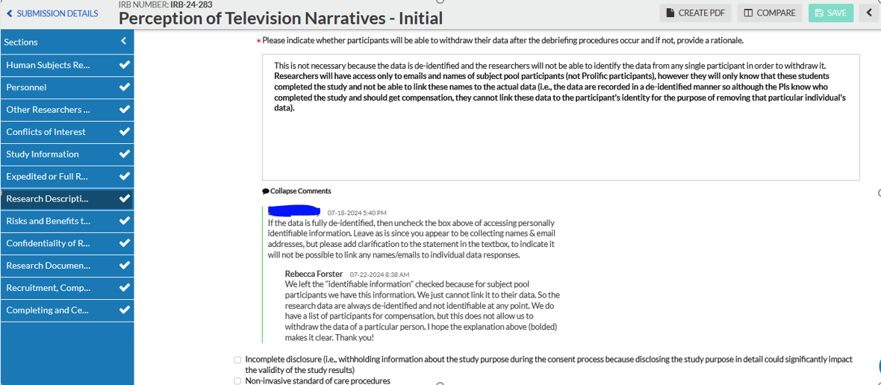
Example:

Slide 11
Q&A
Reach us at:
JIRA: https://chapman.atlassian.net/servicedesk/customer/portal/9
Email: irb@chapman.edu
IRB Zoom Office hours: 9-10 am every 1st Tues. of the month

Slide 12
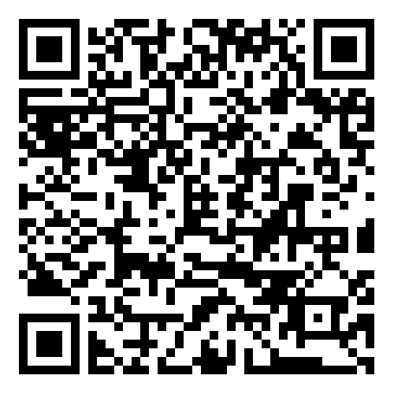
How did we do?
Please scan the QR code and take a 2-minute evaluation.

