Slide 1


The CITI Program Mission Statement
The Collaborative Institutional Training Initiative (CITI Program) is dedicated to promoting the public’s trust in the research enterprise by providing high quality, peer-reviewed, web-based educational courses in research, ethics, regulatory oversight, responsible conduct of research, research administration, and other topics pertinent to the interests of member organizations and individual learners.
These materials are designed and regularly updated to:
Enhance the knowledge and professionalism of investigators, staff, and students conducting research in the United States and internationally
Educate members, administrators, and leadership of ethics committees that review and oversee research
Promote ethical research at organizations through the education of research administrators and organizational leadership
Training on regulations with CITI
This presentation is intended to provide helpful information which will allow you to register for CITI training with ease as a member of the Chapman University research communities, including the various ethics committees.
Link to the CITI Training Website: https://www.citiprogram.org/
(version 7 May 2019)
Updated 13 Jan 2021)

Slide 2
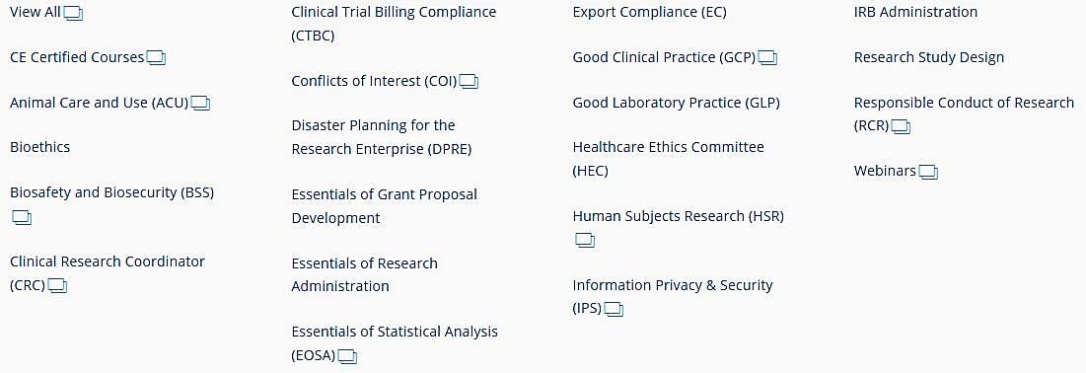

Research Training Topics
CITI provides training in many areas of research as above. See https://about.citiprogram.org/en/courses/ for the complete listing.
Upon completion of a group of modules, a transcript is sent to you and Chapman University. You may need this transcript later for classes, research, grant applications, etc., so please make sure to save it.

Slide 3

Registering yourself with CITI
A tutorial in order to train on the regulatory aspects of research.
This is the opening screen at https://about.citiprogram.org/en/homepage/.
If you have registered before, click on Log In. If you have registered with another institution, log in with your existing credentials. You will be able to affiliate yourself with Chapman University as well.
If you need to register, click on Register. Follow the instructions on the next pages which tailors the registration process to Chapman.
Note that different languages for CITI training are available.

Slide 4
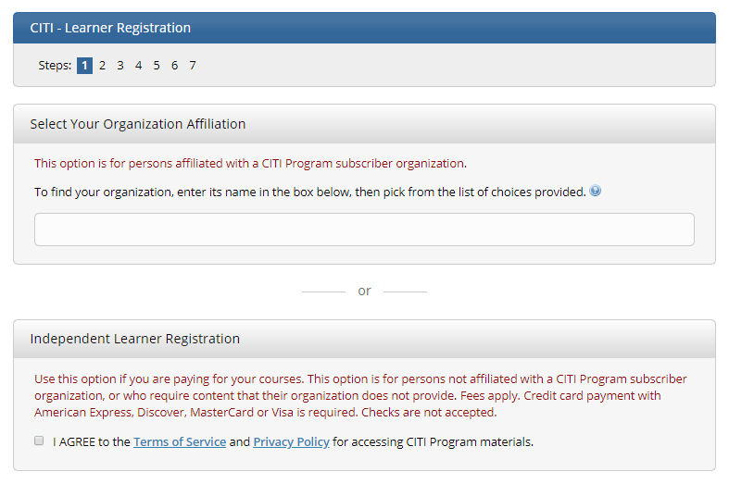

1st – Select the Institution
Note that this is step 1.
Start typing Chapman University…
Agree to the Terms of Service, affirm affiliation with Chapman, and continue.
Skip this section on independent learner registration. Chapman provides this training to you through the Office of Research free of charge, 24/7.

Slide 5
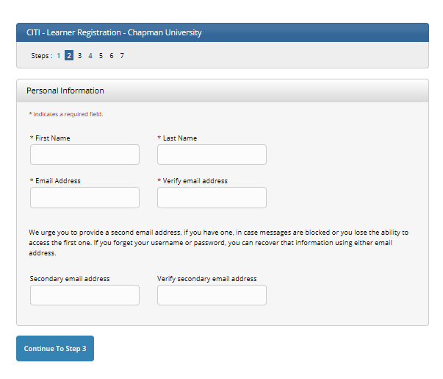
2nd – Provide Personal Information
Note that this is step 2.
The email address does not have to be your Chapman one, but it is highly recommended.

Slide 6
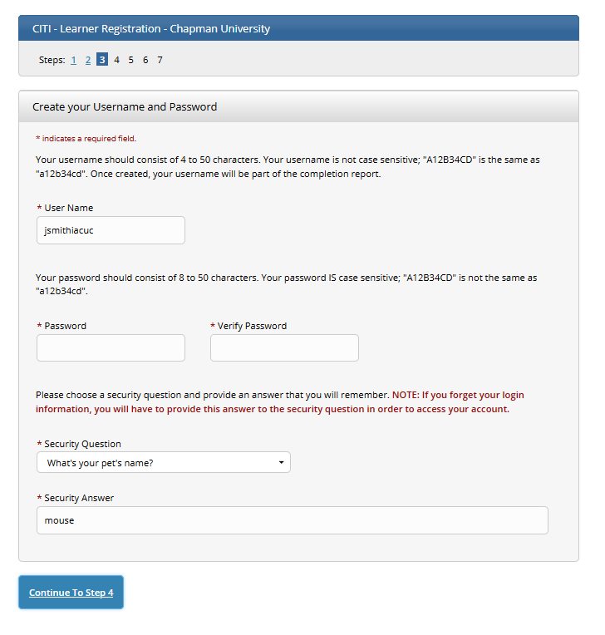
3rd – Username and Password
Note that this is step 3.
The username can be the same as your Chapman identity.
Provide a security question and answer.

Slide 7
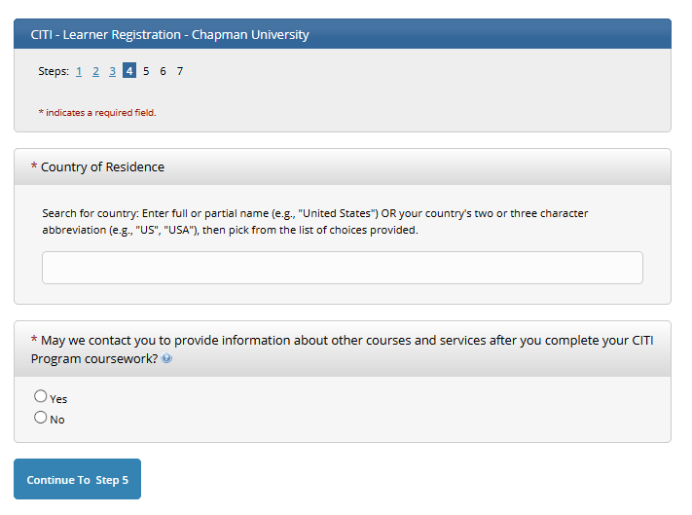
4th – Country of Residence
Note that this is step 4.
CITI is available all over the world and in many languages. If you leave Chapman, you can bring your CITI training with you.

Slide 8
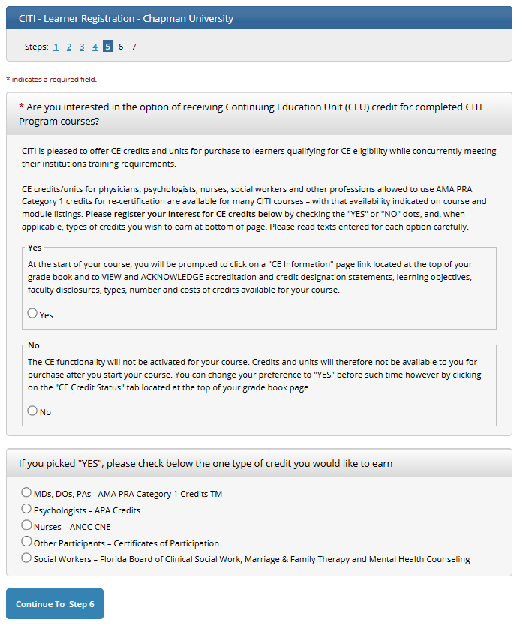
5th – Need CEU credit elsewhere?
Note that this is step 5.
This is continuing education for other purposes. Chapman University does not collect this information. You may skip it.

Slide 9
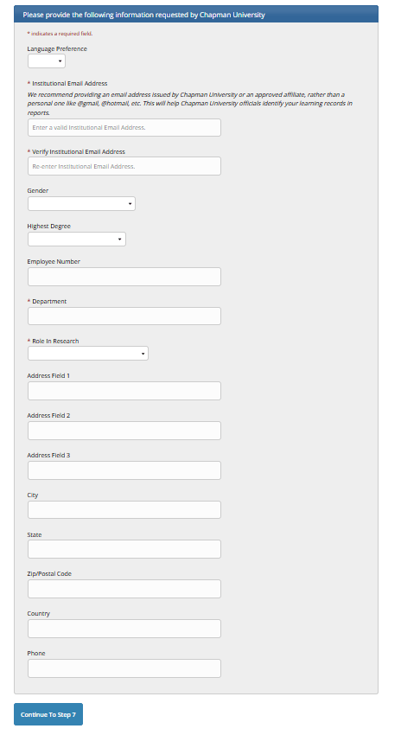
6th – Learner Registration (additional data)
Note that this is step 6.
The Institutional Email Address is of course Chapman University. It’s acceptable to enter a Gmail or other account address.
For Department, enter your major or where you work.
For Role in Research, chose the closest one to what you do. You could be both research staff and a PI, for example.
Chapman does not collect the other information. There is no need to provide it.

Slide 10
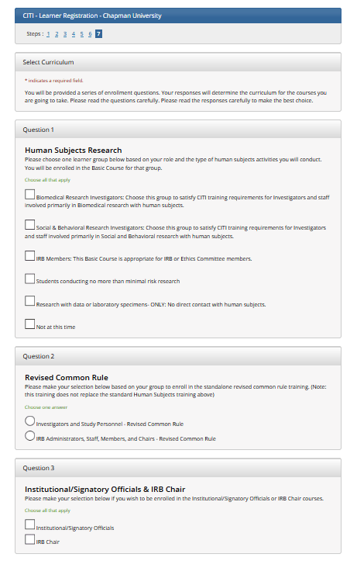
7th – Select Curriculum
Note that this is step 7.
This is the page for selecting the training you need to do, which can be in several disciplines. The options stretch, so you will need to scroll through.
Question 1: Human Subjects Research
Question 2: Revised Common Rule
Question 3: Institutional/Signatory Officials & IRB Chair
Question 4: Responsible Conduct of Research
Question 5: Biosafety/Biosecurity Course
Question 6: Health Information Privacy and Security (HIPS)
Question 7: Good Clinical Practice course
Question 8: Laboratory Animal Welfare
Question 9: Conflicts of Interest course
Question 10: CITI US Export Control
Question 11: Semiannual Evaluations in Depth [IACUC]
Question 12: COVID-19: Back to Campus (2020-2021) [may terminate]
Note: As Chapman adds modules, the choices may not appear exactly the same on-line.

Slide 11
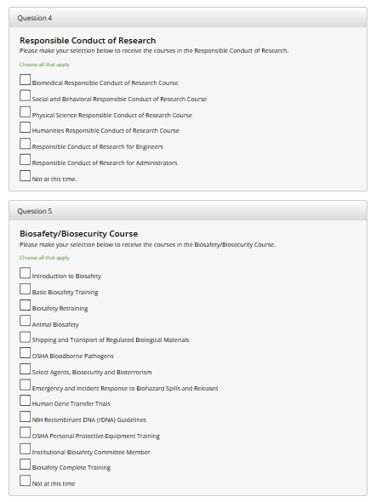
7th – Select Curriculum (first continuation)
Note that this is more of step 7.
Question 4 is Responsible Conduct of Research, often abbreviated RCR. These training modules are often used to satisfy in part the RCR training required by NSF and NIH grants. Face-to-face training may also be mandated.
Question 5 may be required by Chapman’s EH&S (Environmental Health and Safety) office.

Slide 12
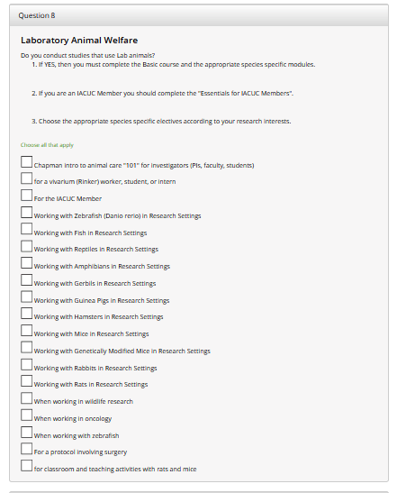
7th – Select Curriculum (second continuation)
Note that this is more of step 7.
Question 8 is concerned with work regarding vertebrate animals. Typical choices are the “intro”, “Rinker”, and IACUC member” modules. Choose any other module as appropriate for what your research or teaching is about.
Contact the IACUC office for guidance.

Slide 13
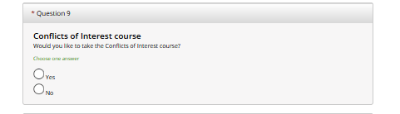

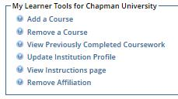
7th – Select Curriculum (third continuation)
Note that this is more of step 7.
Question 9: The Conflicts of Interest course is one of the starred (*) courses, which means you must answer it.
Review your choices in all of the questions.
When finished choosing your training courses, click the Complete Registration button.
You should be ready to start your training.
You can come back later and select additional curriculum. Once registered, your home page will show this box of choices. You can select “Add a course” then.

Slide 14
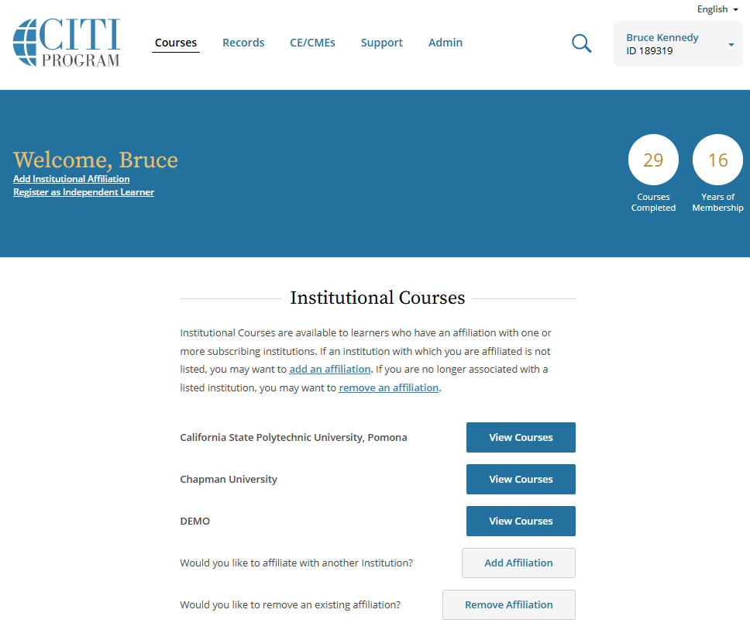

Helpful hints, once registered
To obtain documentation of your training.
Your name and CITI identity number will be up here.
Click here. Courses to take will be listed (see next slide), along with status.
Your institutional affiliations will be here.
If you go some-where else or come to Chapman, re-affiliate here.
Add and remove courses here.

Slide 15
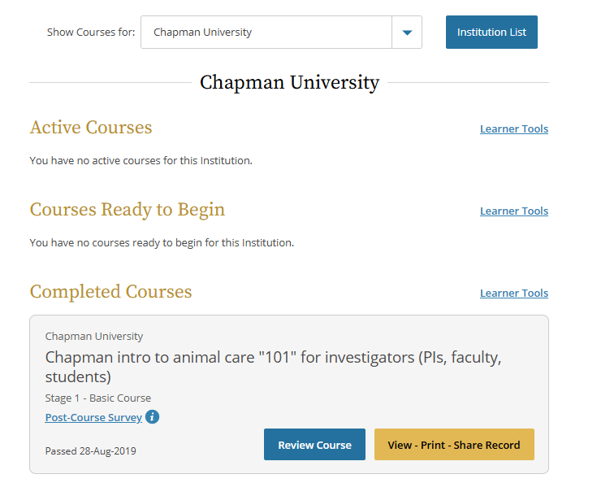

Helpful hints, once registered, cont.
This screen appears when clicking on View Courses from the previous page.
This example from IACUC training shows the courses to do.
Much information is provided about your progress with each course.

Slide 16
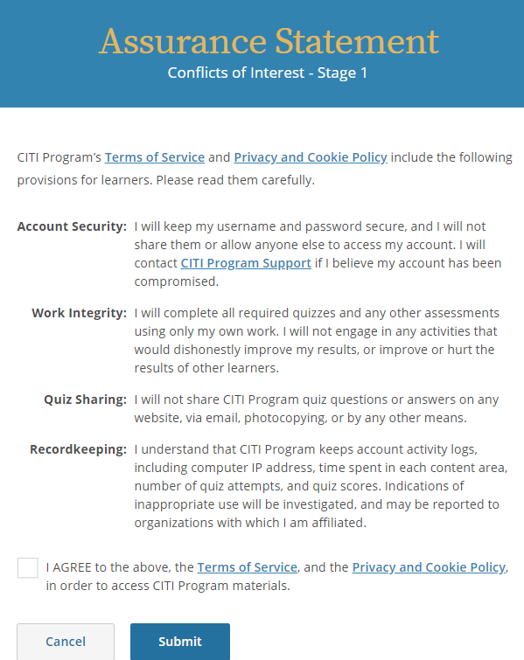
Click on a course to enter and learn!
The example shows having clicked on COI or Conflicts of Interest.
Be sure to complete the Integrity Assurance Statement. It will need to be done each time you select a new course to complete. You declare that you are being ethical about taking the training.

Slide 17
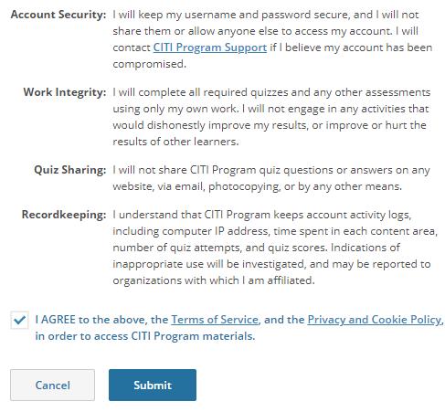
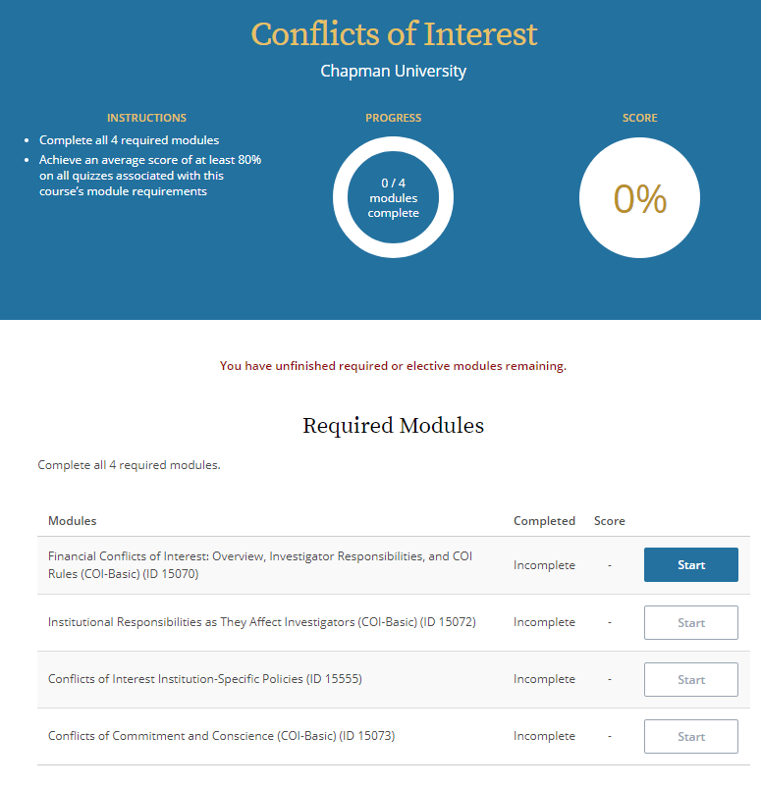
Detail from the Integrity Assurance Statement
After reading, agreeing, and clicking SUBMIT, the page at right will show.

Slide 18
Details about Renewing Your Training
The CITI subscription should automatically remind you by email when it’s time to update your training obligation for research activities.
Most training is valid for three years. Check your CITI training transcript for period of time and enter a reminder in your electronic calendar, such as occurs in Outlook.
“Things” about regulations, processes, expectations, etc., do change. Researchers and instructors using animals need to keep up with the information.
Contact either the CU Office of Research or IACUC with concerns, questions, and suggestions regarding your IACUC training.

Slide 19



Congratulations!
You have gained ethical training.
You have now viewed the CITI registration process for Chapman and are informed about the CITI website and training. Be sure to print and/or save your training records in order to provide evidence of course completion.
Good luck in your career with research and regulations. Thank you for being a part of this ethical process.
Follow this link for instructions from the CITI group on how to obtain your CITI training report and determine whether your research ethics training needs to be renewed or updated.
https://support.citiprogram.org/customer/portal/articles/288752-when-will-the-citi-program-mail-fax-or-e-mail-my-official-certificate-?b_id=2337
Version 13 Jan 2021

