Slide 1

Visit Homepage and “Register“
Investigators who are currently registered through other institutions must add Chapman University as an additional affiliation. Investigators must then complete the required modules (e.g., Social & Behavioral Research Investigators or Biomedical Research Investigators) based on the types of research that will be conducted.

Slide 2
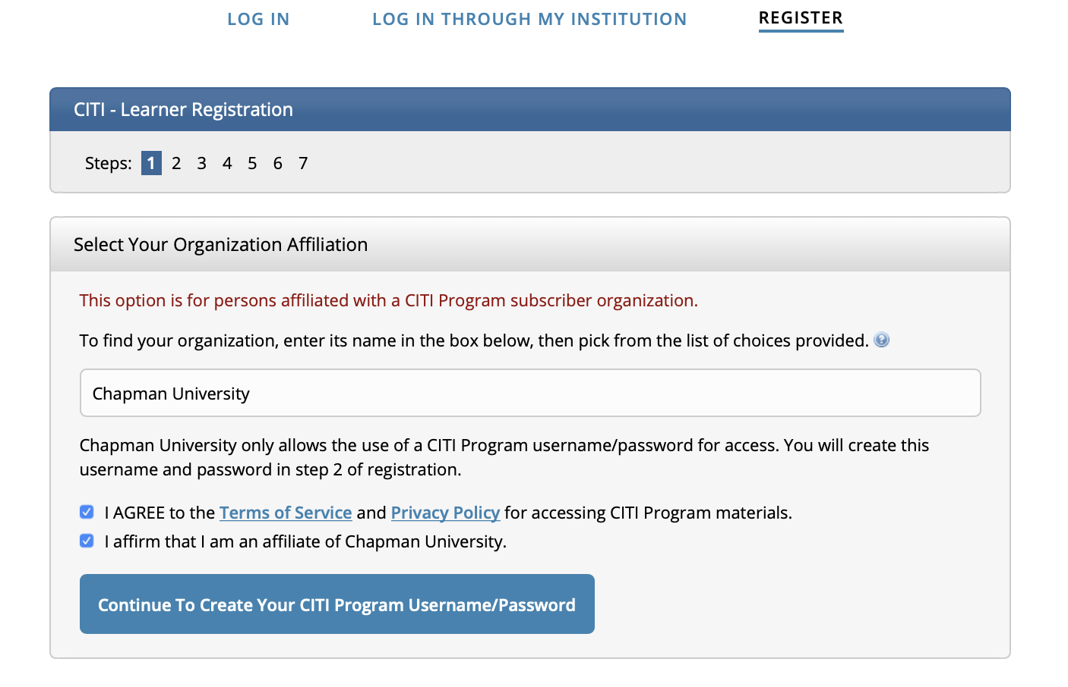
1) Register Under “Organization Affiliation”
Include
“Chapman University”
as the organization
you’re registering under
Then click “continue”

Slide 3
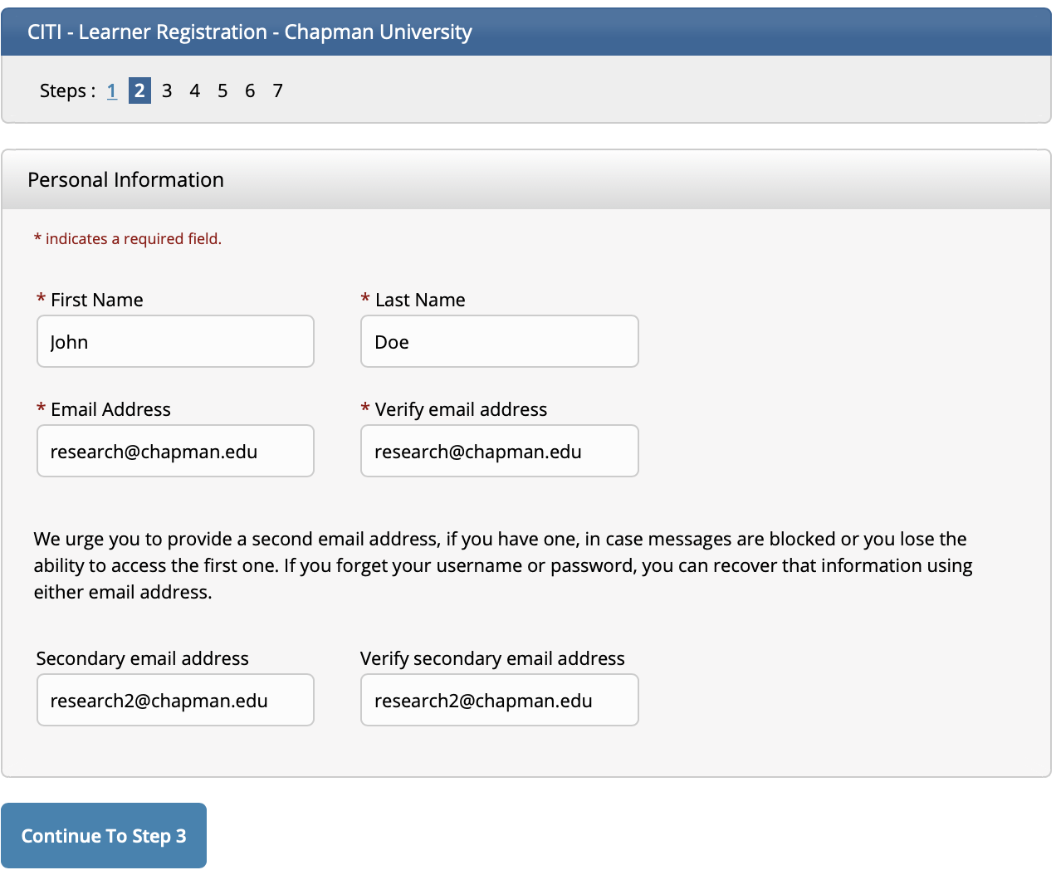
2) Enter Required Information
Then click “continue”

Slide 4
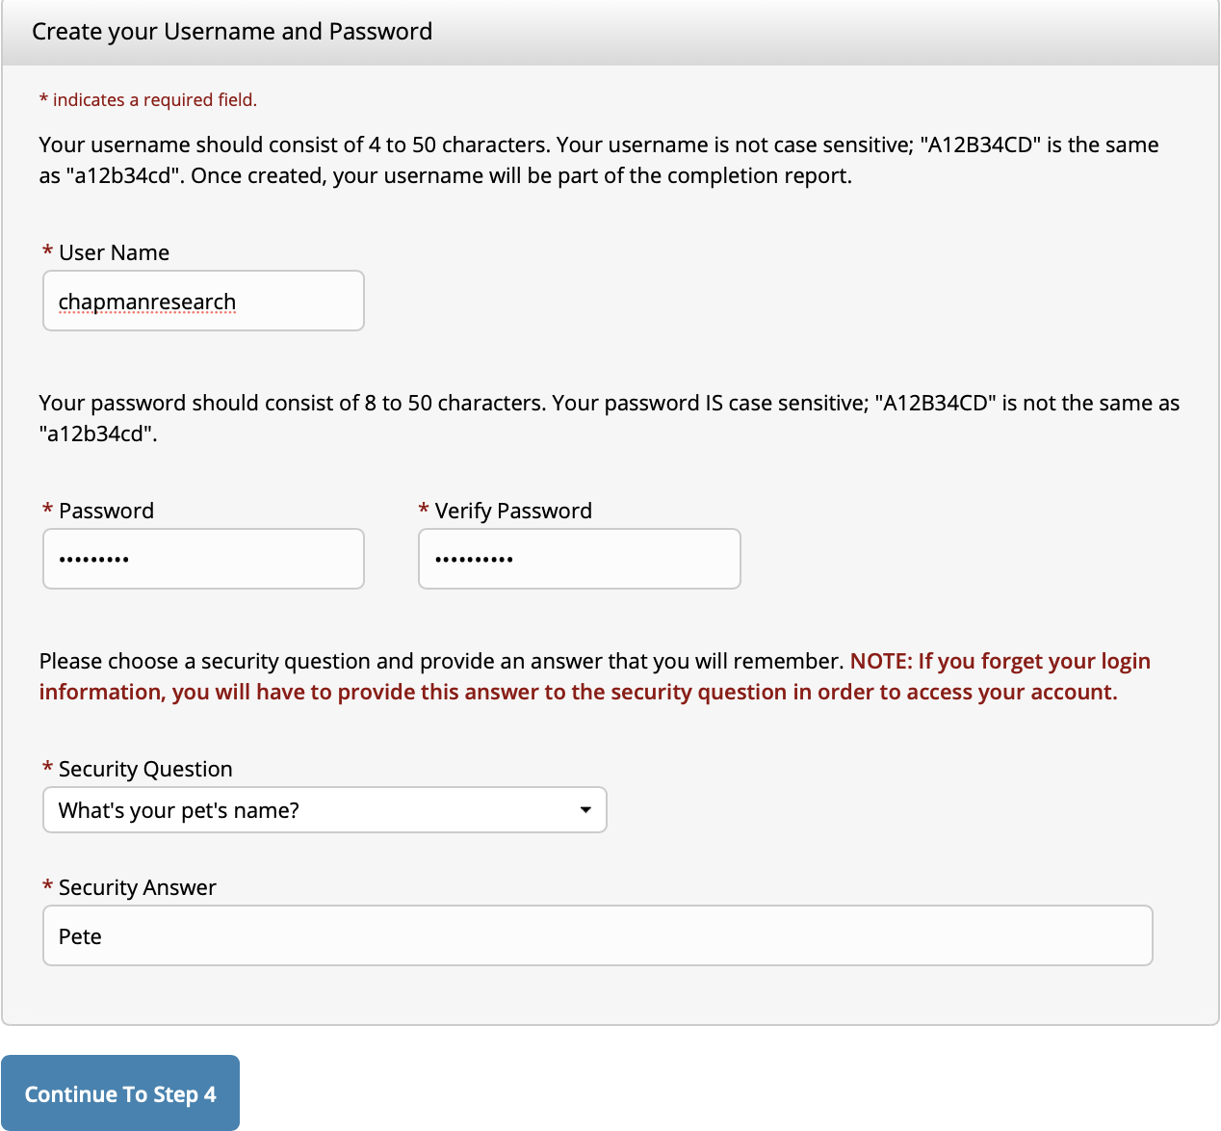
3) Create Username and Password
Then click “continue”

Slide 5
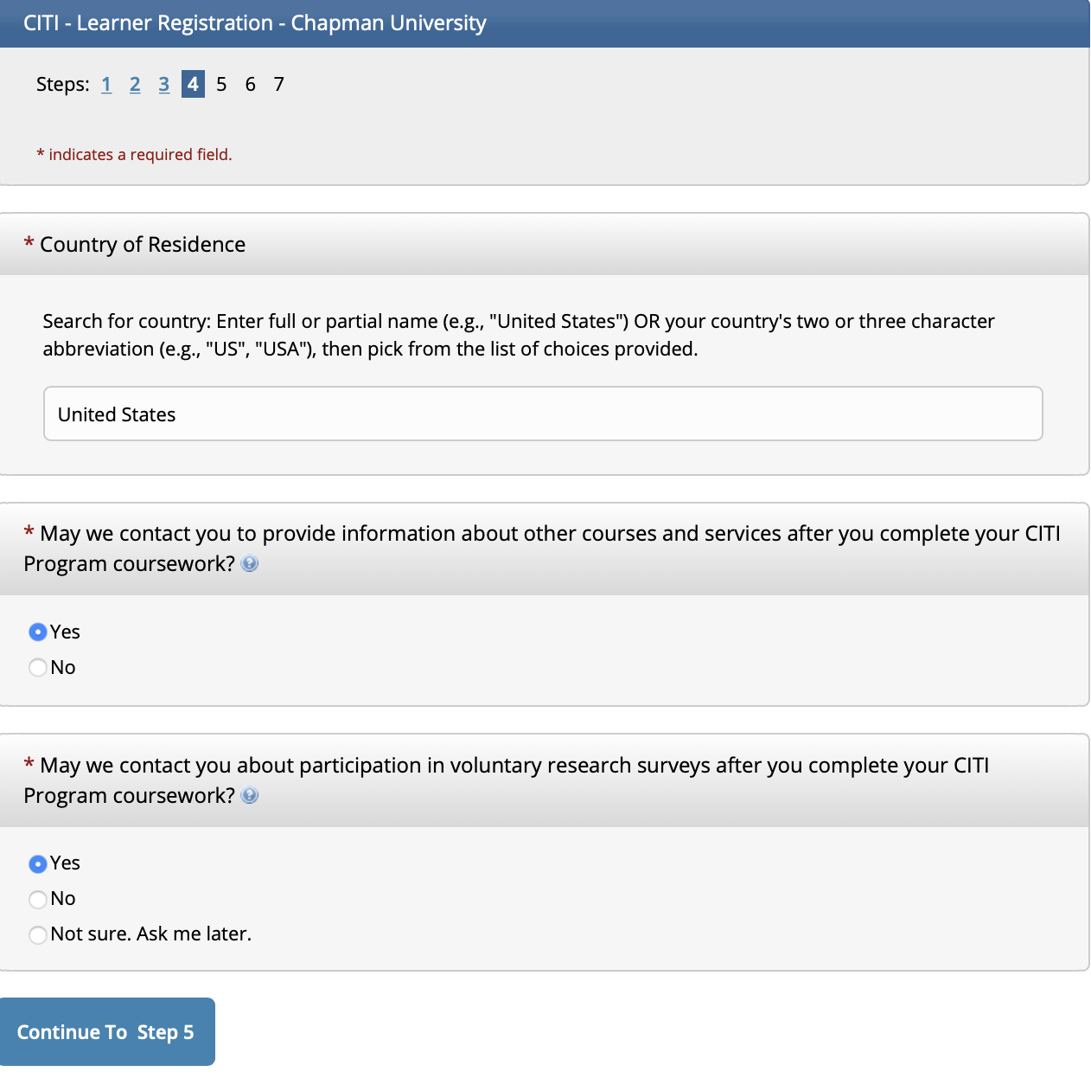
4) Enter Required Information
Then click “continue”

Slide 6
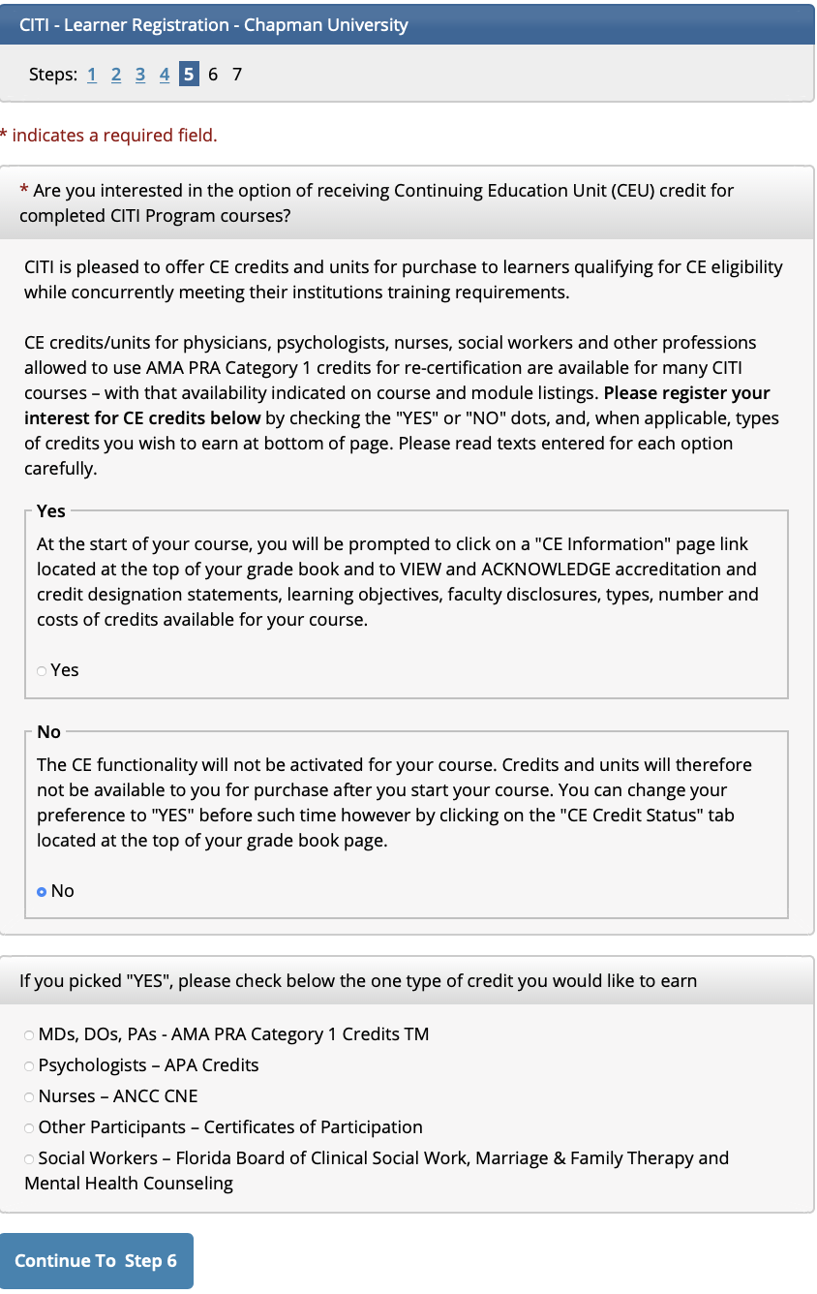
5) Select “NO”
Select “NO”
from suggested
options
Then click “continue”

Slide 7
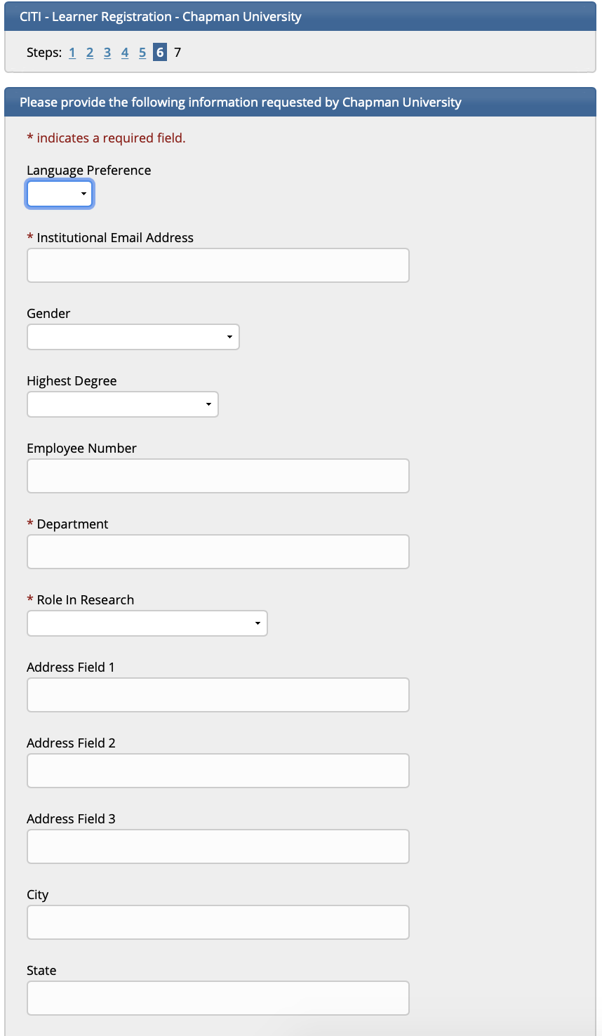
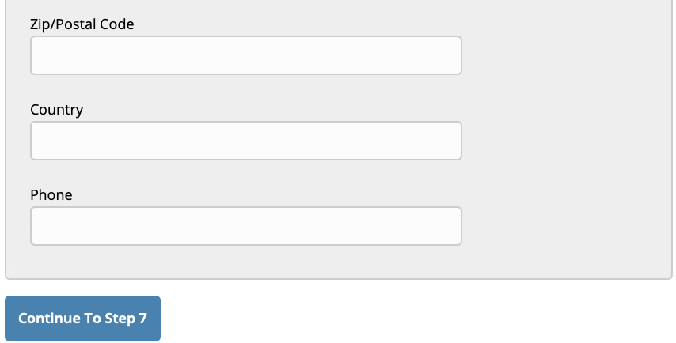
6) Enter Information That Applies to You
Then click “continue”

Slide 8
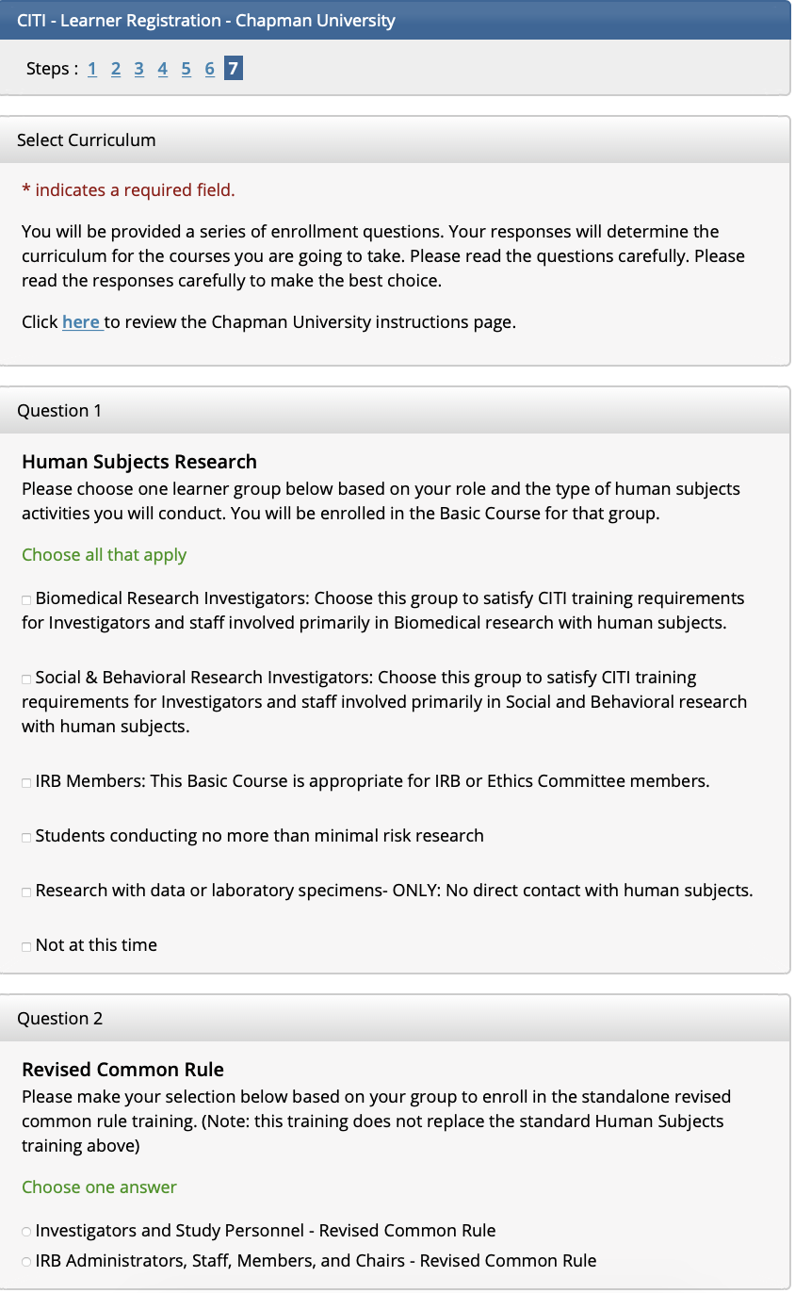
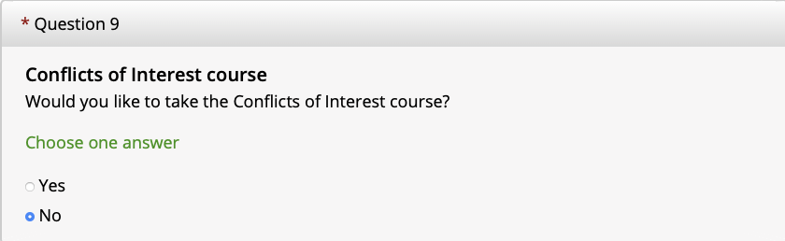
7) To add a course, only answer the questions that are related to the types of research that you will conduct. Select “NO”- Question 9 (required)
Common Questions Answered:
Human Subjects Research (question 1) – to complete the Social & Behavioral Research or Biomedical Research modules
  See document for full list of Social & Behavioral Research modules on the website
Good Clinical Practice course (question 7) – required if conducting clinical trials
Note: you are not required to answer all the questions (except when indicated as required). Only answer questions if it relates to the type of research that you will be conducting. IRB staff and members can require researchers to take supplemental modules, as needed.
Select “NO”
from suggested
options

Slide 9
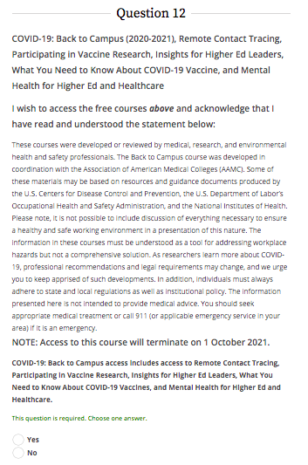
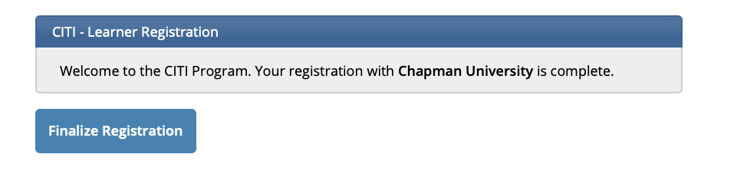
8) Select either “Yes” or “No” for Question 12 (required) and Finalize Registration
Then click “Finalize Registration”

Slide 10
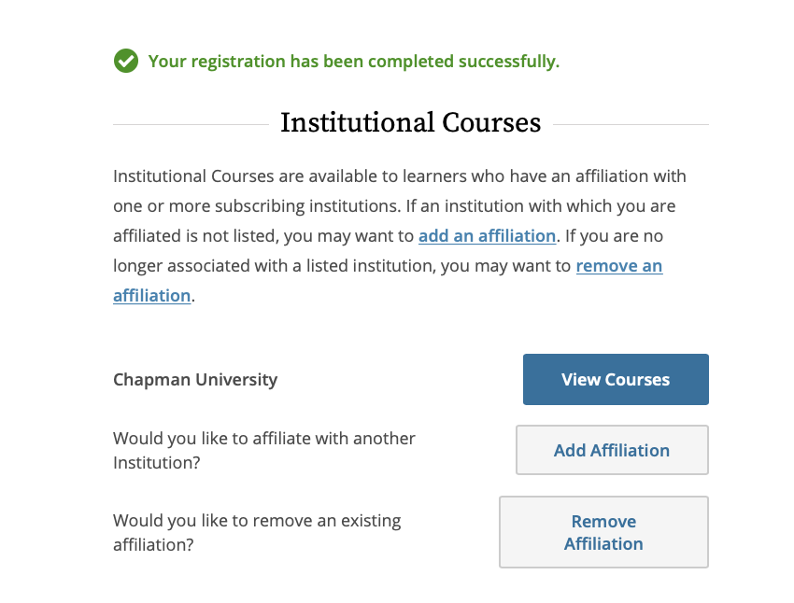
Ensure Registration Is Completed Successfully
*If you have any questions
regarding this process please contact
Chapman University IRB
Email: irb@chapman.edu
Phone: 714-628-2833

Slide 11
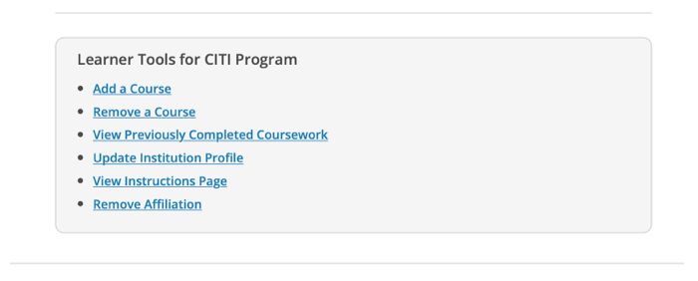
Adding New Courses After Registration
Click “View Courses”
Scroll down to Learner Tools and click “Add a Course”

Slide 12
Answer Questions to Add Additional Courses
Then click “Finalize Registration”

