Slide 1
Flexible Substratum for In Situ Single-Cell Observation
Invention ID: 2020-007
Inventors
Dr. Ashraf Mohieldin, Chapman University
Dr. Surya Nauli, Chapman University
Contact
Lawrence Lau, Director of Industry Alliances & Commercialization lalau@chapman.edu | 714-628-2875

Slide 2
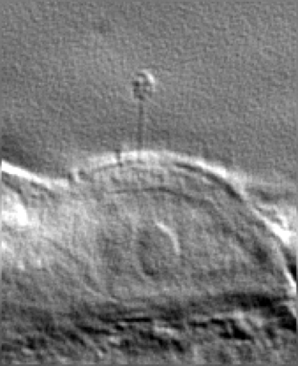
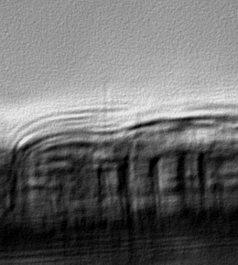
Technology Summary
Researchers at Chapman University have invented a Flexible Ultra-Thin Substratum (FUTS) that is designed to advance single-cell research. Currently, it is the only single-cell research tool that can simultaneously measure second messengers in cilioplasm and cytoplasm; in particular, it enables the visualization of the profile of a single-cell, including its cilia.
FUTS
Transwell
Micro-beads
Alternative research tools for single-cell observations are micro-beads and the Corning Transwell. Although the micro-bead allows for the visualization of single-cells, the visualization quality is poor, especially of the cell cytoplasm.
The Corning Transwell is a transparent membrane optimized for cell attachment and growth. When being used as a cell holder for 3D visualization, the visual quality of single-cells held by the Transwell is very poor compared to that of the FUTS.
Please see figure on the right for comparisons.
20 μm
20 μm
20 μm
5 μm
5 μm
5 μm

Slide 3
Advantages & Applications of the FUTS
The FUTS is an effective microscopy tool for positioning cells in such a way that clearly shows a complete single-cell, including any protrusion organelle such as cilia, without the need of changing the focal plane.
It can work with a fluid-flow system for scientists to observe the cells and their cilia when under fluid pressure. Please play video on the right.
It is compatible with biological approaches such as transfection, immunostaining, in situ hybridization, and intracellular signaling analysis.
It can be used by multi-disciplinaries in biomedical research such as biology, biochemistry, immunology, oncology, biophysics, neuroscience, molecular and cell biology.
It provides the right tool for investigators to analyze single-cell complex biological processes.

