Slide 1

Overview of Cayuse SP & Cayuse Proposals 424 (S2S)
Molly McCarty
Co-Director, Sponsored Projects Services
Pre-Award Administration

Slide 2
Cayuse @ Chapman
Human Subjects Research
IRB
Sponsored Projects
424
Protocol Development
Routing/Approval
Review
Renewal
Protocol Management
SP
(Sponsored Projects)
Federal Proposals
Animal Research
Proposal Submission
IACUC
Routing/Approval
Proposal Files
Award management
(nonfiscal)
Other Proposal
Systems
Nonfederal
Proposals
Conflict of Interest
COI

Slide 3
Beginning June 1, 2018
All proposals are to be routed and/or submitted through Cayuse SP

Slide 4
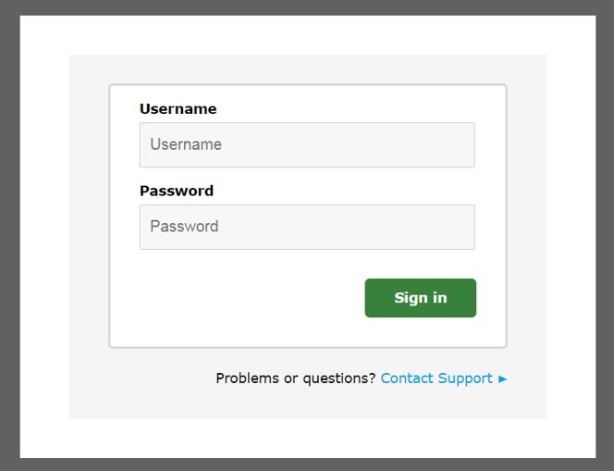
Cayuse Login: https://chapman.cayuse424.com/
Username: Your Chapman ID (eg. Mmccarty) Password: Your single sign-on Chapman password
Cayuse Testing Environment (if you’d like to practice): https://chapman-t.cayuse424.com/
Username: Your Chapman ID eg. mmccarty Password: catcat

Slide 5
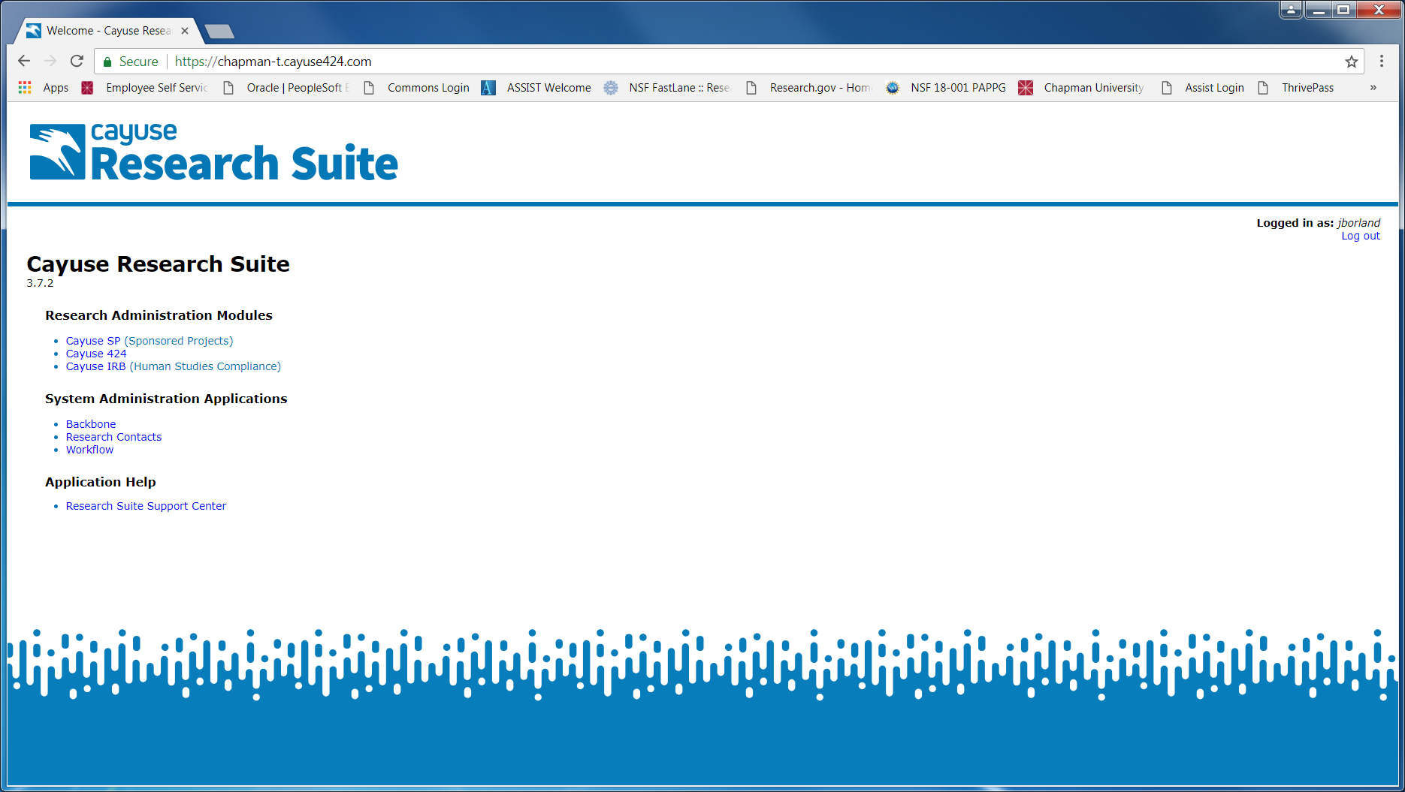

Slide 6
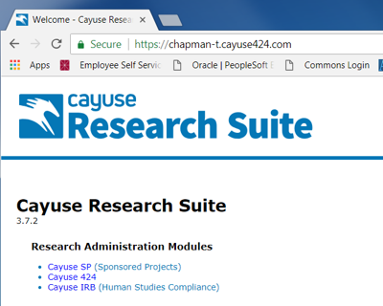
Click the
Sponsored Projects link

Slide 7
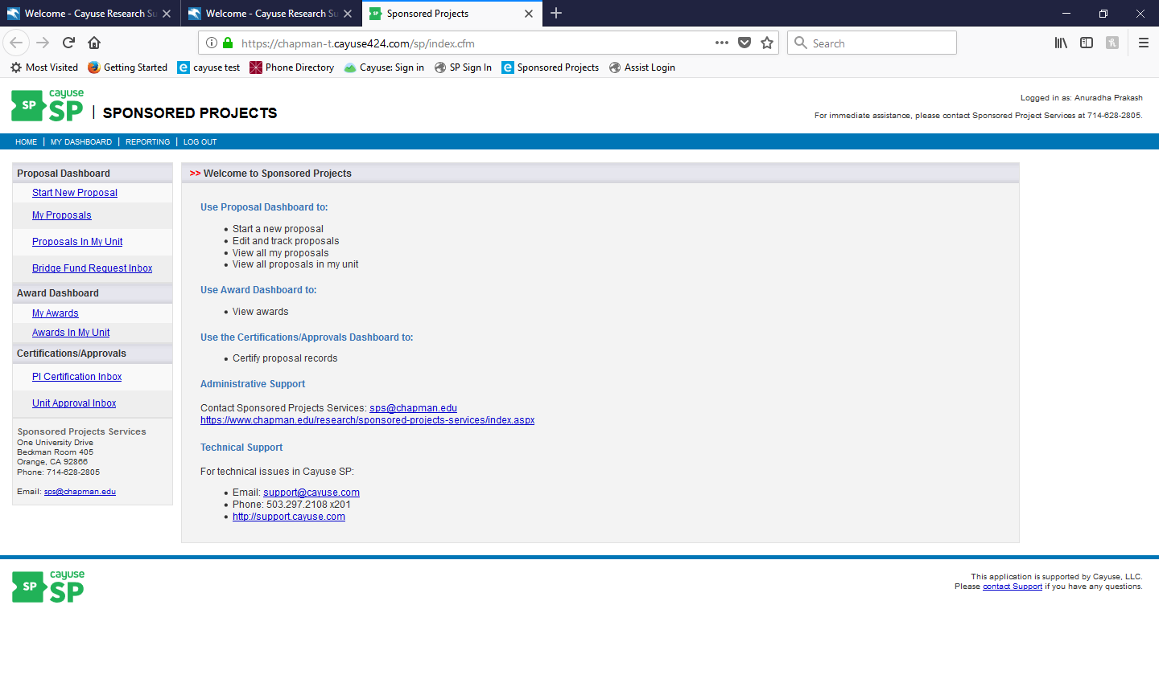
You’ve arrived at the Cayuse SP Navigation Page!

Slide 8
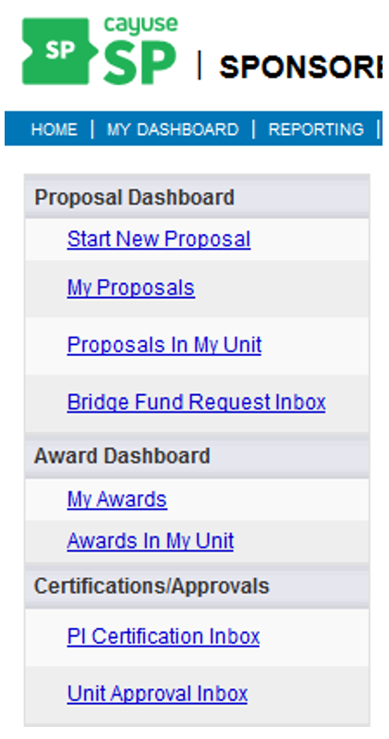
Cayuse SP has multiple Menus and Dashboards for convenient access to project information.
  Menus:
  Home
  My Dashboard
  Reporting
  Dashboards:
  Proposal Dashboard
  Award Dashboard (feature to be rolled out during Phase II of Cayuse implementation)
  Certifications/Approvals

Slide 9
PROPOSAL DASHBOARD
Start New Proposal… We’ll come back to this shortly!
My Proposals:
  Allows you to edit and track unsubmitted and submitted proposals that you created or are named on as a contributing member
  The number to the left of My Proposals in the dashboard list indicates the number of proposals in progress, if any.

Slide 10
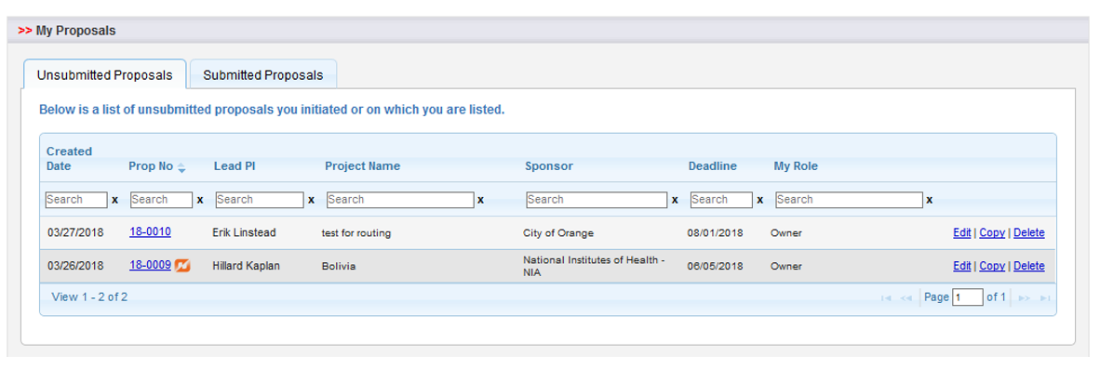
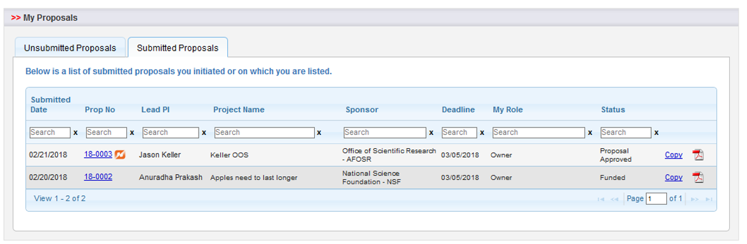
  Unsubmitted proposals are shown by default on the left. Submitted proposals are shown under the tab to the right.
  NOTE: “Submitted” here refers to submitted for University approvals, not submitted to sponsor.

Slide 11
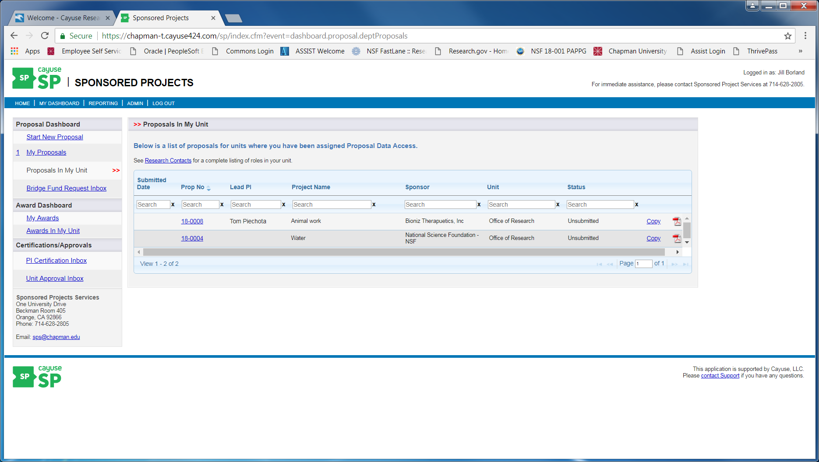
Proposal in My Unit:
Applicable to Chairs, Deans and individuals with proposal data access

Slide 12
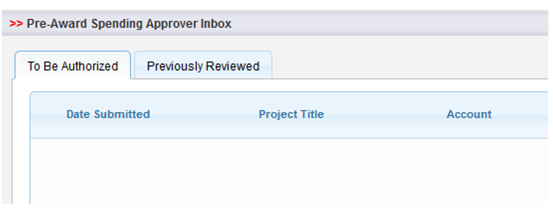
Bridge Fund Request Inbox: (will roll out during Phase II)
  Reflected as “Pre-Award Spending Approver” in the production version of Cayuse SP
  This would have a number next to it if you were to have a message waiting for your approval

Slide 13
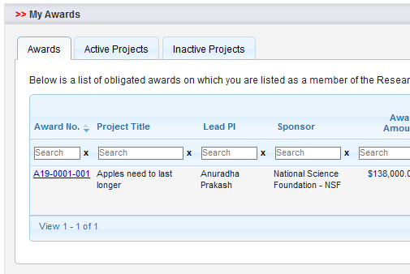
AWARD DASHBOARD
My Awards
  AWARDS lists awards received
  ACTIVE PROJECTS (currently funded projects)
  INACTIVE PROJECTS (projects that have ended)

Slide 14
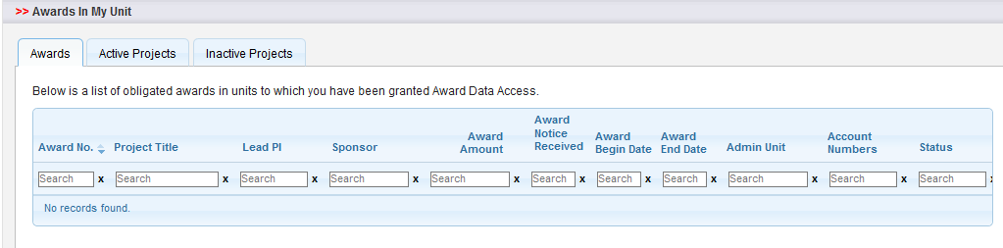
Awards My Unit
  Applicable to Chairs, Deans and individuals with award data access. This access can be requested from SPS.

Slide 15
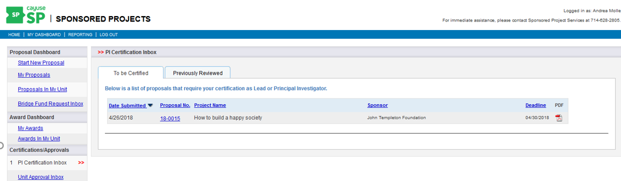
CERTIFICATIONS/APPROVALS
PI Certification Inbox
  To be Certified: Lists items awaiting PI/Lead certification
  Previously Reviewed: List of items already addressed

Slide 16
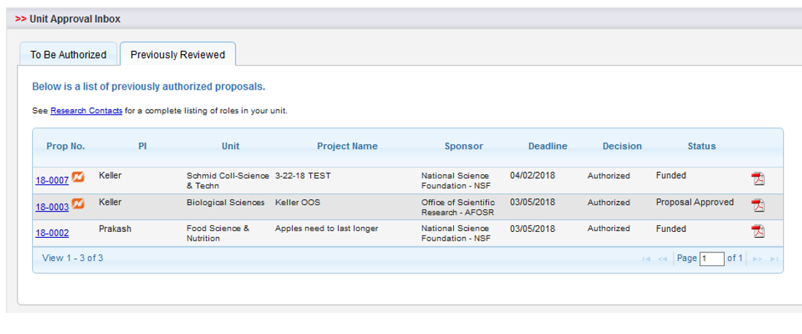
Unit Approvals would be applicable to Chairs, Deans and individuals with award data access, which can be requested from SPS.

Slide 17
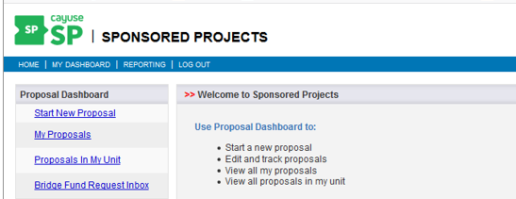
and now…back to…PROPOSAL DASHBOARD
Click
Start New Proposal

Slide 18
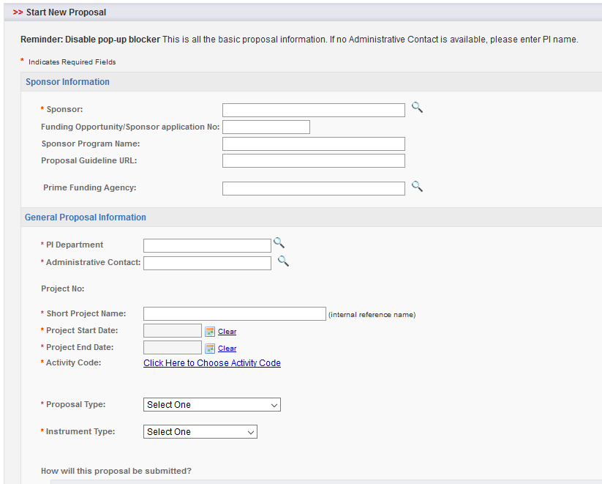
This basic proposal information needs to be completed to start a proposal.

Slide 19
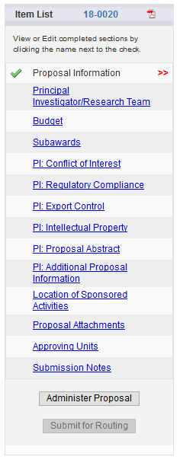
Once this information has been completed and saved, the Item List will appear on the left.
The double red arrow indicates the section of the Item List you’re currently on
A green check mark will appear in the Item List, indicating that all required information is complete for a section
If the proposal is paired with a Cayuse 424 application (for federal submission purposes), the pairing icon will appear
Throughout the proposal, an asterisk (*) indicates that a response is required and must be addressed before the page can be saved. You will receive an error message if you try to save without completing the required information.

Slide 20
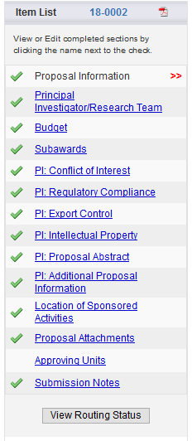
A completed Item List will appear as follows...

Slide 21
Let’s finish today’s overview by taking a look at the types of proposals that will be routed through Cayuse SP!
  Non-federal (Cayuse SP only)
  Federal (Cayuse SP and Cayuse 424 application)
Please remember to contact SPS at any time if you need assistance. We’re happy to help!
Molly McCarty, Co-Director SPS, Pre-Award, ext. 7394
Megan Faulkner, SPS Research Administrator, ext. 5459

