Slide 1

Using PHI in Research Procedures and Case Studies June 2024
Professor Mary Kennedy Vice Chair, IRB
Crean College of Health and Behavioral Sciences - Communication Sciences and Disorders
with
Judith Tran – Senior Compliance Administrator & Jen Donais – Asst. VP for Research Integrity & Compliance
Office of Research & Graduate Education

Slide 2
Agenda
Review PHI
Describe IRB updates to accessing, storing and using PHI for research
Describe what is needed/not needed in Cayuse
Discuss options for accessing PHI
Provide case examples
Provide links to additional information on the IRB website
Opportunity for questions and discussion

Slide 3
What is Protected Health Information?
Protected health information (PHI) is any information in a medical record or designated record set that can be used to identify an individual AND that was created, used, or disclosed while providing a health care service such as diagnosis or treatment.
HIPAA (Health Insurance Portability and Accountability Act of 1996) regulations allow researchers to access and use PHI when necessary to conduct research.

Slide 4
HIPAA provisions provide options for PIs to use PHI for research
Rule #1
PHI cannot be shared with anyone outside the research team and can be used only per the patient’s authorization and consent forms or necessary waivers
Ruler #2
Researchers cannot attempt to re-identify the data or contact patients if securing a data set
Ruler #3
Researchers must be trained in HIPAA using the CITI module

Slide 5
Research data that is PHI & defined in Confidentiality section of Cayuse
Chapman PI gets Data from a HIPAA-covered Entity
Participant’s Authorization to Collect PHI
Limited Data Set that includes PHI
IRB Waiver of Authorization (e.g., records review)

Slide 6
18 Personal Identifiers When medical information from a HIPAA provider, is COMBINED with other personal identifiers = PHI
1. Name
2. Address
3. Dates related to an individual: admission, diagnosis, discharge, services, DOB, DOD, etc.
4. Telephone numbers
5. Fax number
6. Email address
7. Social Security number
8. Medical info, e.g., diagnosis, record #
9. Health plan beneficiary number
10. Account number
11. Certificate/license number
12. Any vehicle or other device serial
13. Device identifiers or serial numbers
14. Web URL
15. Internet Protocol (IP) address
16. Finger or voiceprints
17. Photographic images
18. Any other characteristic that would uniquely identify the individual (e.g., codes)

Slide 7
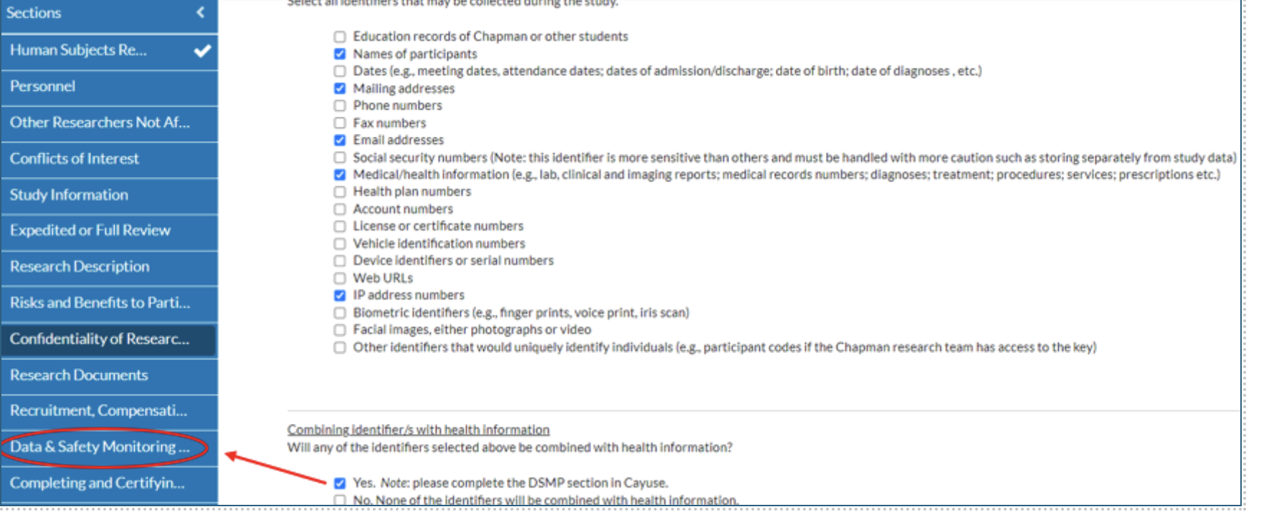
Confidentiality section in Cayuse: 18 identifiers

Slide 8
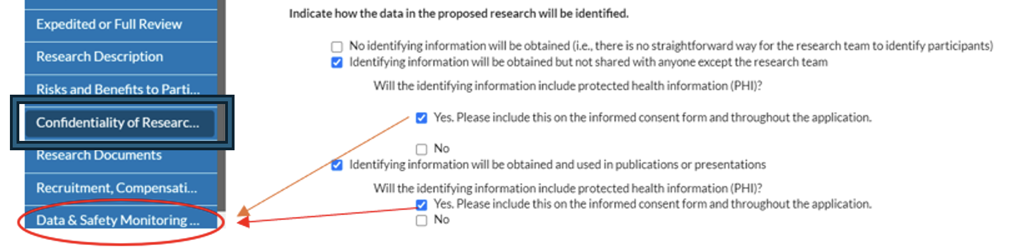
Confidentiality section in Cayuse:

Slide 9
PHI and What is Required
Participant authorizes access
Authorization form on IRB website
Data Safety & Monitoring Plan (DSMP)
Limited data set with PHI
Data Sharing &/or Data Use Agreement
Data Safety & Monitoring Plan (DSMP)
Waiver of authorization to access PHI
Minimal risk, authorization is not possible, etc.
Data Safety & Monitoring Plan (DSMP)

Slide 10
Limited Data Set that includes PHI
Limited data sets may be provided to Chapman researchers under a data use agreement (DUA), where the PI must agree to:
- use and disclose the data only as prescribed in the DUA or as required under law, and
- report unapproved disclosures of the data (e.g., a breach) within 5 business days of discovering the unapproved disclosure, and
- make no effort to identify or contact individuals in the data; and
- contact the IRB if the Chapman team receives identified data that is outside of the LDS agreement.

Slide 11
Limited Data Set Example with PHI
1. Name
2. Town/City/Zip
3. Dates related to an individual, e.g., of admission, diagnosis, discharge, services, DOB, DOD
4. Telephone numbers
5. Fax number
6. Email address
7. Social Security number
8. Medical info, e.g., diagnosis, record #
9. Health plan beneficiary number
10. Account number
11. Certificate/license number
12. Any vehicle or other device serial
13. Device identifiers or serial numbers
14. Web URL
15.Internet Protocol (IP) address
16.Finger or voice prints
17.Photographic images
18. Any other characteristic that would uniquely identify the individual, e.g., codes

Slide 12
This kind of data is NOT PHI
Health Information from Participants in a New Study
Participants Share health information with PI
A limited data set without health AND identifying information
Data is completely de-identified

Slide 13

De-Identified Data Are Not PHI
Holding the “codes” that links identifiers to data, means the data is not completely de-identified.
“Anonymous” data means the identifiers were never collected by anyone.
Definitions of types of data are in the Confidentiality of Research section of Cayuse
Chapman can receive fully de-identified data from a HIPAA-covered entity with no special provisions.

Slide 14
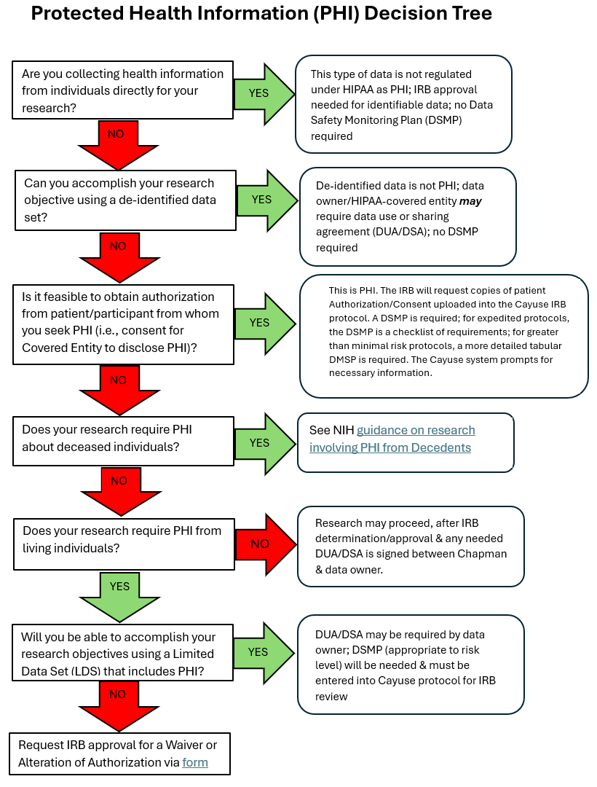

Slide 15
Case Study 1: A physical therapy PI will collect PHI in a new study
The IRB application must include:
"Authorization to use or disclose PHI for Research” form to seek approval to collect PHI & requests PHI from the participant’s doctor.
Informed consent form (ICF) should include a statement about*:
how long identifying information will be kept
who has access
DSMP that describes the safeguards for protecting participant PHI.
PI keeps records of the use and transfer of PHI.
*this is the same as for studies that have any identifying information.

Slide 16
Case Study 2: A pharmacy PI will bring PHI to Chapman from a hospital in a retrospective medical records review study
PHI will be included in a limited data set (LDS).
PI completes IRB application and a DSMP.
A data-sharing agreement is executed between the parties, with specific conditions for the use and disclosure of the data
PI must also sign the data-sharing agreement when PHI is transferred to Chapman.
Data provider must provide Chapman with written authorization and consent demonstrating that data was collected in a way that permits Chapman’s use of the data in research (usually part of the data sharing agreement).
IRB approval can occur prior to when the DUA is fully completed.

Slide 17
Protecting PHI in Research: Data safety standards
Separate PHI from the linked data set, i.e., data that contains PHI and data sets where codes have replaced PHI.
PHI, the codes and linked data should be kept in separate electronic folders or in a locked file cabinet located in a Chapman office or lab.
Only authorized researchers can access.
Computer files with identifying information, including PHI, must be password protected
Avoid sending PHI through email if possible.
Use SECUREMAIL if you must send PHI through email.
Notes:
Date recorded on phones, tablets, and other mobile devices must be transferred to a secured cloud server. This is because mobile devices are more susceptible to loss or theft. After that, PHI must be deleted from collection devices entirely.

Slide 18
IRB Requirements on use of identifiable health information
Requirement | Cayuse section containing trigger question(s) | Trigger question(s)
Authorization to Use or Disclose PHI for Research Purposes | Recruitment, Compensation and Informed Consent | Selecting “Identifiable health information will be coming from a HIPAA-covered entity is required”.
 | Research Documents | Selecting “identifiable health information will come directly from a HIPAA-covered entity (e.g., doctor, clinician, laboratory)”
Minimal Risk DSMP (Data and Safety Monitoring Plan) Covers minimum standards on securely handling data | Data & Safety Monitoring Plan | Selecting “My study is considered minimal risk, and I will be using identifiable health information.”
Greater than Minimal Risk DSMP An example is posted within the IRB “Guidance for Accessing Health Data Including PHI” | Confidentiality of Research | Selecting “yes” to “will identifying information include health information?”
 |  | Selecting “medical/health information” as an identifier
 |  | Any of the 17 other identifiers is selected and when “yes” is marked for the follow-up question “will any identifiers selected above be combined with health information?”
 | Data & Safety Monitoring Plan | Marking “My study is considered more than minimal risk, and I will be using identifiable health information.” and the follow-up option “Identifiable health information will be coming from a HIPAA-covered entity (e.g., doctor, clinic)…”
Notes:
Authorization – usually signed alongside ICF; some content similar with ICF but explicitly says data is no longer HIPAA-protected (Health Insurance Portability and Accountability Act); says who (e.g. doctor) is disclosing the health information and to whom (Chapman); specifies what health information (e.g., CT scans, hearing test results, etc.) will be used
Minimal risk DSMP – appears as checkbox in Cayuse; minimal data security standards:
_only research team has access
-use of only encrypted devices
Transfer of data within 24 hours from portable devices to secure location
breach- report to IRB within 24 hours, then formal report within 5 biz days
If funded study, work with OOR’s SPS
Abide by any restrictions in DUA
Completion of “CITI Health Information Privacy and Security (HIPS) for Clinical Investigators”
Greater than minimal risk DSMP: (includes but not limited to)
How frequent subjects will be checked and by whom
Reporting mechanism
Data elements to be reviewed and frequency of review to ensure integrity

Slide 19
Who to Contact for Help
Professor Mary Kennedy (IRB Vice Chair, College of Health and Behavioral Sciences) – markenne@chapman.edu (thru July 2024)
Judith Tran (Office of Research) – estran@chapman.edu
Jennifer Donais (Office of Research) - donais@chapman.edu
Phillip Lyle (IS&T) – plyle@chapman.edu

Slide 20
Supplementary Materials & Resources

Slide 21
Helpful Links
Authorization on Use of PHI for Research
https://www.chapman.edu/research/integrity/irb/forms-and-instructions.aspx
Data and Safety Monitoring Plan
https://www.chapman.edu/research/integrity/irb/policies.aspx

Slide 22
Privacy Board Review Process – IRB/PB
Informed
consent
Authorization to use or collect PHI for research (or waiver of auth.)
Data use/data transfer
terms?
data safety protections
DSMP
+
+
+
Do the informed consent, the authorization to use or collect PHI for research, and the data use/data transfer terms align?
Do the data safety protections adequately protect participant privacy? (with assistance from IS&T)
Reviews and approves requests for waivers of authorization to collect/use PHI.
DSMP template in Cayuse for minimal risk studies; detailed plan for > minimal risk studies

Slide 23
Case Study 3 – Research on Decedents
A researcher plans to review medical records of deceased persons to verify biological specimen data using data from a California archive.
If PHI is included in the records, IRB approval is needed before accessing records (CA law), whether the PHI will be collected or used in the study;
PIs may be asked to show IRB approval before accessing the data.
HIPAA requires that the data be solely used for research, that it is necessary for the research project, and that the PI can document that information is needed from a deceased person.
PHI guidance document includes these descriptions.
Representation form for research involving decedents

Slide 24
Additional External Guidance
Data Management and Sharing Policy | Data Sharing (nih.gov)
Research Data Management @Harvard
DMPTool

Slide 25
Thank you! Questions and Discussion

