Slide 1
Faculty Grant for Research, Scholarship and Creative Activities (FGRSC)
Martina Nieswandt & Paige Rodriguez
Office of Research & Graduate Education
January 16, 2025
Notes:
Overall – aim for 45 / 50 min of presentation

Slide 2
Agenda
Purpose of FGRSC
Who is eligible to apply?
What documents do I need to submit?
Guiding questions for proposal development
How to submit my proposal package and by when?
Review process
Questions

Slide 3
Purpose of the FGRSC
Providing competitive, merit-based support for research, scholarly, and creative activities in the humanities, fine arts, performing arts, social sciences, education, and other related disciplines:
  Leading to the development of new or the advancement of existing scholarship/creative activities
  Enhancing intellectual and creative life of Chapman’s community and beyond
The FGRSC does not support projects that focus primarily on education (e.g., program development) or provides funding for publication of research/scholarship or creative activities.

Slide 4
Who is eligible to apply?
Tenure track, tenured, and non-tenure track faculty members in the humanities, arts, social sciences, education, and other related fields
Faculty must be in good academic standing
Non-tenure track faculty who have expectations of scholarship in their contracts.
Note: only one application per faculty member

Slide 5
Who is NOT Eligible?
Faculty who received funding from OOR in the past three years (2025/2026, 2024/2025, and 2023/2024)
Faculty who have funds available exceeding $20,000

Slide 6
What documents do I need to submit?
Project Narrative – maximum 5 pages
Bibliography and References Cited – maximum 2 pages
Budget and Budget Justification – use provided form
Current, Pending, and Planned Support – use provided form
Curriculum vita(s) or Biosketch(es) – maximum 2 pages
Letter of Support from Dean or Department Chair/Head
Letter of Commitment from Community Partner Organization, if applicable – maximum 2 pages
Statement of Work for Subaward, if applicable – maximum 1 page
Equipment Price Quote from Vendor, if applicable

Slide 7
Project Narrative
Format
  Five single-spaced pages maximum with 1-inch margins on all sides, and fonts of either Arial 10 point or Times New Roman 11 point.
  Use the section headers and the order speciﬁed below
Writing Tips:
  Write in straightforward language
  Avoid the use of technical or discipline-speciﬁc jargon
  Keep acronyms to a minimum and spell them out the ﬁrst time you use them
  Refer to the Review Criteria and Guiding Questions provided in the Request For Proposals
Keep in mind that reviewers will possess general content knowledge, but not necessarily speciﬁc expertise in your area of study.

Slide 8
Guiding questions for proposal development
Project Narrative
Scholarly/Creative Merit – demonstrate intellectual rigor, artistic excellence, or creative innovation within its discipline; clearly articulated and well reasoned goals/objectives
Questions to ask yourself: Do the reviewers see that …
My project demonstrates intellectual significance along with a clear and persuasive rationale? Do I provide sufficient evidence to support how the project is expected to lead to advances in the field?
My project’s goals and objectives are clearly articulated, well-reasoned, and adequately supported with relevant background, information and/or preliminary data? If hypothesis driven, are my hypotheses clearly stated?

Slide 9
Guiding questions for proposal development
Project Narrative
Contribution to the Field – meaningful contributions to scholarship, artistic practice or cultural understanding; distinctive, offering fresh insight and new value; innovative approaches, theories, discourse, interpretation, methods.
Questions to ask yourself: Do I clearly outline…
That and how my project makes a meaningful contribution to scholarship, artistic practice, or cultural understanding?
That my project is distinctive in offering fresh insights and new value for the field(s) and/or the public through innovative approaches, theories, discourse, interpretations, and/or methods?

Slide 10
Guiding questions for proposal development
Project Narrative
Feasibility and Resources – evidence of proposed project’s feasibility, timely completion possible and with the necessary resources and expected outcomes.
Questions to ask yourself: Do I clearly state …
My work plan including roles and responsibilities of all project personnel including community collaborators, if applicable?
That the resources and timeline is adequate to ensure success (expected outcomes) for my proposed project?
That the environment in which the work will be done contribute to the probability of success and will beneﬁt from speciﬁc assets (e.g., archives, special collections, translation expertise, technical assistance, databases or tools, geography, facilities, or availability of subject populations)?

Slide 11
Guiding questions for proposal development
Project Narrative
Impact – professional development, students’ education and training (if applicable), broader community
Questions to ask yourself: Does my proposal …
Adequately describe how my project benefits
  my professional development,
  students involved in the project and
  the broader community?

Slide 12
Guiding questions for proposal development
Project Narrative
Investigator – evidence about eligibility for an FGRSC award; well-suited to carry out the project
Question to ask yourself: Do I…
Describe how my emerging/ongoing record of accomplishments makes me well-suited to carry out the project?
Include evidence that I am eligible based on FGRSC criteria?

Slide 13
Budget and Budget Justiﬁcation
Align your budget with the proposed work and clearly justify each budget category.
Budget categories:
  Undergraduate and graduate student costs and fringe beneﬁts
  Travel
  Community collaborator service payments (if applicable)
  Equipment, supplies and materials
  Participant support costs
  Animals and animal care
  Contractual services
If applicable: Contract with a Community Partner Organization for community-engaged research. Make sure that community collaborator is appropriately compensated, and budget line items are clearly justiﬁed and consistent with the Letter of Commitment and Statement of Work?
Notes:
Couple things to point out: Any students you would like to hire with your grant money you will need to account for fringe (linked in guidelines)
Travel must be related to the project (we will talk more about this In a few slides)
- Equipment will require a quote from the vendor (this can be a screenshot or an official quote)
- Please include a DETAILED justification on the right hand column; hard for us to interpret why some line items may be needed if not explained
*show sample

Slide 14
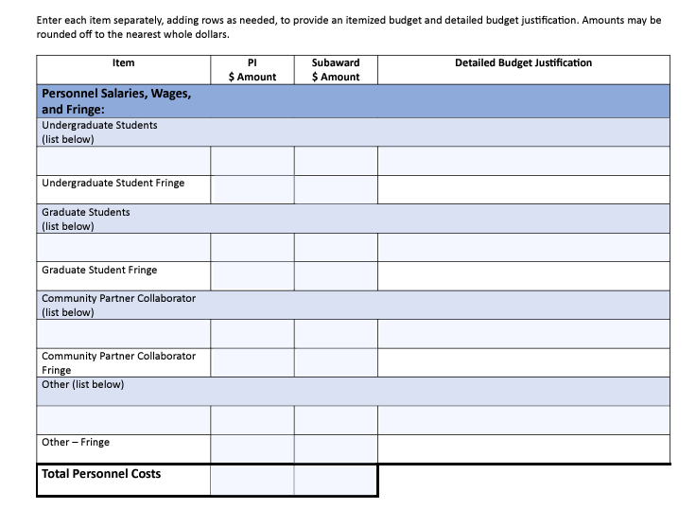
Sample Budget – page 1
Notes:
- Two page document available on our webpage
First page is about personnel
- Discuss fringe rates – a percentage of cost of employee benefits relative to the employee’s salary.
- Community partner or subaward document / email us

Slide 15
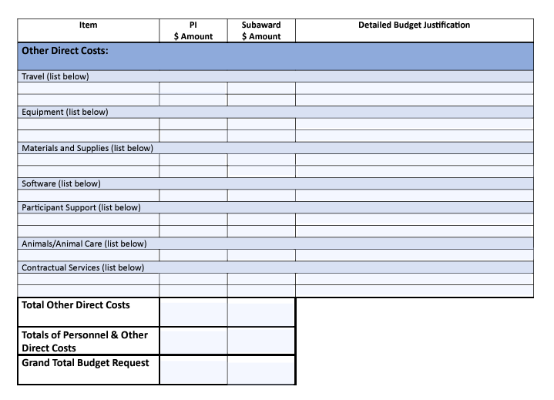
Sample Budget – page 2

Slide 16
Unallowable Costs
Salaries or other direct remuneration to faculty members of Chapman University.
Administrative support or oﬃce expenses related to research.
Maintenance contracts on equipment.
Travel to meetings, conferences, sabbatical sites for purposes other than conducting the proposed work.
The writing and preparation of manuscripts intended to be used as standard textbooks.
Projects that could receive support from publishers or other contracting entities.
Publication costs or reprints for individual faculty or for departmental monographs or series.
The preparation of lectures, demonstrations, syllabi, or other course-related materials.
Departmental symposia, seminars, retreats, or colloquia.
Projects whose purpose is support of undergraduate or graduate students pursuing their own research.
The remedy of budgetary deﬁciency in other research contracts or grants.
Bridge funding or marginal support for other substantially funded research.
Notes:
Please carefully look over the unallowable costs:
- specifically want to point out publication cost this doesn’t cover. Refer to SOARs (support open access research and scholarship)
Travel must be part of the proposed work

Slide 17
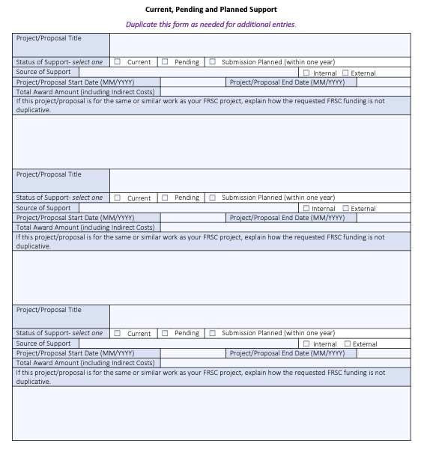
Current, Pending, and Planned Support
Notes:
- also available on our Internal Funding webpage
- this is the current, pending and planned support document: for you to report all of the current/pending/planned funds at your disposal (examples - IDC, gift accounts, external grants, startup funds)
- We check with the colleges and our offices to check all funding available to you to make sure you are within eligibility of 20K
- duplicate this page as many times as needed

Slide 18
Curriculum Vita or Biosketch
Maximum 2 pages
Format as appropriate for your ﬁeld
Add C.V. for yourself and any collaborators
Include your most recent publications or creative works, or those most relevant to the work proposed.
Notes:
- CV or biosketch; use whatever is most appropriate for your field
- remember to add CVs for any collaborators as well

Slide 19
Letter of Support from Department Chair or Dean
Maximum 1 page
Letter should address:
  Your record of accomplishment relative to your potential to
    successfully complete the proposed work
    enhance your reputation and research proﬁle
    enhance department/college/school’s reputation.
Letter should describe:
  Your career stage
  How the project will advance your research program vis a vis the FGRSC program aims
  Good academic standing
  For NTT outline of research/scholarly/creative expectations
Notes:
Here is where for NTT of mid career faculty need either their expectation of scholarship

Slide 20
Documents for working with
Community Partner Organization
Letter of Commitment from Community Partner Organization(s)
  Maximum 2 pages
  Signed by authorized person of organization, e.g., Board Chair or Executive Director.
  State speciﬁcally the partner's intention to collaborate and what community problem or opportunity will be studied.
  Describe:
    the partner’s involvement in developing the project,
    how they will participate,
    the resources they will devote to the project
    name, title, and position of the lead collaborator and key staﬀ,
    activities, timeline, and
    expected outcomes and impact.
  Describe any ﬁnancial and in-kind contributions (e.g., 10 hrs. for data collection)
  If the partner organization will be a sub- awardee, reference the Statement of Work for Subaward.
Notes:
Encourage you to read over this, in guidelines; only applicable if you have a community partner or a subaward site

Slide 21
Documents for working with
Community Partner Organization
Statement of Work for Subaward – accompanies Letter of Commitment
Maximum 1 page
Describe:
  Activities and deliverables of the subaward in details
  Who will be directly responsible for accomplishing the work
  An itemized budget and justiﬁcation that matches the subaward items listed on your Budget and Budget Justiﬁcation form.

Slide 22
Equipment Price Quote from Vendor (if applicable)
Attach a copy of a recent vendor quote for the requested equipment

Slide 23
Proposal Submission
Via Cayuse SP
Deadline: Monday, March 2, 2026, at 12 (Noon) PM.
Email officeofresearch@chapman.edu before routing for preliminary check
Notes:
- NTT faculty will need to request access to Cayuse from Paige
- email us for check

Slide 24
Review of Proposals
Proposal evaluated by committee of faculty peers from the applicants’ colleges/schools based on the following criteria:
Scholarly/Creative Merit
Contribution to the Field
Feasibility and Resources
Impact
Investigator

Slide 25
Review of Proposals
Administered by the Oﬃce of Research & Graduate Education (OOR&GE).
Peer review:
  Reviewers based on disciplinary areas and, whenever possible, expertise consistent with the proposal topic.
Panel review:
  Research and scholarly active faculty members
    review proposals based on ad peer reviews and their own reviews, and
    collectively select proposals to recommend to the VPR for funding
VPR makes final determination of awards

Slide 26
Grant Resubmission Support - Ongoing
Purpose: Resources to strengthen and resubmit previously reviewed, and highly scored but unfunded grant proposals.
Eligible:
  Tenure-track and tenured faculty members; non-tenure track faculty members with expectations of research and scholarly activities.
  Faculty must be in good academic standing and have no more than $30,000 in available funds.
  An unfunded proposal that hasn’t been resubmitted more than once.
Eligible Activities: Professional writing and editing services, generation of additional preliminary data, consultant fees for proposal enhancement, other activities that directly address reviewer feedback.
Expected Outcome: Submission of improved proposal to funding agency within the funding period or 12 months after the start of the funding period.

Slide 27
Grant Resubmission Support - Review Criteria
Response to Reviewer Feedback: Clear plan addressing specific reviewer concerns; identification of key weaknesses to be addressed; strategic approach to strengthening the proposal
Resubmission Strategy: Specific activities planned (data generation, writing support, etc.); target funding agency and program identified; timeline for resubmission is clearly stated with identifiable milestones
Likelihood of Success: Strength of additional data (if applicable); appropriateness of proposed improvements; potential competitiveness after proposed enhancements
Applicant Eligibility and Qualifications: Verification of eligible faculty status; track record of research and scholarly productivity, and grant submissions; demonstrated commitment to research, scholarly, and creative excellence
Budget and Budget Justification: Clear and reasonable budget within the budget limits; direct alignment between budget items and proposed activities; appropriate use of funds per program guidelines
Evidence of Previous Submission: Documentation of reviewed but not-awarded proposal; reviewer comments/feedback provided; demonstrated competitiveness of original proposal (e.g., score, reviews)

Slide 28
New Research Exploration – One-Time Funding Opportunity – Due: Monday, February 16, 2026, 12 PM
Purpose: One-time funding opportunity (seed funding) supports faculty in pursuing new research, scholarly, and creative directions.
Eligibility:
  All tenure-track and tenured faculty members; non-tenure track faculty members with expectations of research and scholarly activities.
  Faculty must be in good academic standing; must not have any available funds exceeding $30,000.
Eligible Activities: Exploration of emerging research areas with NO preliminary data and aligned with new funding priorities; research activities to develop proposals for new funding.
Expected Outcomes: Submission of a proposal to a funding agency within 18 months after start of the funding period.

Slide 29
New Research Exploration – Review Criteria
Significance/Importance: Argues effectively that project has potential to lead to significant contributions to the concepts, theories, methods, technologies, applications, treatments, outcomes, services, and/or preventive interventions that drive the field or discipline.
Innovation/Novelty: Demonstrates that project develops or employs innovative/novel theoretical or creative concepts, approaches, methods, instrumentation, technologies, and applications.
Approach and Timeline: Outlines clearly articulated and well-reasoned plan of action.
Feasibility and Resources: Described project is achievable and potential concerns about feasibility have been addressed.

Slide 30
New Research Exploration – Review Criteria
Investigator: Provides evidence that the applicant is eligible for the New Research Exploration award and is well-suited to carry out the project.
Impact and Outcomes: If objectives of project are achieved, the project has high potential for leading to further work with value or impact in the ﬁeld and will lead to disciplinary achievement and extramural funding.
Budget and Budget Justiﬁcation: Budget is appropriate and suﬃcient to conduct the proposed work.

Slide 31
Questions?
Email: oﬃceofresearch@chapman.edu

