Slide 1
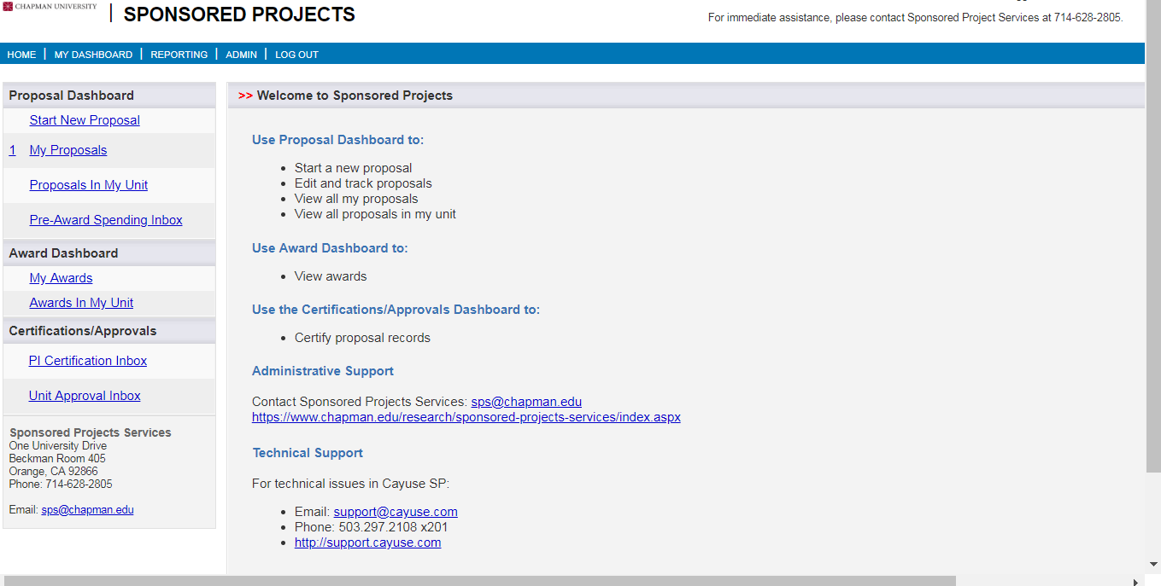

Slide 2
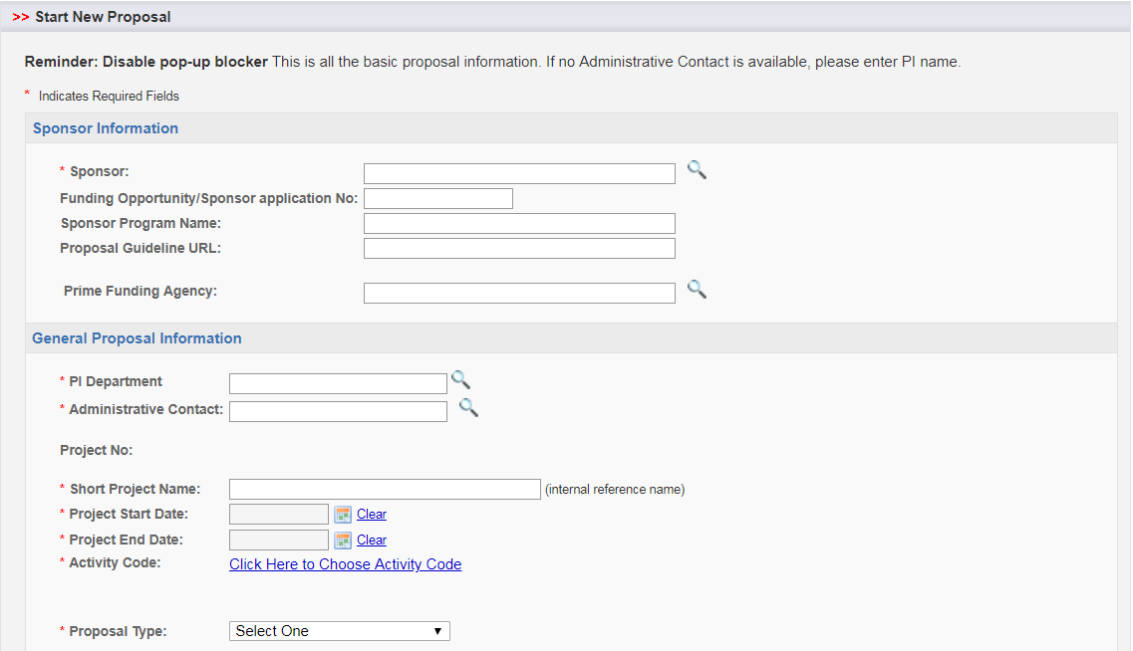
Choose college or departmental support person. If none, then choose the appropriate SPS Research Administrator
Choose appropriate code from the dropdown menu

Slide 3
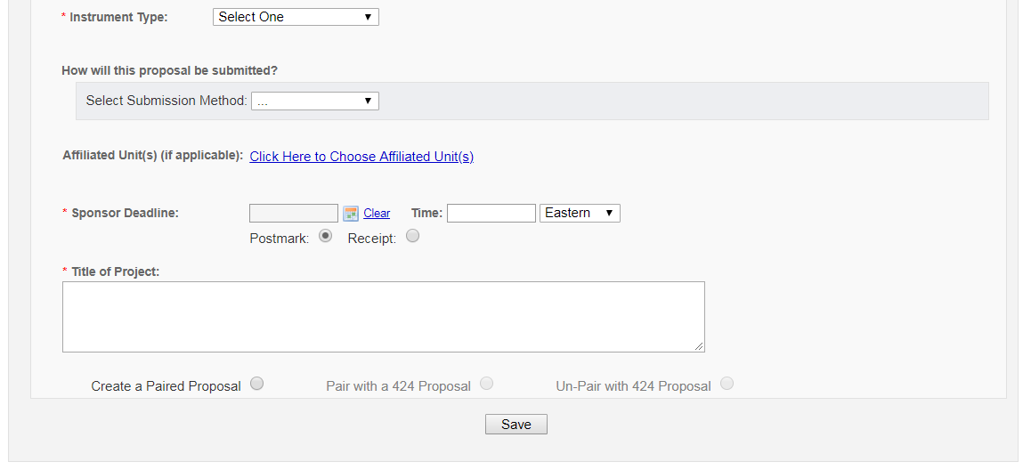
Select unit that will dedicate resources to the project, if no key personnel from that unit are included in the proposal (lab use, students from that unit, etc.)

Slide 4
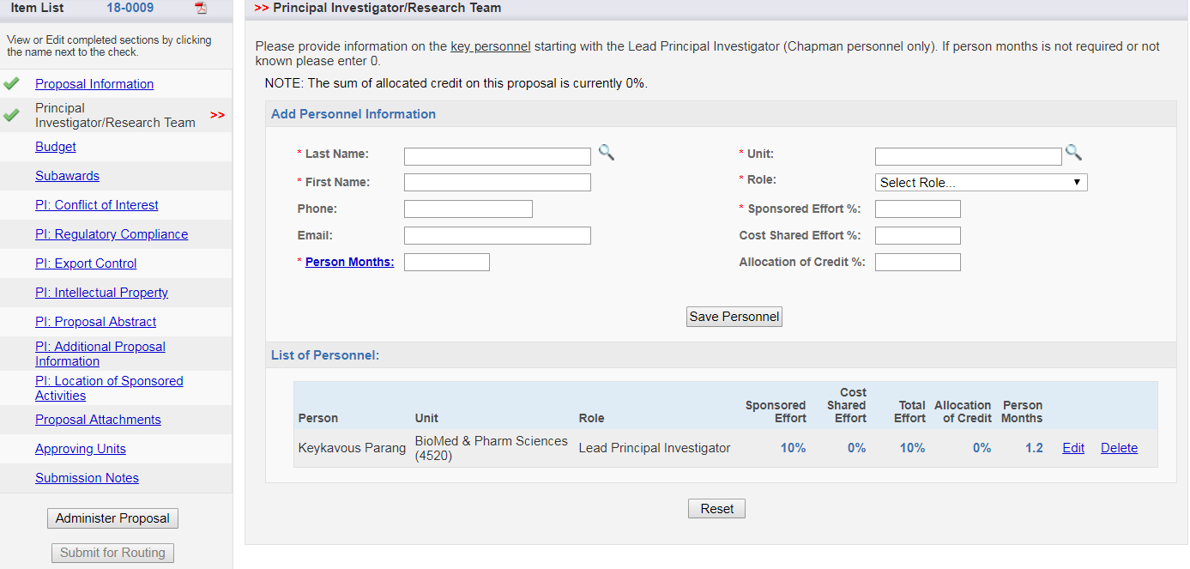
If unsure of person months calculation, enter 0 and SPS will calculate for you. Field cannot be left blank.

Slide 5
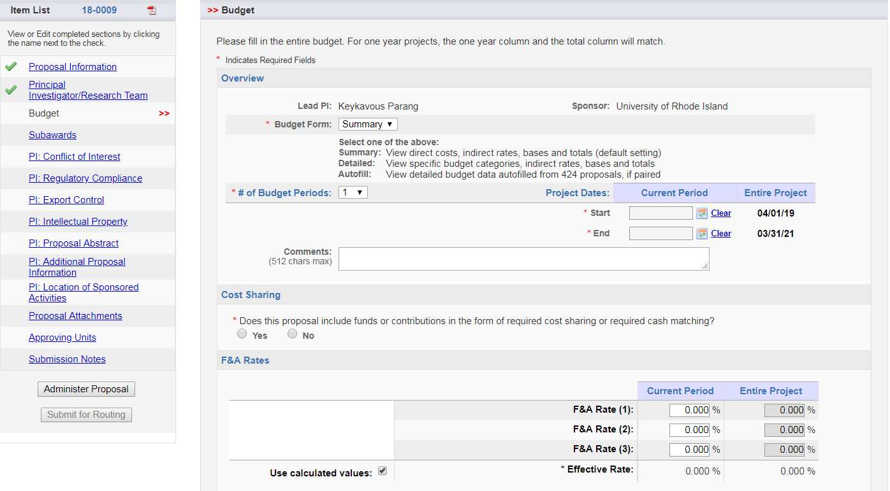
Click the F&A Rate field to choose the appropriate indirect rate for the project.

Slide 6
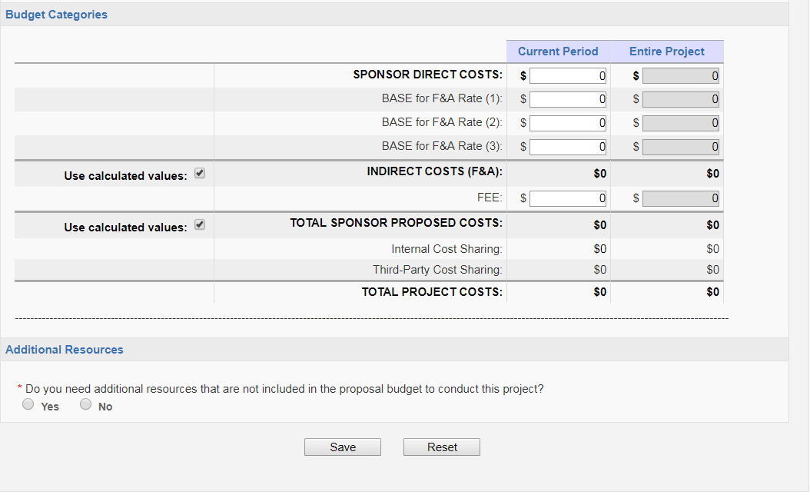
If Yes, choose resource(s) from the list and provide explanation.

Slide 7
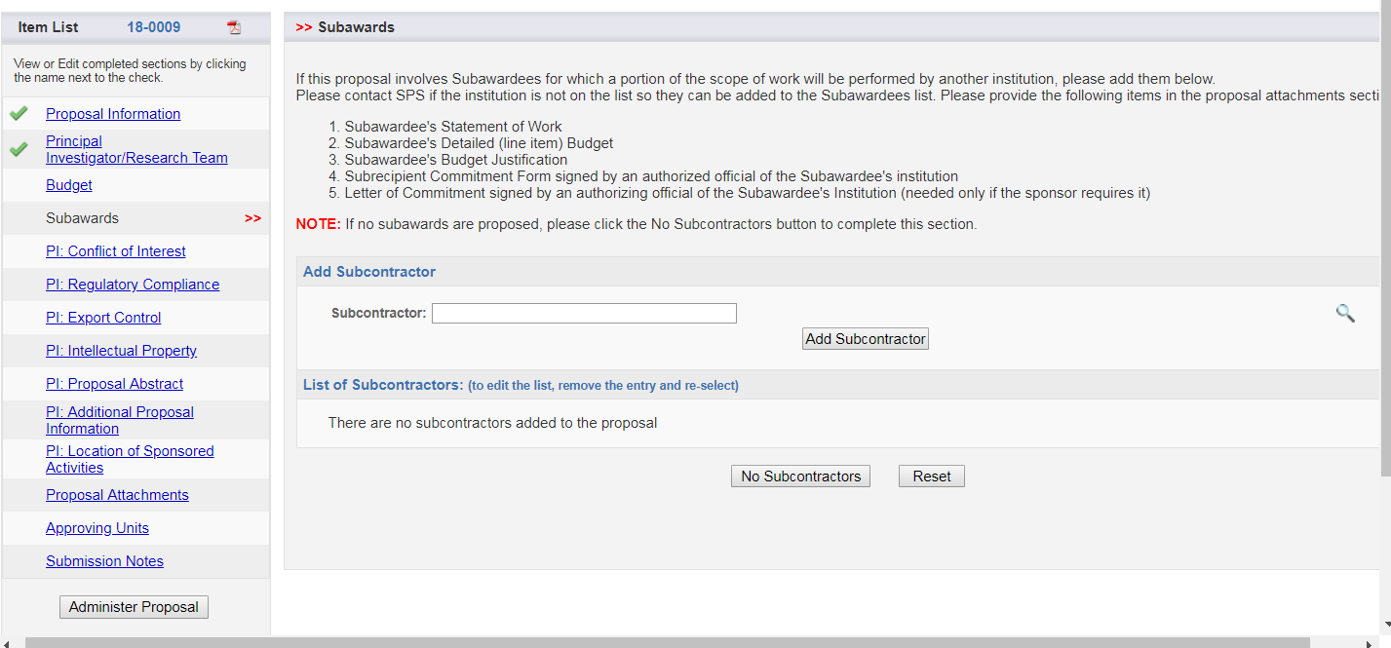
Click to search for subcontractor. If sub is not included on the list, please contact SPS Research Administrator and they can add the subcontractor for you.

Slide 8
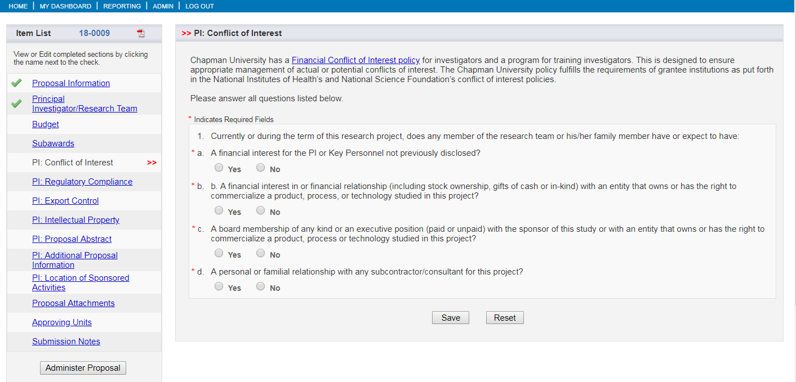

Slide 9
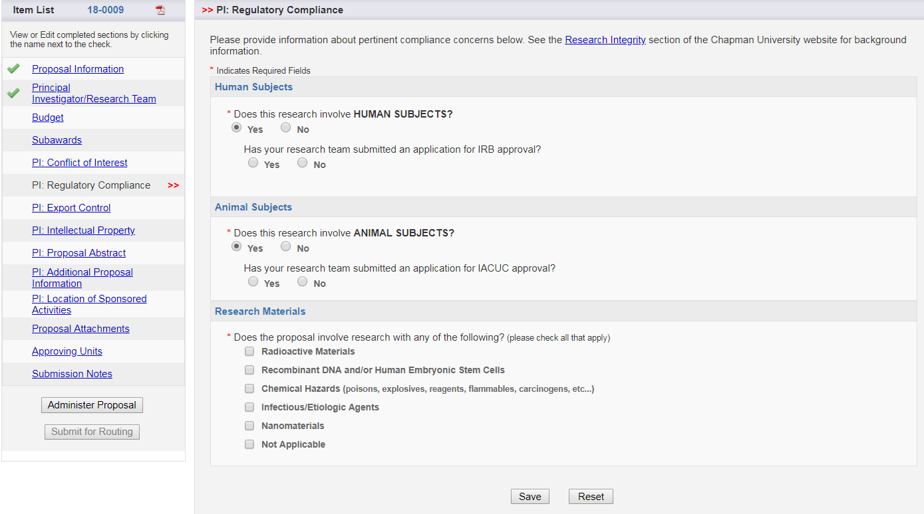

Slide 10
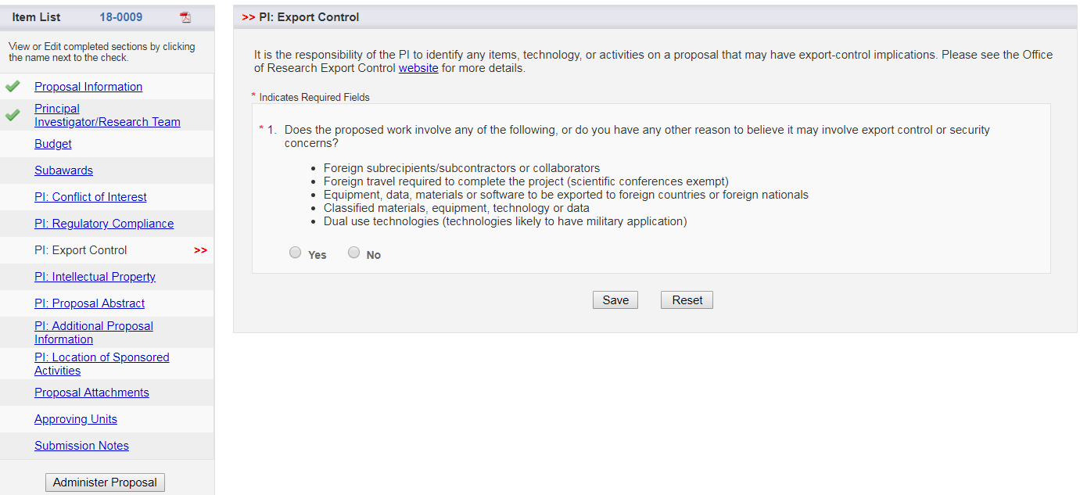

Slide 11
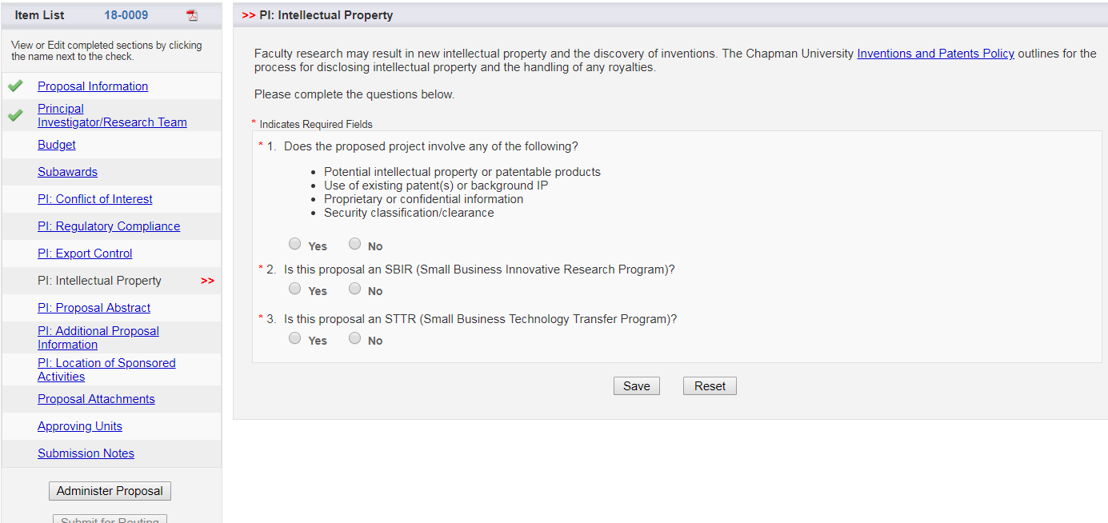

Slide 12
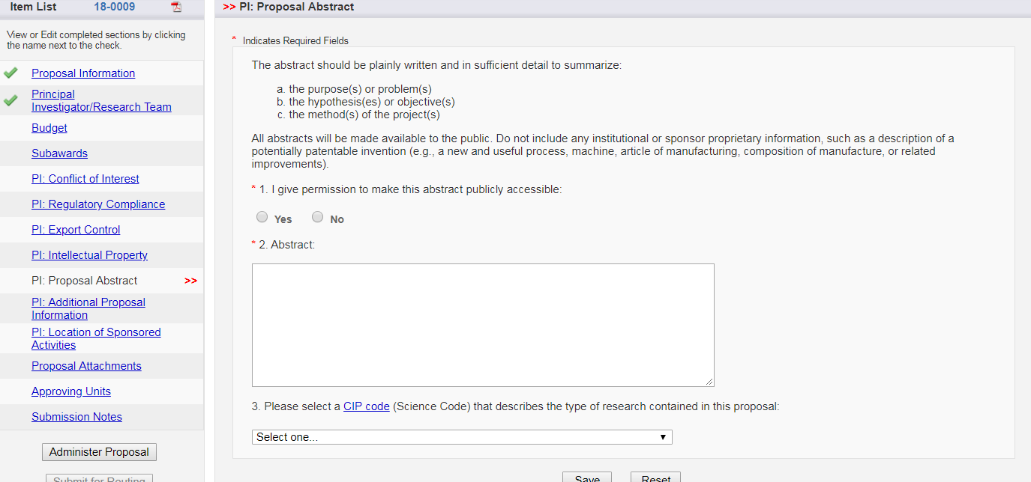
This permission authorization is regarding internal Chapman permissions only.
If Abstract/Summary is uploaded to Cayuse SP as an attachment, please enter Attached in this text box.

Slide 13
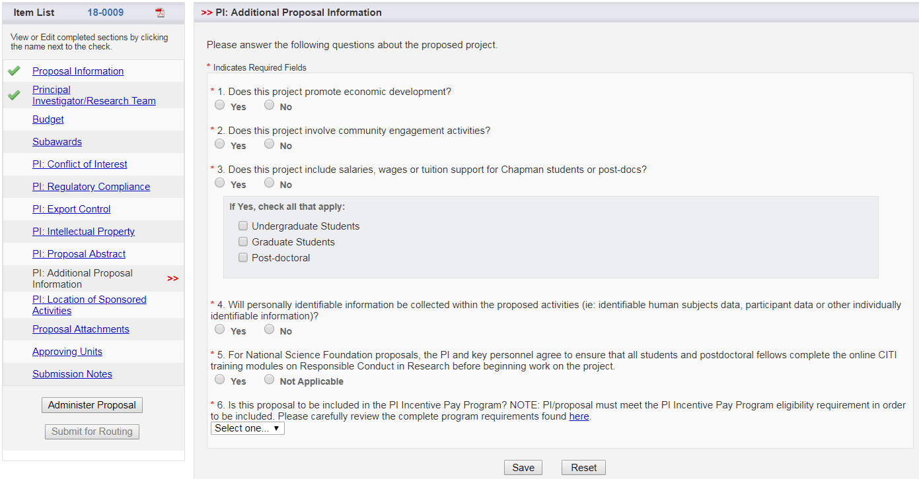
IMPORTANT: Be sure to answer this question regarding PI Incentive Pay Program, since the university policy states PIs must opt in at the time of proposal.

Slide 14
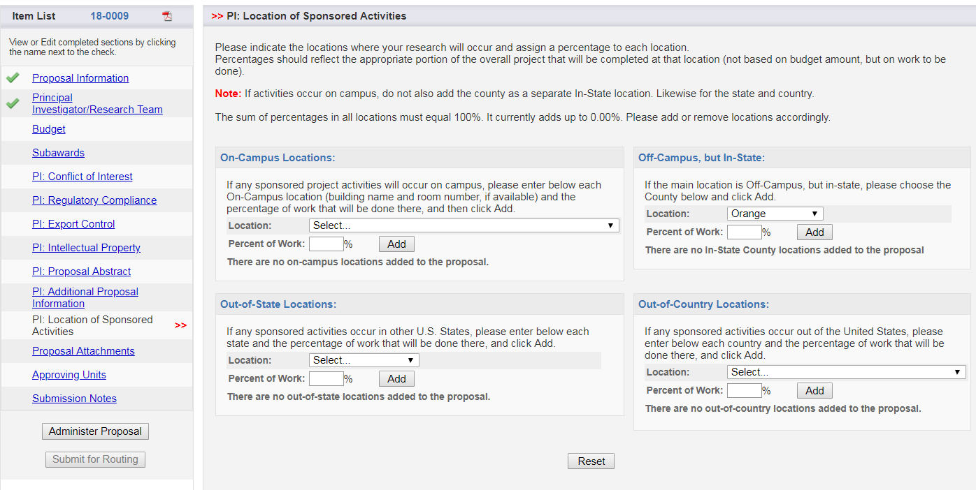

Slide 15
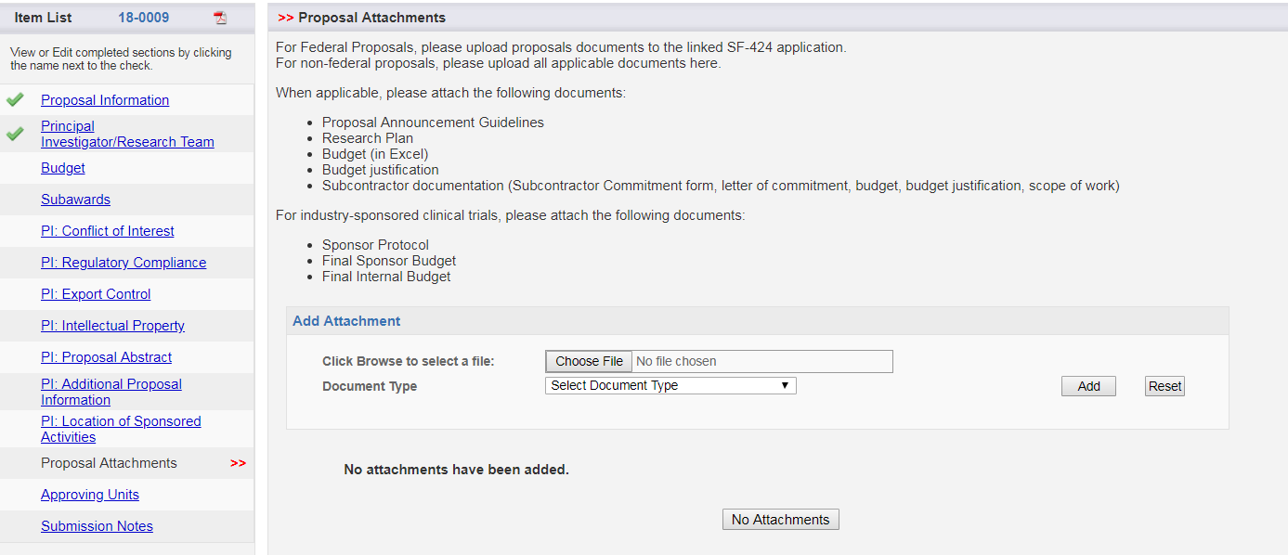
Please note instruction regarding proposal documents.

Slide 16
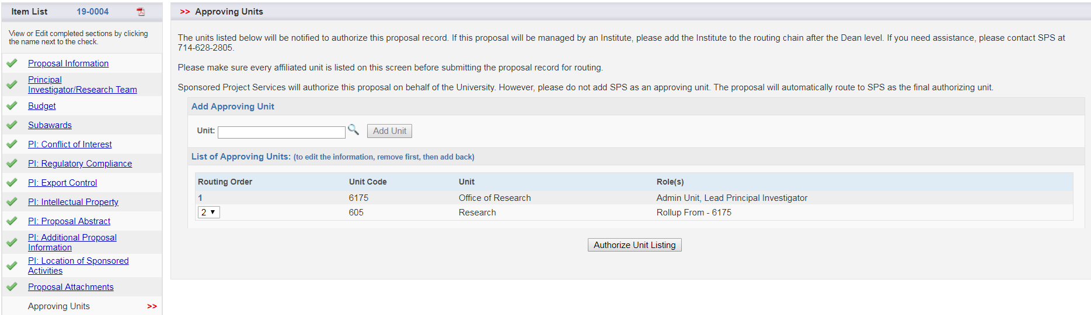
IMPORTANT: Review Approving Units list above. If the list appears correct, click Authorize Unit Listing. If the list appears to be incorrect, please contact your SPS Research Administrator for assistance.

Slide 17
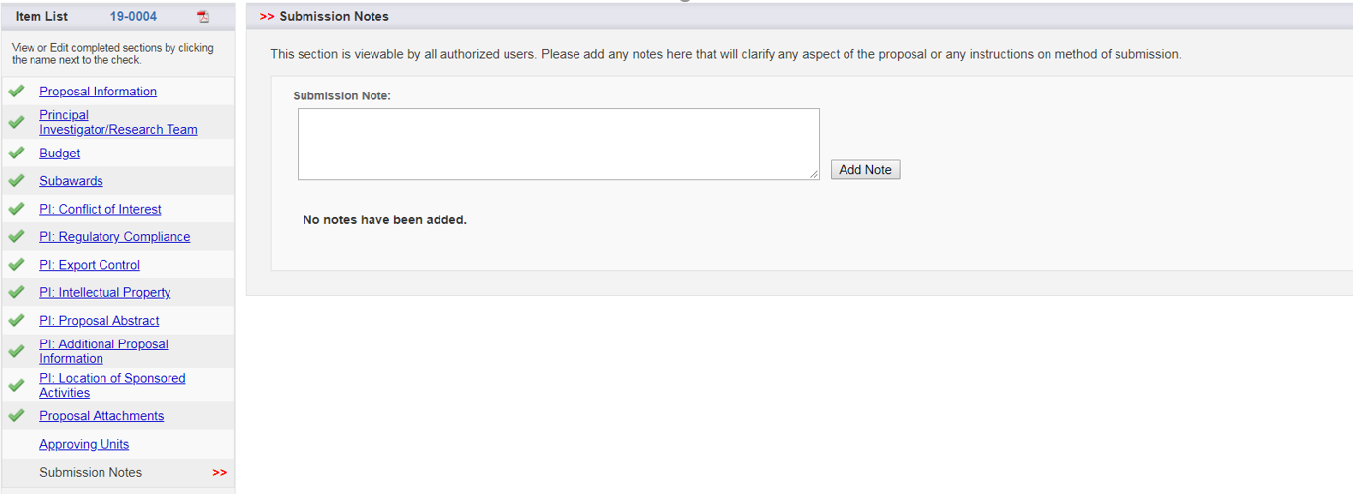

A complete list of green checks appears when all required items have been completed. Please notify your SPS Research Administrator when you are ready to route your proposal.

Slide 18
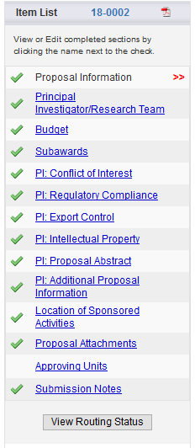
Once a proposal has been submitted for routing, the status of approvals can be viewed here.

Slide 19
REMINDERS:
  Non-federal (Cayuse SP only)
  Federal (Cayuse SP and Cayuse 424 application)
Please remember to contact SPS at any time if you need assistance. We’re happy to help!
Molly McCarty, Co-Director SPS, Pre-Award, ext. 7394
Megan Faulkner, SPS Research Administrator, ext. 5459

