Slide 1
Paws Up for Workplace Wellness and Engagement: Intellectual Wellness
Working Remote Committee
Thursday, June 17, 2021 3:00 p.m. – 3:45 p.m.
Jen Ruby, Manager – Wallace All Faiths Chapel
Annie Tang, Coordinator of Special Collections & Archives and Librarian for art and Film & Media Arts
Notes:
Welcome to the Paws up for Workplace Wellness and Engagement event for Intellectual wellness.
We are so glad that you are here and that you joined us! It is great to see all of your faces. I am your co-host, Jennifer Ruby, Manager of the Wallace All Faiths Chapel at the Fish Interfaith Center.
PAUSE
And I am Annie Tang, Coordinator of Special Collections & Archives, Subject Librarian for Art and Film & Media Arts
Annie will be co-hosting with me today

Slide 2
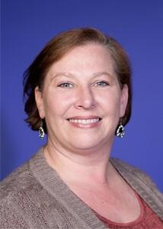
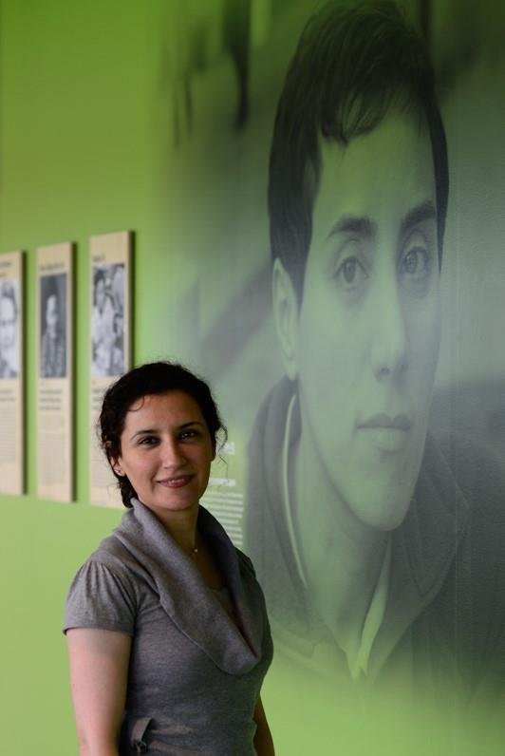
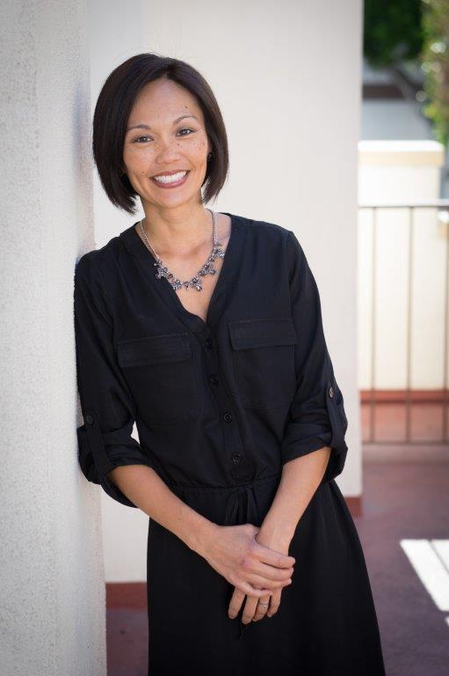
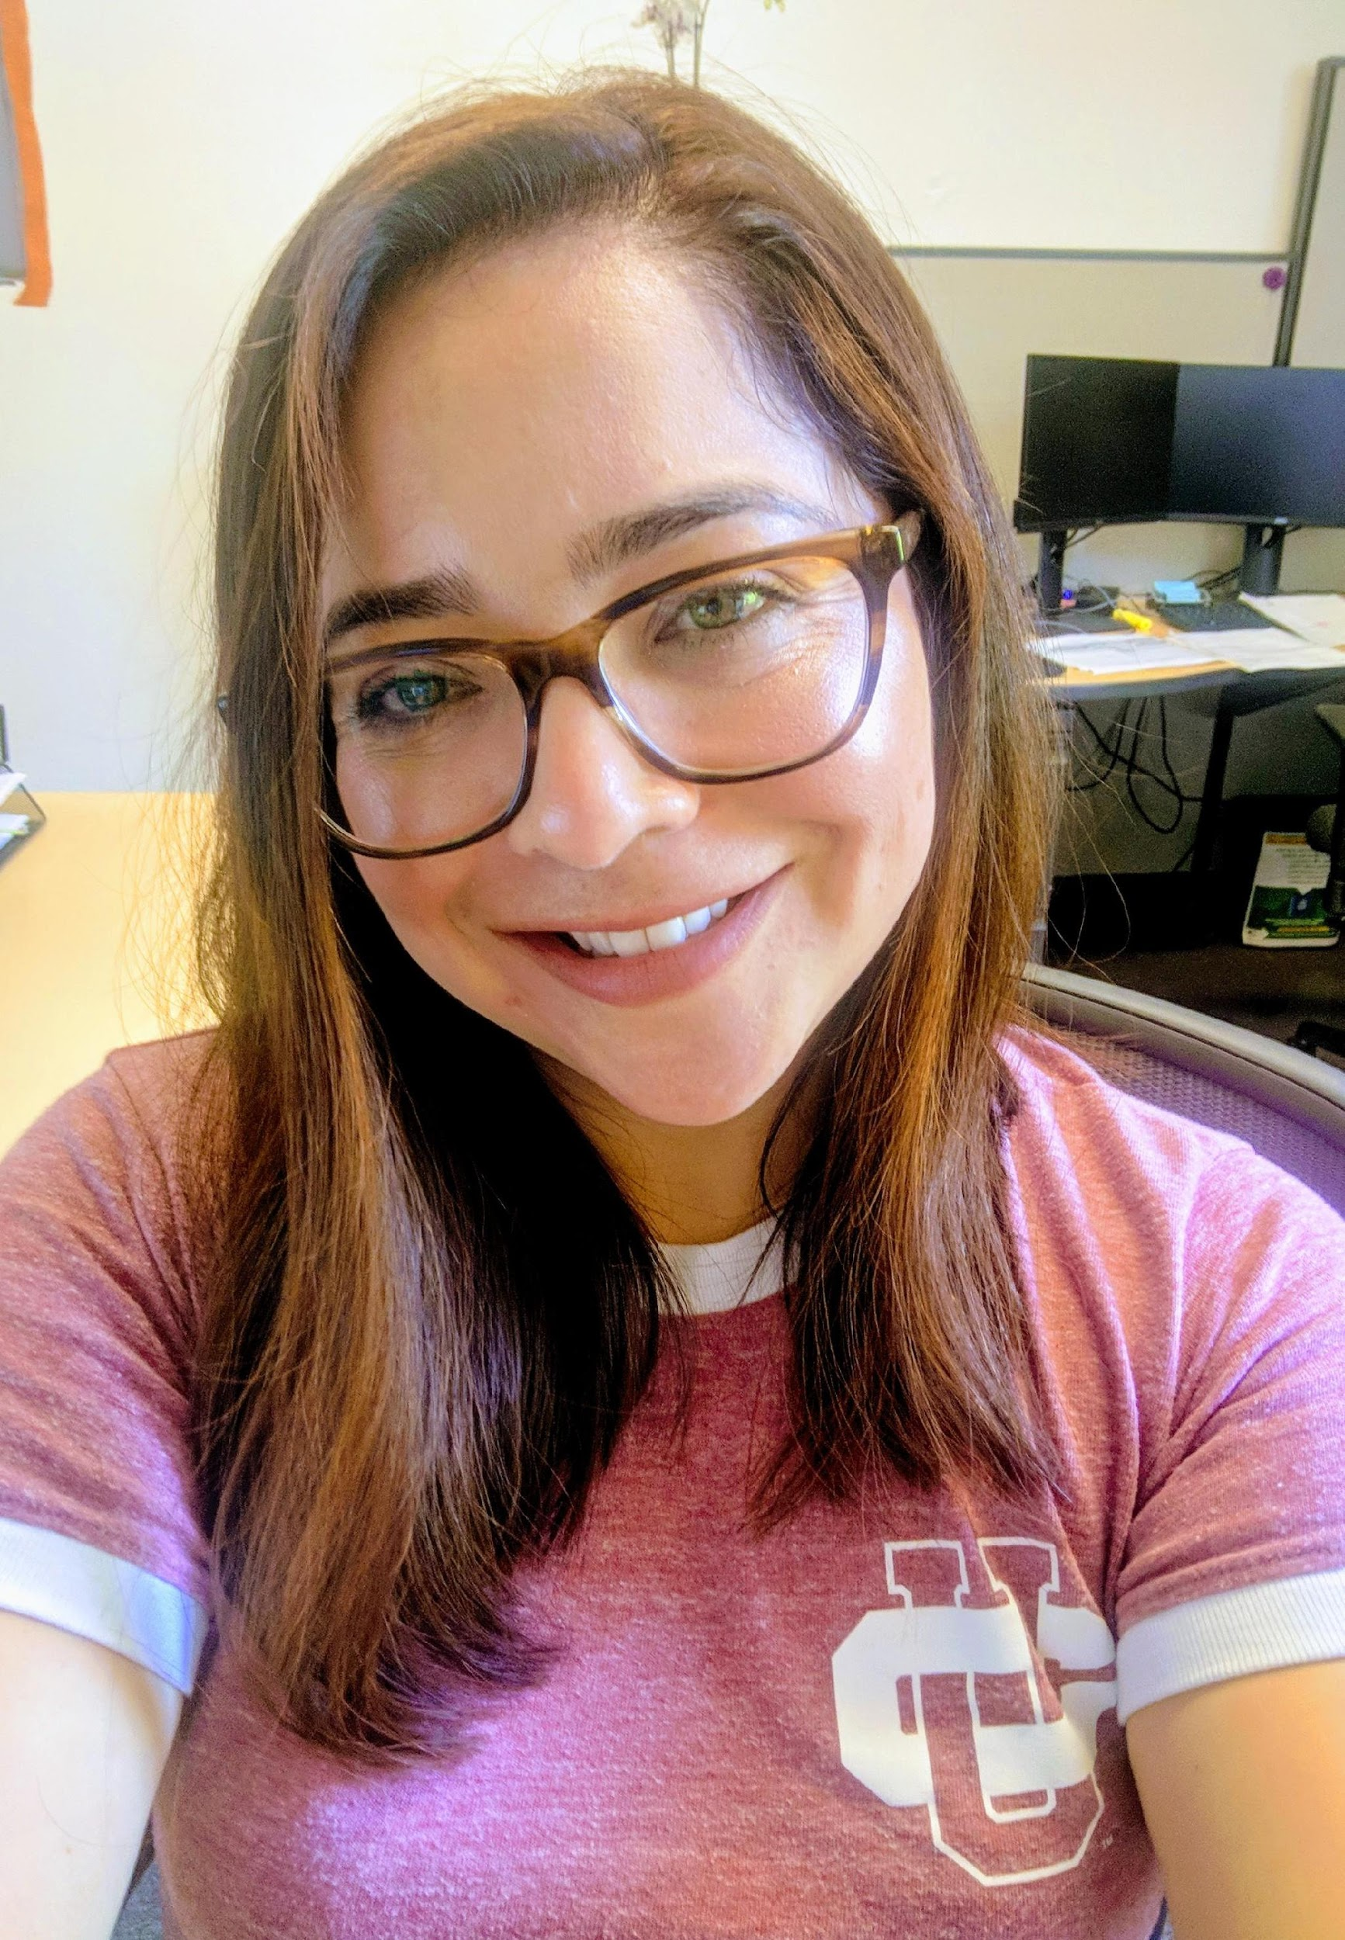
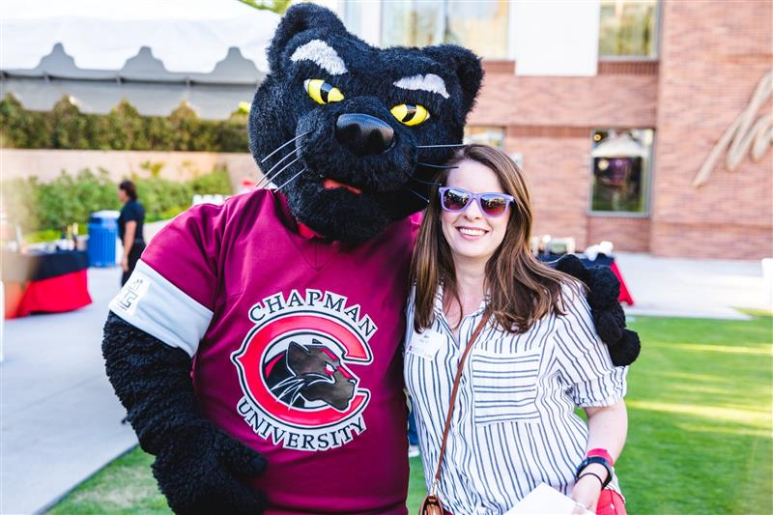
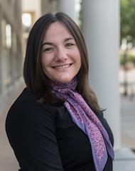
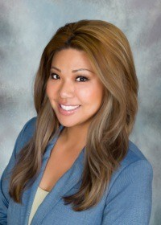
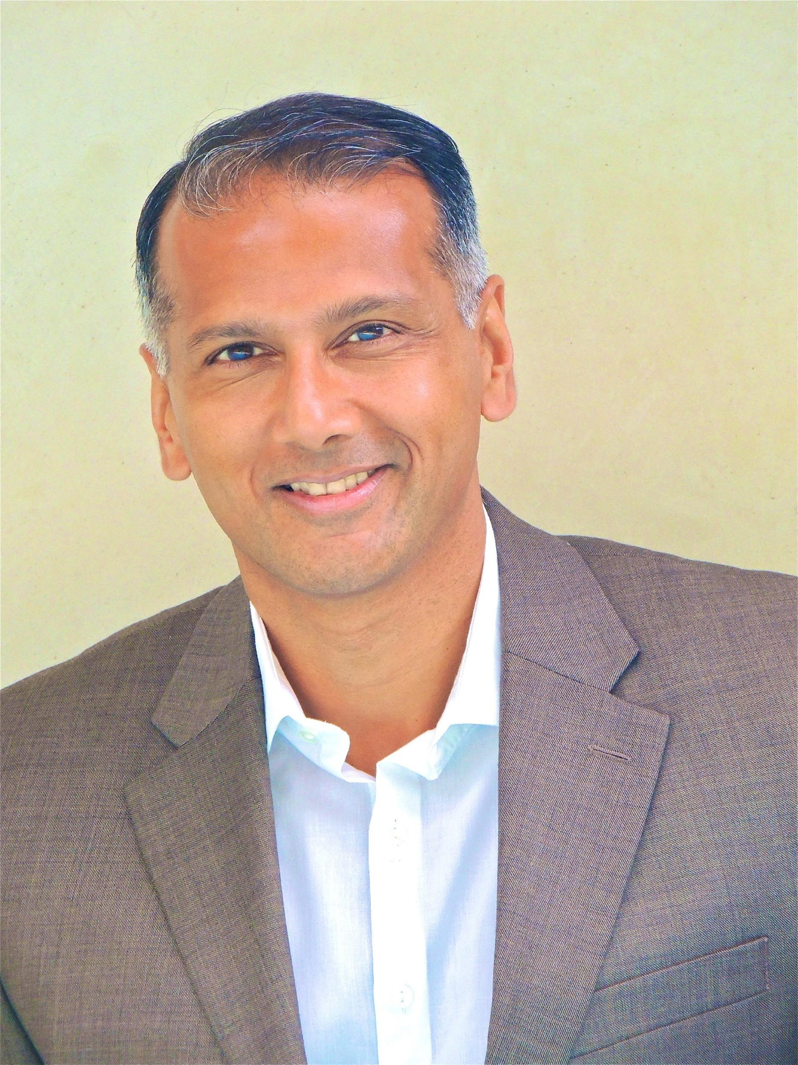
“Paws Up for Workplace Wellness and Engagement Series” Team
About the Committee that brought you this series:
Jill Borland
Director, Sponsored Projects Services
Anali Makoui, Director, Strategic
Communication and Assessment,
Human Resources
Michelle Sypinero, Director, Client Services,
Information Systems and Technology
Martha Castrejon,
Talent Specialist, Human Resources
Jen Ruby, Manager,
Fish Interfaith Center
Rachael Martin, Assistant Vice President,
Talent Management, Human Resources
Sharon Krueger, Director, Administrative Operations, Human Resources
Margaret Olano, Assistant Director, Operations,
Schmid College of Science and Technology
Tim Frenchcampbell, Wellness and Leave Administration Specialist for Human Resources
Amy Stevens, Director of Public Relations for Strategic Marketing and Communications
Joseph Anderson, IS&T Client Services/Media Technician
Jay Kumar, Director of Contemplative Practices
and Wellbeing for the Fish Interfaith Center
Notes:
This event is part of the working remotely series and as a friendly reminder - staff and administrators who participate in the event agree to use their image or likeness for promoting future paws up for wellness and engagement events. We cannot do these events, without the support from our amazing team, so I want to recognize our committee members who helped to make these events a reality.
They are an integral part of the planning phase, as well as serving behind the scenes, on the day of the event. Let’s give these wonderful members a round of applause for their amazing efforts. (pause for applause)

Slide 3
Eight Dimensions of Workplace Wellness & Engagement
Notes:
Today’s event is part of our working remotely series which consists of nine events that started last November and run through this coming July, the series focuses on the eight dimensions of wellness . So far we have covered six dimensions and two more to go! Today’s event cover’s intellectual wellness and our next event covers physical wellness. We look forward to seeing you at those events.

Slide 4
Learning Objectives
• Learn about the resources Chapman has
• Engage with your coworkers in this event
• Find ways to nurture your own intellectual wellness
Notes:
These are the learning objectives for this event. We hope that you
Learn about the resources Chapman has
Engage with your coworkers at this event
&
Find ways to nurture your own intellectual wellness
Now we will cover some resources that Chapman offers

Slide 5
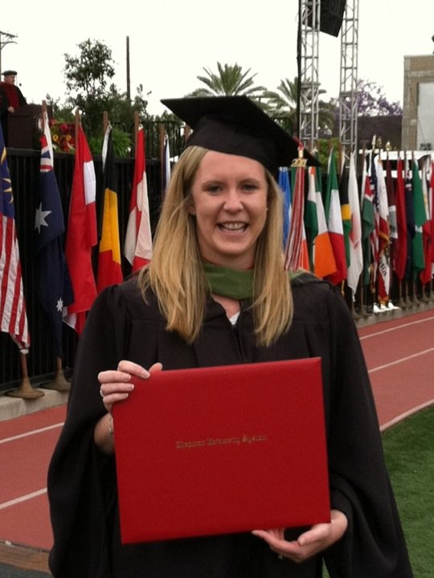
Tuition Remission
Staff and Administrators may qualify for tuition remission
Notes:
Tuition Remission – I Loved Sarah’s Kudoboard Post on this resource! Eligible Chapman employees may qualify for tuition remission. Additionally, Chapman also offers a tuition discount and has a tuition exchange program for eligible family members and dependents. For more information, please visit the corresponding sections on the Benefits webpage.

Slide 6
LinkedIn Learning
LinkedIn Learning Tutorials and Training Resources
Notes:
LinkedIn Learning.
Allison and Cheryl mentioned this resource on their Kudoboard posts! Chapman Employees have access to LinkedIn Learning until August. Take advantage this summer of all of the great tutorials and trainings. For those of you who participated in last month’s event you were able to see Dr. Jay Kumar’s tutorial! Check out the chat for the link to more information on LinkedIn Learning.
https://www.chapman.edu/campus-services/information-systems/training/linkedin-learning.aspx
https://www.chapman.edu/campus-services/information-systems/training/linkedin-learning.aspx
LinkedIn Learning Tutorials and Training Resources
LinkedIn Learning (Formerly Lynda.com)
LinkedIn Learning is the leading provider of online software training videos, with on-demand access to videos on software, digital design, digital media techniques, and more. But it's not just for the tech savvy. Straightforward and easy-to-follow training can help anyone learn, master, and apply digital tools and techniques, from the digital novice all the way to the seasoned pro.
Search and learn topics by subject, software, vendor, or author. Whether you're learning Microsoft Excel basics, brushing up on your Photoshop skills, or mastering web design and development, with access to more than 58,000 online video tutorials, the world is your digital oyster. With new training materials added monthly, you'll never run out of new things to help fill the old brain.
Visit the LinkedIn Learning site and log in with your Chapman user ID and password.
Login Instructions:
Click "Sign in" in the top right corner of the LinkedIn Learning home page.
Click "Sign in with your organization account" below the blue login button.
Enter your Chapman University email address and click "Continue".
You will then be re-directed to the Chapman University Single Sign-On page where you will need to enter your full "Chapman email address and password".

Slide 7
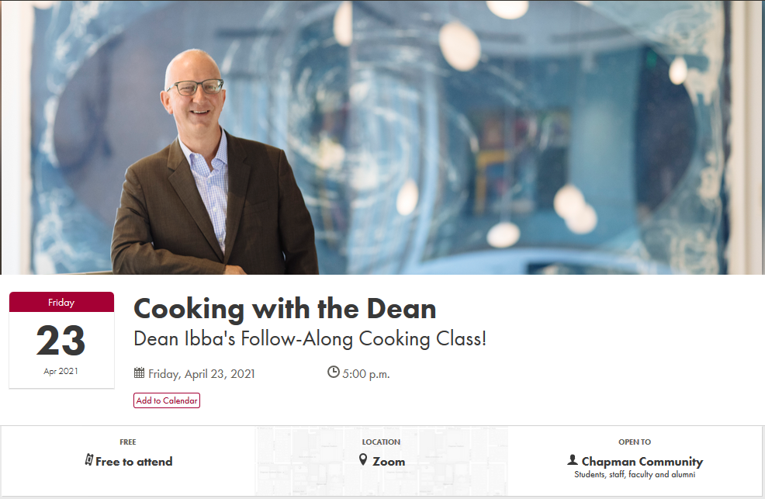
Events, Master Classes and more!
Events
Master Classes
Concerts
Art Walks with your pup
and more!
check out events.chapman.edu for opportunities
Notes:
Events, Master Classes and More! We work at this incredible institution with all sorts of opportunities for staff. I highly recommend checking out events.chapman.edu and sorting by staff. This will bring up any event that staff are welcome to. You never know what new skill you might hear about or what fun fact about Chapman’s art collection you might learn. Not to mention the benefit of getting to see our fellow coworkers!
And now I would like to welcome Annie to share with us about our amazing Leatherby Libraries!

Slide 8
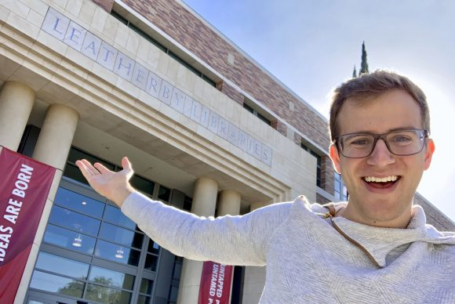
Leatherby Libraries
Learn more about Chapman University’s Leatherby Libraries at
https://www.chapman.edu/library/index.aspx
or email Annie at awtang@chapman.edu
Notes:
Learn more about Chapman University’s Leatherby Libraries at
https://www.chapman.edu/library/index.aspx
or email Annie at awtang@chapman.edu

Slide 9
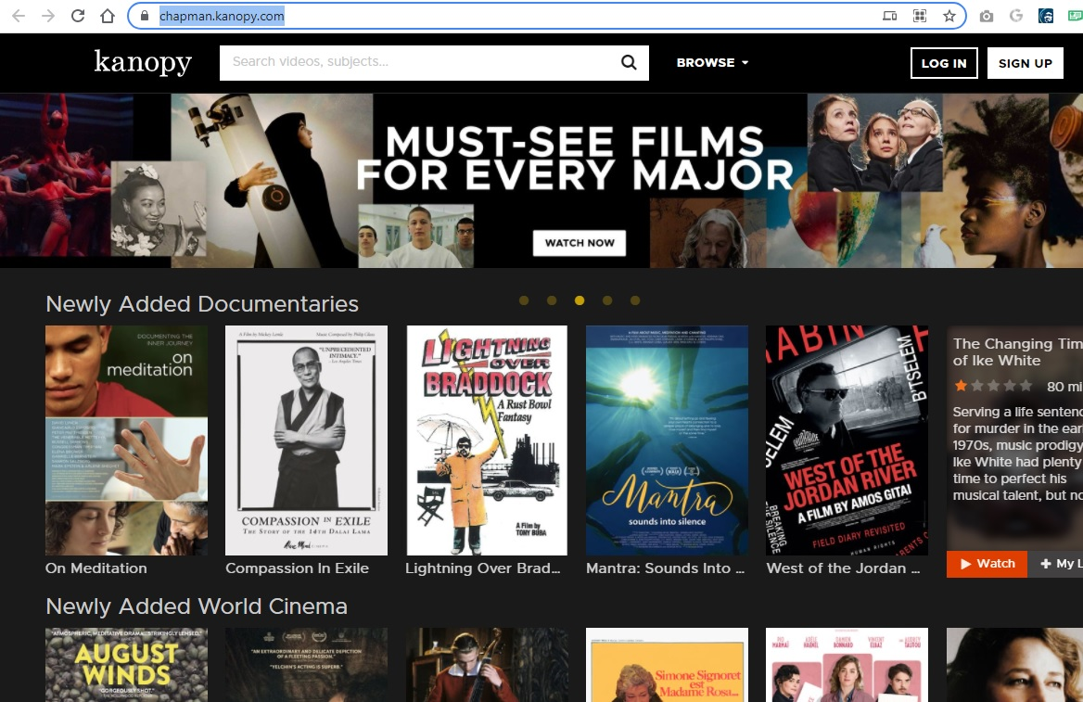
Leatherby Libraries: Services
Checking out books, DVDs, and more
Streaming content
Research assistance/instruction
Notes:
Checking out physical media: https://www.chapman.edu/library/index.aspx
Streaming video content: https://www.chapman.edu/library/_files/documents/policies/streamingvideopolicy08.27.20.pdf

Slide 10
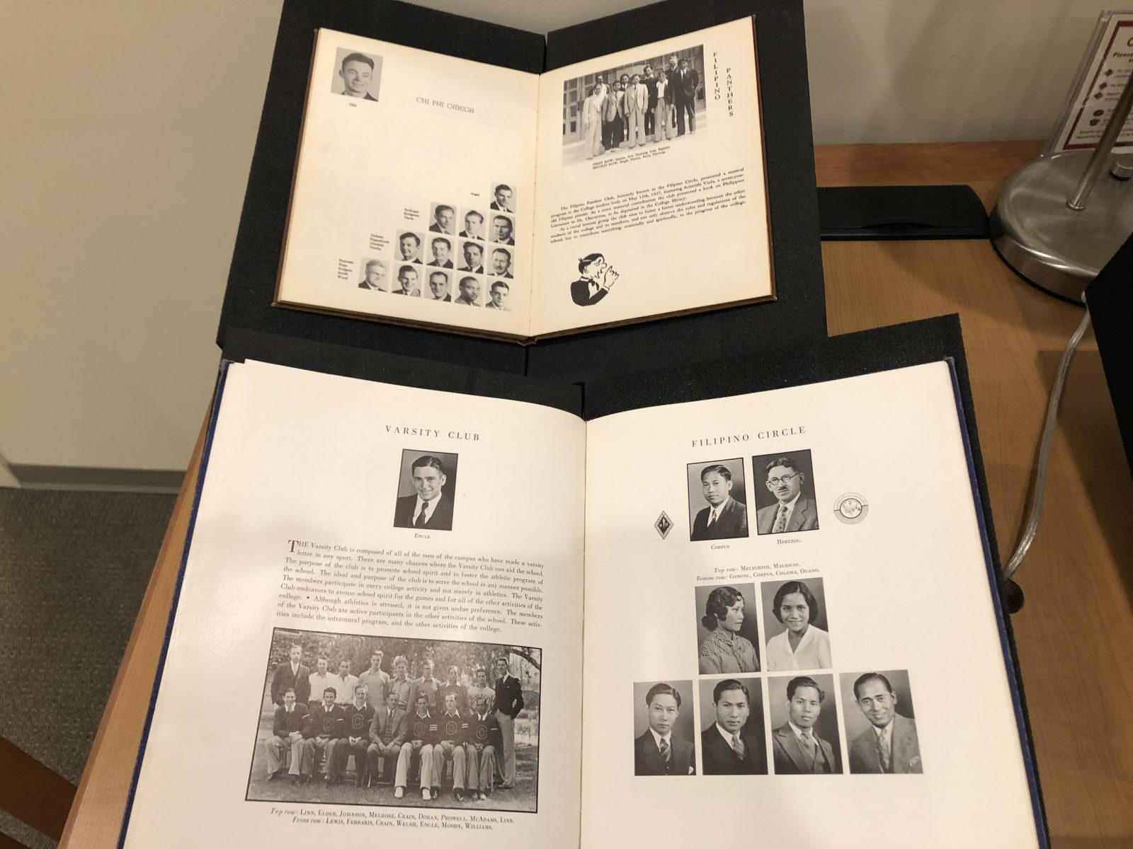
Leatherby Libraries: Outreach
Events
Exhibits
Displays
Yearbook pages from the 1920s revealing the faces of the Filipino Circle club.
Notes:
Examples of:
Events: Join the Leatherby Libraries This Summer for Virtual Community of Readers 2021
https://blogs.chapman.edu/library/2021/06/04/join-the-leatherby-libraries-this-summer-for-virtual-community-of-readers-2021/
Exhibits: https://blogs.chapman.edu/library/2019/06/27/pinoy-panthers-the-history-of-filipino-and-filipina-students-at-chapman-university/
Displays:
https://scalar.chapman.edu/scalar/celebrating-lgbtq-pride-month-at-the-leatherby-libraries/index

Slide 11
Intellectual Wellness Opportunity Drawing
Notes:
Let’s have some fun!
Before Michelle spins the Prize wheel, I want to go over the rules to ensure we are all on the same page.
A kudoboard post and attendance at this event were required for you to be eligible to win a prize, you must be present when your name is called to win.
There is only one prize per employee.
If your name is selected, please be ready to share your Kudoboard post. Margaret will share the link to the Kudoboard post in the chat. And if you can take some time to make sure you get that set up for yourself. Participants who post to the Kudoboard agreed to have it displayed on the working remote series on the HR webpage. Alright everyone!!! Ready!?!?!!?!?
I will now unshare so Michelle Can Share the Wheel of Names
If you won a prize, please email krueger@chapman.edu with your home address and to discuss possible pick up/delivery options
CHANGE SCREEN SHARE TO WHEEL OF NAMES

Slide 12
Thank you
Reminder:
Continue to visit the Paws Up for Workplace Wellness and Engagement website for information on this series.
If you won a prize, please email Sharon Krueger krueger@chapman.edu with your home address and to discuss possible pick up/delivery options.
Keep a look out for our upcoming survey!
Join us for our next program:
Physical Wellness
Facilitated by Anali Makoui, Margaret Olano & Martha Castrejon on Wednesday, July 14, 3:00 p.m. – 3:45 p.m.
Notes:
a. Thank you so much for joining us today! It was such a joy to see everyone! And I hope that everyone was able to take away some resources and tips to incorporate Intellectual Wellness into their lives both at home and at work.
b. Please continue to visit our webpage, Paws Up for Workplace Wellness and Engagement for information on our series
c. If you won a prize, please email Sharon Krueger to discuss p/u from the mailroom
d. The kudo board is available for viewing on the Working Remote Series section of the HR webpage
e. keep eyes out for our upcoming survey on the Paws up for Workplace Wellness Series
e. Don’t forget to mark your calendars and Join us for our next program!
i. Physical Wellness
ii. Facilitated by Anali Makoui, Margaret Olano and Martha Castrejon on Wednesday, July 14 at 3pm

Slide 13
Paws Up for Workplace Wellness - Intellectual Wellness
Today's program has ended.
Join us next time for Physical Wellness
Wednesday, July 14
3 p.m. – 3:45 p.m. PT

