Slide 1

People Soft Finance
2021-2022 Fiscal Close Workshop

Slide 2
Agenda
Fiscal Year End Basics
Helpful Reports
Common issues that delay processing and closing
Concur—Travel/Expense/P-Cards
New Fiscal Year – 22/23 activities
Approver’s Out of Office Delegate Reminder
Contacts

Slide 3
FY 21/22 Year End Prep—The Basic Steps……
Review 21/22 Departmental Fiscal Closing Calendar.
Close existing Purchase Orders.
PO must be fully-paid, with no outstanding vouchers.
Contact Purchasing@chapman.edu to close.
Ongoing POs allocated to Sponsored Grants and/or Capital Projects do not need to be closed.
Close Cash Advances/Travel Requests to relieve encumbrance.
Unissued requests must be closed/inactivated in Concur.
Issued requests must be reconciled by completing the Concur expense report.
Review YTD Activity.
Review expenses for correct Department/Program.
Begin any correction requests promptly.
Ongoing Activity.
Review worklists frequently and take appropriate action—Approve/Deny/Send Back.
Ensure items are moving through workflow—Are Out-of-Office flags in place?

Slide 4
FY 21/22 Year End Prep—The Basic Steps……
Here to Help.
Servicedesk@chapman.edu
Purchasing@chapman.edu
AccountsPayable@chapman.edu

Slide 5
Helpful Reports
Budget Summary Inquiry
Can drill down – Details available
Has Encumbrance and Available Budget Balance
Downloadable to Excel
KK Detail
Similar to GL transaction Detail - identifies transactions by ENC, PreENC and Expenses to find out of balance transactions
Req and PO Budgetary Activity Report
Has Summary of PR and/or PO balances
PO Activity Report
Shows PO’s current statuses (Complete/Close, Dispatched, Pending Approval, Open)
PO Listing Detail
Has AP Voucher and PO Line Detail
PO Status Summary Query
Has Chartfield, AP Vouchers, Receipt #s, and Invoice #s
GL Transaction Details
Has Actuals

Slide 6
Common Issues--that delay processing & impact closing
PO invoices with Match Exceptions: Non-Receiving, Receiving in the wrong line, or not enough fund left in the PO to pay invoices.
Expense Report Pending Department’s action: Initiated but not submitted in Concur and submitted but pending approval in Concur.
Budget block: not enough fund to pay expenses or no budget exists.
Worklist: not checked or acted on regularly.
Out Of Office Delegate: not set up when the approver is out of the office.

Slide 7
PO Invoice Receiving - Reminder
Receive your invoice on time in PS. (Please refer to deadlines on checklist)
Receive in the correct line.
Receive the correct amount and/or quantity.
Use the correct receiving date.
Always compare your invoice and PO. Make necessary adjustment with Purchasing if PO needs to be modified before invoice can be paid.
Make sure you have enough funding in the PO before you receive your invoice in PS.

Slide 8
Concur Travel Expenses
Travel Requests for FY 22/23 Please wait until 6/1 or after to enter TR.
ONLY ENTER Travel Requests between now and 5/31/22 if need Cash Advances.
Travel Requests and Cash Advances MUST be fully approved in Concur before CA can be paid.
For future year travel entered this year, under Expense Type, select “Future Year Travel”.

Slide 9
Concur Travel Expenses (continued)
21/22 Travel Expense and Reimbursement Report must be submitted online in Concur and fully approved on or before June 3rd, 2022.
Expense Report must associate with both TR and CA when they are applicable.
Clearing unused TR Encumbrances – Reminder: “Close/Inactivate Request” in Concur relieves encumbrances
If there is a CA outstanding, please submit Expense Report to clear encumbrance and advance.
Expense Report must have itemized expense type to ensure accounting line is properly recorded.
Travel crossing fiscal year(s) --If the majority expenses fall in the current FY, submit for the CY. Otherwise, submit for the next FY. If not fully approved by May 31, all travel expense report should be added to accrual worksheet. (Do not include Pcard transactions on accrual worksheet.)

Slide 10
Concur P-card Expense Reporting
P-Card transactions should be reconciled, submitted and fully approved in Concur for cycle 4/27 to 5/27/22 no later than 5:00pm on June 3rd to ensure posting to departmental GL in MAY 2022 ledger.
P-Card transactions between 5/28 to 5/31/22 will be forwarded to the cardholders individually after 5/31/22 to provide allocations for FYE accrual only
Questions related to Concur Pcard Reconciliations, please contact Heidi Negret at Negrete@chapman.edu

Slide 11
FY 20/21 New Year Reminder
Reminder: Receipts – Be sure to enter PO receipts for FY21/22 when goods are received, or service rendered.
Requisitions for new FY 22/23 – Requisition date, Budget date, and Accounting date, must all show 06/01/2022. For any further concern or assistance, please contact Purchasing department (purchasing@chapman.edu).
Prepayments– Should be recorded as “Current Year” if entered on or after June 1st.

Slide 12
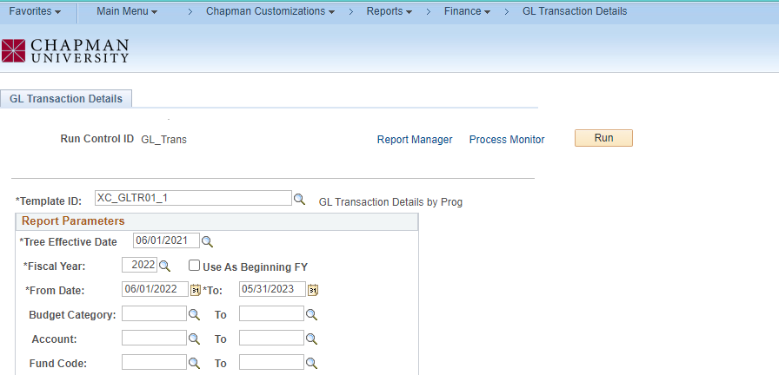
FY 22/23 New Year Reminder - Continued
Running Reports – for new 22/23 year when prior year still not rolled with Balance Forwards. Input the “from” year dates as beginning dates for balances.

Slide 13
!! IMPORTANT !! Out Of Office Delegate
PLEASE COMMUNICATE TO ALL REVIEWERS AND APPROVERS
Don’t leave on vacation, on sabbatical, on leave or on business trips without setting your OUT OF OFFICE delegates in PeopleSoft and Concur
Set Both– Approvers need to set Concur Out of Office AND Peoplesoft Out of Office
P-card holders if out of office in May, please set up delegate prior to leaving the office.
Concur– P-card delegates are set in Concur
Please review PeopleSoft and Concur Approval Worklist regularly and take care of pending transaction timely.
Approver forgot to set OOO? Email servicedesk@chapman.edu requesting OOO setup. Specify the date range, alternate approver & include Dean/VP approval in the email.

Slide 14
Contact Information
Servicedesk@chapman.edu
Purchasing@chapman.edu
AccountsPayable@chapman.edu
Concur Pcard: Negrete@chapman.edu
Concur Expense Reports, Travel Requests & Cash advances: vanburen@chapman.edu

