Slide 1
Active Shooter Response
Strategies to Survive an Active Shooter on Campus
Notes:
Mark: You hear shots down the hall. What do you do?

Slide 2
RUN. HIDE. FIGHT.® Surviving an Active Shooter Event

Slide 3
Objectives
Define various shooting situations.
Provide general strategies for surviving an active shooter.
Do Something!
RUN, HIDE, FIGHT!
Discuss Police Response and Resources
Discuss pre-planning
Know your surroundings
Think “What if…?”

Slide 4
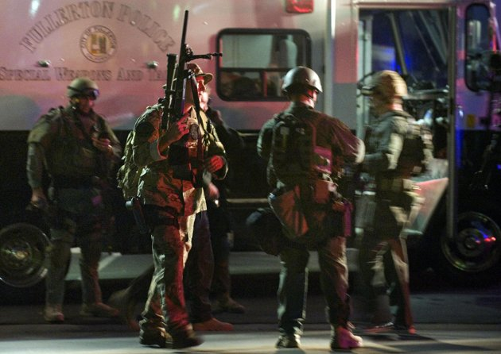
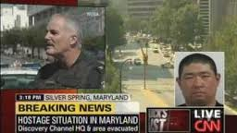
Shooter Situations
Barricaded Suspect
Hostage Situations
Active Shooter
Notes:
John

Slide 5
Active Shooter
An active shooter is an individual actively engaged in killing or attempting to kill people in a confined space or other populated area. In most cases, active shooters use firearms and there is no pattern or method to their selection of victims.
Active shooter situations are unpredictable and evolve quickly. Leaves little or no time for proper planning and requires law enforcement to take immediate action.
Active shooters usually will continue to move throughout a building or area until stopped by law enforcement, suicide, or other intervention. Typically, the deployment of law enforcement is required to stop the shooting and to prevent further harm to victims.
Notes:
John

Slide 6
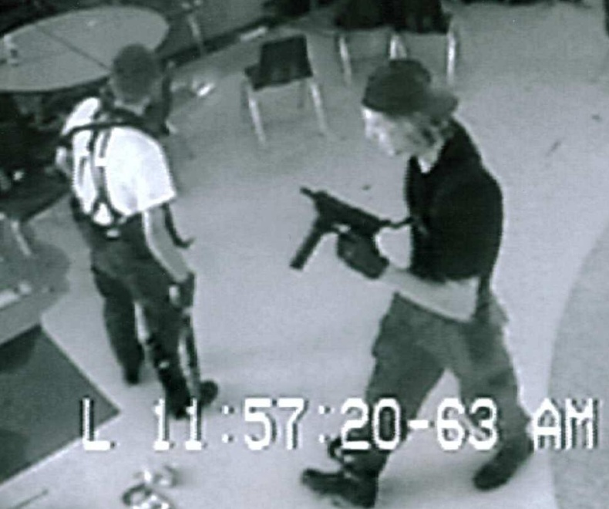
Active Shooter Mindset
Desire is to kill and seriously injure without concern for their safety or threat of capture.
Normally has intended victims and searches them out.
Accepts targets of opportunity while searching for or after finding intended victims.
Shooters mentality is not to escape. His/her goal is to kill and injure.
There is no “typical profile” for active shooters.
Notes:
Mark

Slide 7
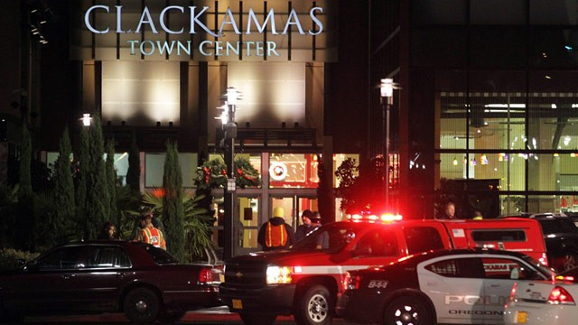
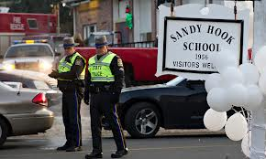
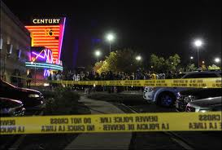
The Sad Reality
“The reality of the situation is – it’s a sad reality, but it’s reality – there are no sanctuaries anymore. We’ve seen this happen in schools, in malls, playgrounds, parks, churches. No place is safe anymore.”
Karl Kick, Washington Post
Notes:
Mark

Slide 8
Not a New Problem
University of Texas at Austin August 1, 1966
California State University, Fullerton July 12, 1976
San Diego State University August 15, 1996
Virginia Polytechnic Institute April 16, 2007
Northern Illinois University February 14, 2008
University of Alabama in Huntsville February 12, 2010
Notes:
Mark

Slide 9
Not a New Problem
Ohio State University March 9, 2010
University of Texas at Austin September 28, 2010
San Jose State University May 10, 2011
University of California, Berkeley November 15, 2011
Virginia Polytechnic Institute (Part Two) December 8, 2011
University of California, Santa Barbara May 23, 2014
Seattle Pacific University June 5, 2014
Notes:
Mark

Slide 10
Active Shooter Incidents in U.S., 2000-2013
Notes:
Mark

Slide 11
Active Shooter Incidents in U.S., 2000-2013
Notes:
Mark

Slide 12
Active Shooter Incidents in U.S., 2000-2013
Notes:
Mark

Slide 13
Active Shooter Incidents in U.S., 2000-2013
Notes:
Mark

Slide 14
Active Shooter Incidents in U.S., 2000-2013
Notes:
Mark

Slide 15
True or False?
Many attackers felt bullied, persecuted or injured by others prior to the attack.
Most attackers showed some history of suicidal attempts or thoughts, or a history of feeling extreme depression or desperation.
Most attackers had no history of prior violent or criminal behavior.
Incidents of targeted violence at school rarely are sudden, impulsive acts.
Prior to most incidents, other people knew about the attacker’s idea and/or plan to attack.
While Chapman has resources to identify individuals of concern, there is no “crystal ball” to determine who will become an Active Shooter.
Notes:
Mark: In 80% of incidents 1 other person knew; 60% at least 2 others knew.

Slide 16
Potential Indicators of Violent Behavior
Violent fantasy content
Anger problems
Fascination with weapons
Boasting and practicing combat proficiency
Loner
Suicide ideation
Homicidal ideation
Stalking
Non-compliance and disciplinary problems
Imitation of other murders
Interest in previous shooting situations
Victim/martyr self-concept
Strangeness and aberrant behavior
Paranoia
Violence and cruelty
Inappropriate affect
Acting out
Police contact
Mental health history related to dangerousness
Expressionless face
Unusual interest in police/military/terrorism activities and materials
Use of alcohol/drugs
Source: Virginia Tech Panel Report
Notes:
John

Slide 17
Active Shooter Myths
“He didn’t fit the profile.”
“He just snapped.”
“No one knew.”
“He hadn’t threatened anyone.”
“He was a loner.”
“He was crazy.”
“If only we’d had a SWAT team or metal detectors.”
“He’d never touched a gun.”
“We did all we could to help him.”
“School violence is rampant.”
Source: Secret Service Study
Notes:
Mark

Slide 18
The Biggest Myth
Notes:
Mark

Slide 19
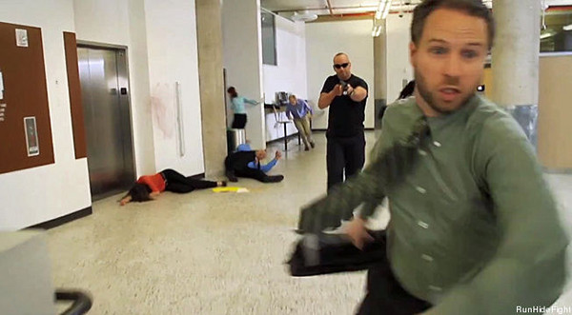
Active Shooter on Campus
DO SOMETHING!
Run!
Hide!
Fight!
Notes:
Mark

Slide 20
If Active Shooter is in Your Immediate Vicinity
DO SOMETHING!
Stay calm and focus on survival.
Evacuate and RUN from the shooter if you feel you can get out.
Evacuate regardless of whether others agree to follow
Leave your belongings behind
Help others escape, if possible, but do not attempt to move the wounded.
Notes:
Mark

Slide 21
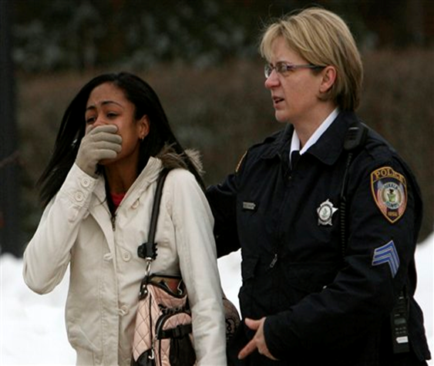
Northern Illinois University
NIU Student Witness Lauren Carr
“I could get up and run, or I could die here. A student in the front row was bleeding, but he just kept running. I heard this girl scream, ‘Run, he’s reloading the gun!’”
Notes:
Mark

Slide 22
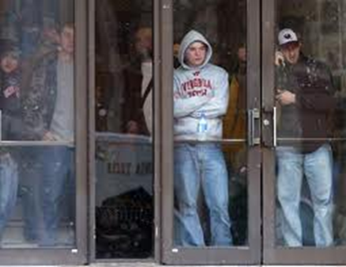
If Active Shooter is in Your Immediate Vicinity
If evacuation is not possible find a place to HIDE.
Conceal and shield yourself behind something which will provide protection from bullets.
Spread out and try not to bunch up with others, making easy targets.
If indoors, get into a room and
Lock the deadbolt
Barricade the door
Close blinds and turn off lights
Eliminate all sounds of activity and remain quiet
Place cell phones on vibrate
Notes:
Mark

Slide 23
Northern Illinois University
NIU Student Ashley Dallman
Was in an acting class in another building when Cole Hall students came running in and informed them of the shooting
“We all started crying. We didn’t know what to do.”
Professor locked the doors and they listened to news reports on the radio for about an hour before school official told them to leave
Notes:
Mark

Slide 24
Northern Illinois University
NIU Faculty Michael Gentile
Was meeting with two students directly beneath the lecture hall when shooting happened
Heard gunshots and locked his office door
Remained barricaded until police arrived about 90 minutes later
Used surveillance camera just outside his office door to confirm that the people knocking on the door were the police
Notes:
Mark

Slide 25
If Active Shooter Enters Your Room or Office
Trust your instincts and DO SOMETHING!
As a last resort, your only option may be to FIGHT.
If you decide to FIGHT you must commit to it and not hesitate.
Coordinate an attack with the others in the room.
Use improvised weapons and throw items at head
Yell “gun!”
Charge together
Grab the gun, pointing the barrel away from you, and twist
Even if shot do not stop
You must become the predator to win and survive!
Notes:
Mark

Slide 26
Seattle Pacific University
The gunman was armed with a shotgun and more than 50 shells.
He fatally shot a 19-year-old freshman and wounded two other young people before his plan to kill as many people as possible — and himself — was thwarted.
Student Jon Meis was a building monitor who subdued the gunman as he stopped to reload his shotgun. Meis pepper-sprayed and tackled him, while several other bystanders also helped hold down the gunman until police arrived.
Notes:
Mark

Slide 27
Active Shooter on Campus
If and when it is safe to do so call 9-1-1 and provide the following information
Your name
Your location
Number of suspects
Suspect(s) description
Suspect(s) location
Suspect(s) weapon information
Suspect(s) direction of travel
Personal or group medical needs
Call back number
Do not hang up on dispatcher (unless your safety requires you to hang up)
Notes:
John

Slide 28
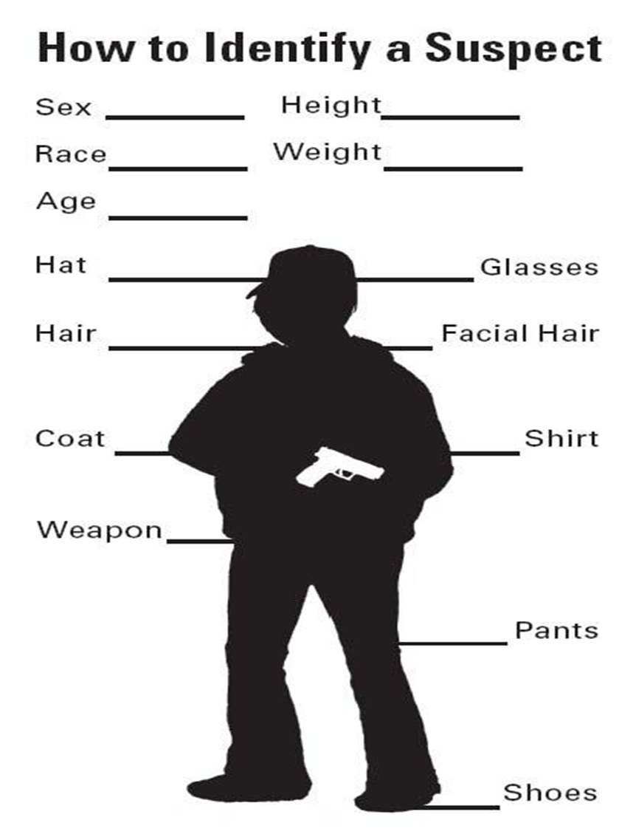
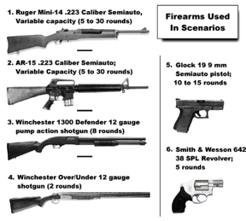
Suspect Description
Start from head to toe.
Think of as much as possible.
Don’t forget the weapon.
Notes:
John

Slide 29
What to Expect From Public Safety
The Department of Public Safety (DPS) coordinates planning and training with the following local agencies
Orange Police Department (OPD)
Orange Fire Department (OFD)
Orange County Sheriffs Department (OCSD)
Orange County Bomb Squad
Because DPS Officers are unarmed they must wait for an armed response from OPD.
DPS will provide OPD with the shooters last known location, descriptions, and facilitate access to campus buildings.
Notes:
John

Slide 30
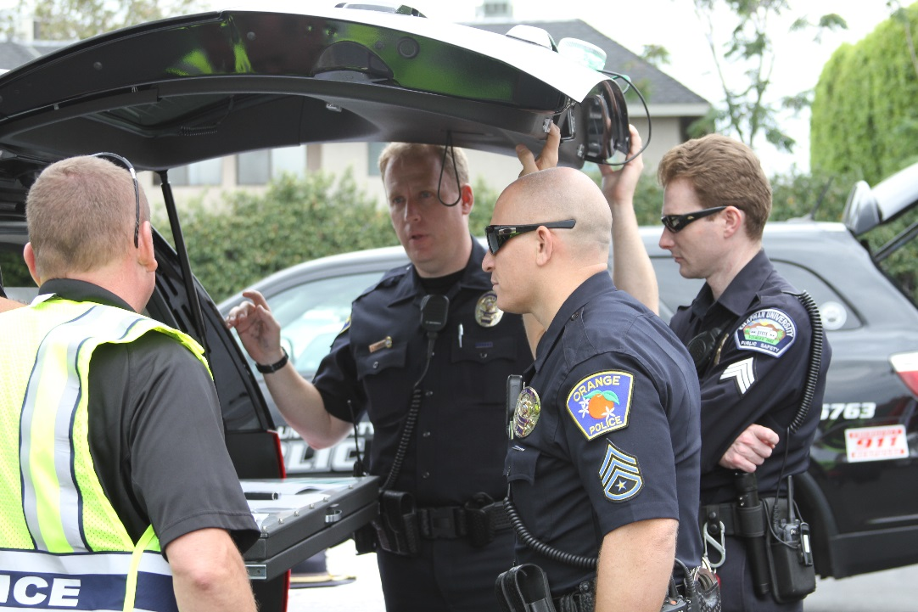
Coordinated Response
Notes:
John

Slide 31
Law Enforcement Response
Officers will respond to location of last shots
Officers usually arrive in teams of four (4)
Officers may wear regular patrol uniforms or external bulletproof vests, Kevlar helmets, and other tactical equipment
Officers may be armed with rifles, shotguns, handguns
Officers may use pepper spray or tear gas to control the situation
Officers may shout commands, and may push individuals to the ground for their safety
Notes:
John

Slide 32
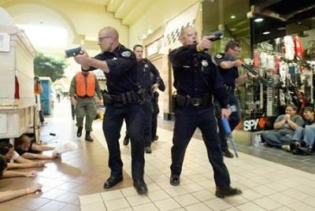
Law Enforcement Response
The first Officers arriving will not stop to help injured
Expect rescue teams comprised of additional officers and emergency medical personnel to follow the initial officers. These rescue teams will treat and remove any injured persons.
They may also call upon able-bodied individuals to assist in removing the wounded from the premises.
Notes:
John

Slide 33
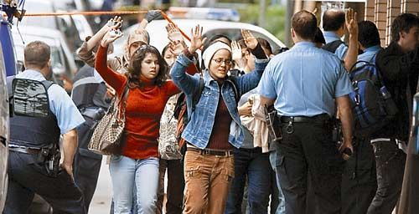
Law Enforcement Response
Remain calm and follow all directions
Keep your hands up in plain view, with nothing in them
Avoid making any quick or unexpected movements
Avoid pointing, screaming, yelling or grabbing onto officers
You will be escorted or directed to a safe location
Notes:
John

Slide 34
An Active Shooter Notification
Panther Alert: Armed individual at large on campus at (insert location). (Shots have been fired). Avoid the area. RUN, HIDE, FIGHT. Updates to follow.
Notes:
Mark

Slide 35
Plan and Prepare
You can’t make decisions if you don’t know it’s happening!
Register for Panther Alert today at https://web.chapman.edu/EmergencyContactInformation/
Know your exits and know your doors.
Have an exit strategy and a plan to lock your doors.
Have a Pre-Plan and identify safe spaces where you can easily shelter-in-place
Doors that can be locked
Moveable furniture that can be used to reinforce the door
A telephone in the room
First floor windows that open to provide means of escape
Hiding places
Wedges for the doors
Notes:
Mark

Slide 36
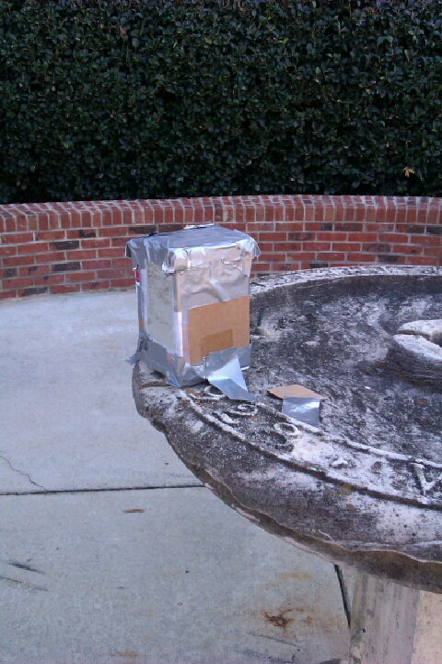
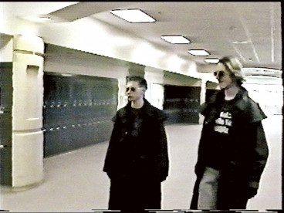
If You See Something, Say Something
There is no way to prevent an active shooter from coming to campus but detection is the best method of reducing the likelihood of an active shooter incident.
If you notice any odd or threatening behavior in any individual on campus, report it to DPS immediately at (714) 997-6763.
Notes:
Mark

Slide 37
Resources
Student Concern Intervention Team (SCIT)
http://www.chapman.edu/students/health-and-safety/student-concern/index.aspx
A program intended to encourage faculty, staff and students to report behaviors of concern by a Chapman student which may affect the community as a whole and get the student help.
Student Psychological Counseling Services (SPCS)
(714) 997-6778
Department of Public Safety
(714) 997-6763
Human Resources
(714) 997-6686
Notes:
John: Discuss SCIT

Slide 38
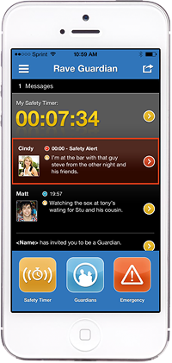
Panther Guardian
Turn your phone into a personal safety device.
Set a Safety Timer – Notify people you trust to check in on you if you are alone or in an unfamiliar place.
Manage & Message Your Guardians – Invite family, friends, or others to be your Guardian, and communicate with them within the app as needed.
Easy Emergency Communication – Call Public Safety directly for help if you are in trouble and send text tips – including photos – if you see something suspicious.

Slide 39
Questions?

