Slide 1
PeopleSoft Time & Labor
Time Reporter Training
September 2016

Slide 2
Agenda
PeopleSoft Time & Labor
Login Process
Timesheet Review
  Reporting Time
  Exceptions
Launch Pad

Slide 3
Time & Labor
PeopleSoft (PS) Time & Labor replaces current Web ATO
Approvals performed in the system
Hardcopies with manager’s signature no longer required (except when delegating)
Pilot User Group live with June 2016 timesheet
Remaining Admins live with Sept 2016 timesheet

Slide 4
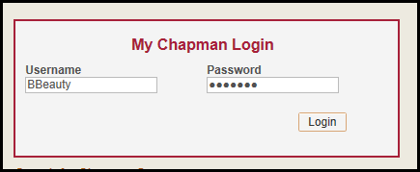
Login Process
Login through the portal
  https://my.chapman.edu
  Enter Username and Password

Slide 5
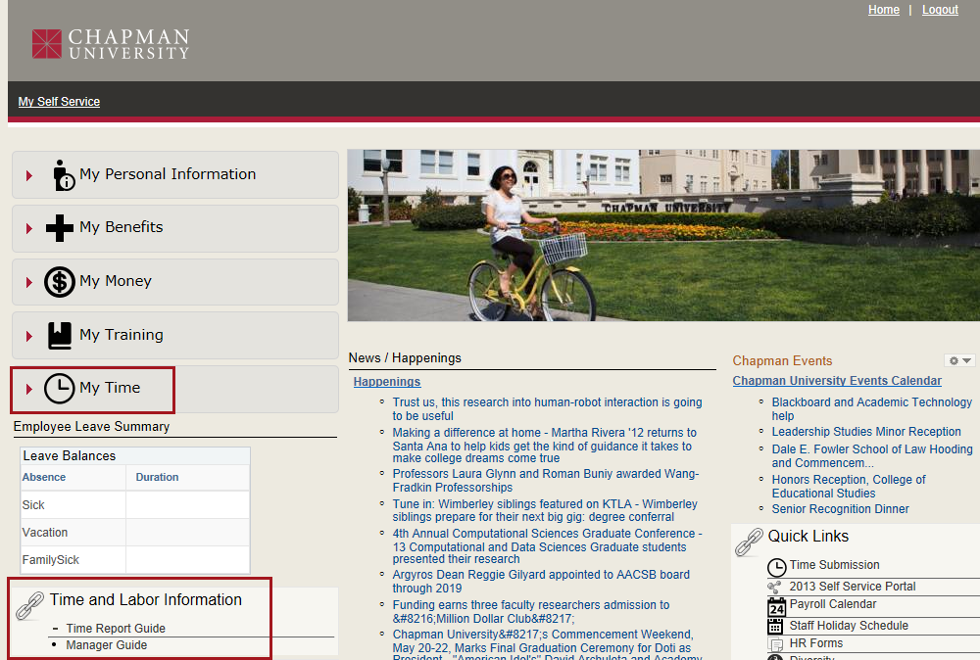
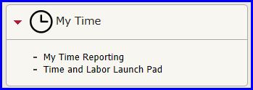
Login Process (con’t)
My Self Service Page

Slide 6
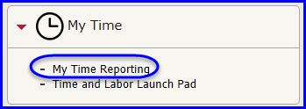
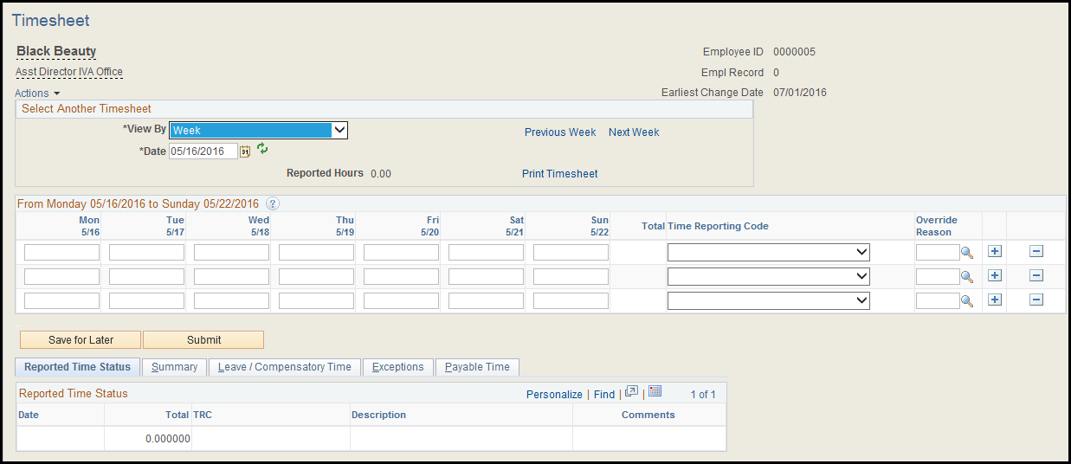
Login Process (con’t)
Click on the My Time Reporting hyperlink
Timesheet displays

Slide 7
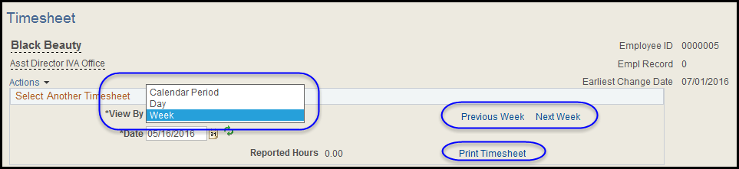
Timesheet Header
Select View By (Calendar Period = Month)
Click previous or next to get to the next period
Click Print Timesheet when ready to print

Slide 8
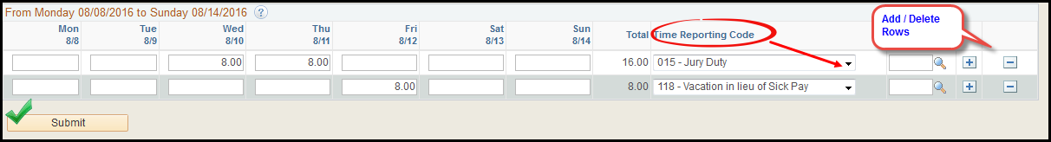
Timesheet – Reporting Time
Enter Hours and Select Time Reporting Code (TRC)
Click ‘Submit’ when ready for manager approval
  If viewing by Week, then need to submit 4 weeks
  If viewing by Calendar Period, submit once for the period
  To make changes to your timesheet:
    Add/Delete rows and re-submit
    Change TRC codes or time entered and re-submit

Slide 9
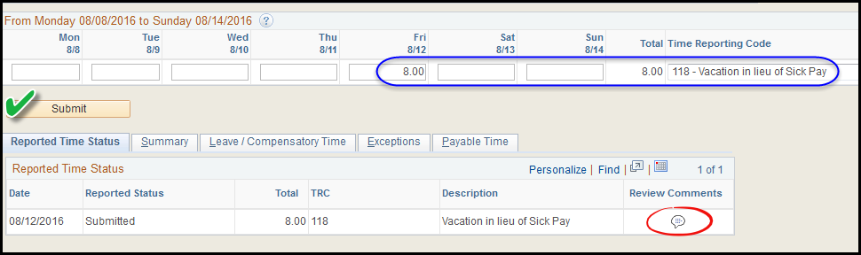
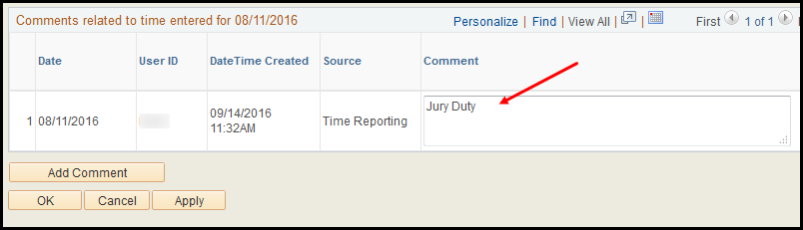
Timesheet – Reporting Time
Reported Time Status Tab
  Summarizes exception time reported
  Enter comments by clicking on the comment bubble

Slide 10
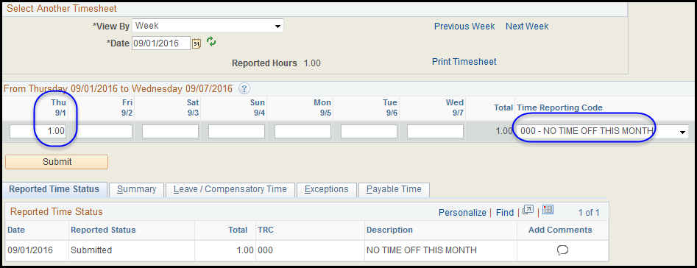
Timesheet – Reporting Time
Reporting No Time Off
  Must enter 1 hour and select TRC 000 – No Time Off

Slide 11
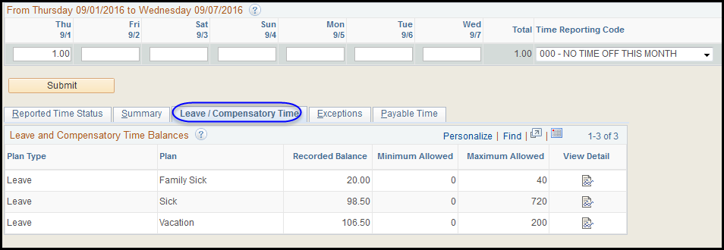
Timesheet - Leave Balances
Leave/Compensatory Time Tab
  Displays remaining balances
Note: Chapman University does not permit compensatory time.

Slide 12
Exception Rules & Resolutions
Sick Before/After Holiday
  If manager does not allow, employee must manually correct and resubmit their timesheet
Less than 90 days not eligible for benefits
  Employee must correct their timesheet and resubmit
Excessive Leave Time
  Employee must correct their timesheet and resubmit

Slide 13
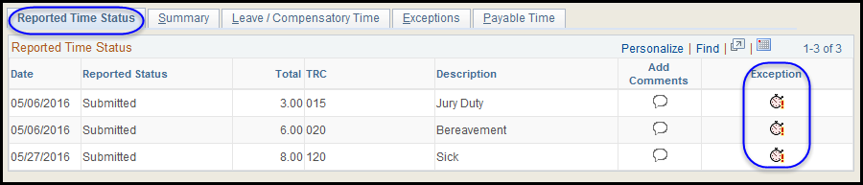
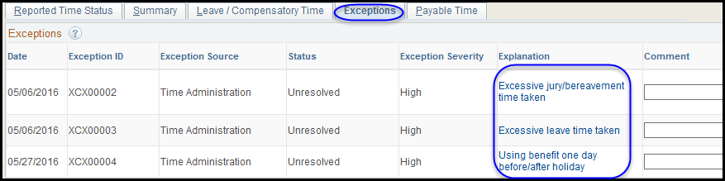
Timesheet - Exceptions
Displayed on the Reported Time Status and Exceptions Tabs

Slide 14
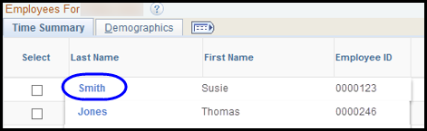
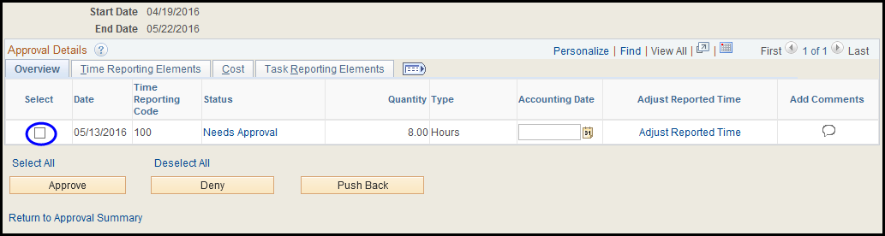
Manager View - Approve Payable Time
Select employee’s last name to see details
Review the details and disposition

Slide 15
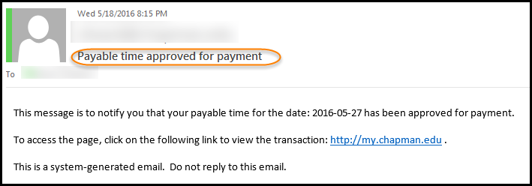
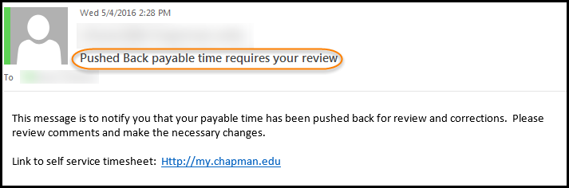
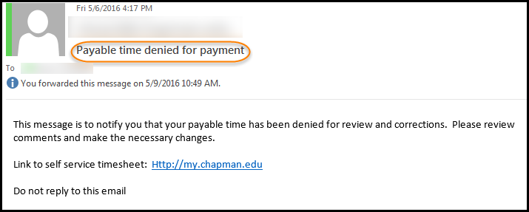
Email Notification Samples
Generated when manager approves, denies or pushes back

Slide 16
Manager Delegation Process
Manual process
  Reporter prints Timesheet from Timesheet page
  Reporter signs hard copy and gets signature from Manager’s delegate
  Time Reporter sends signed hard copy to payroll

Slide 17
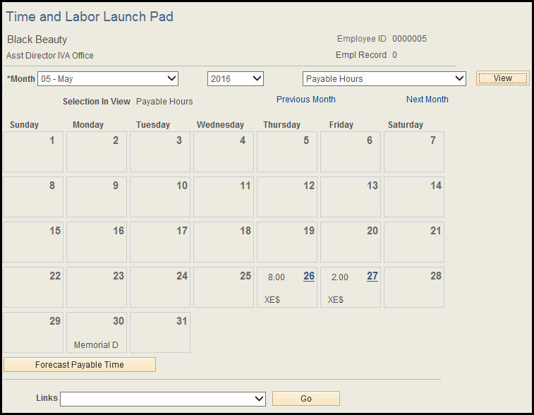
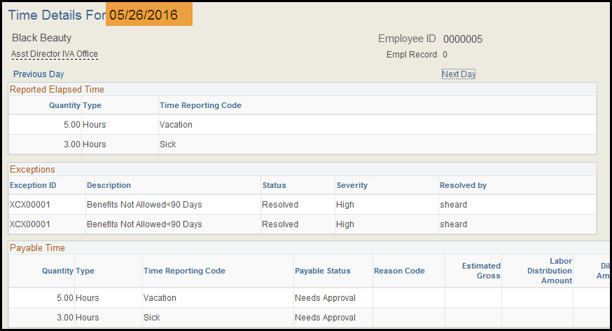
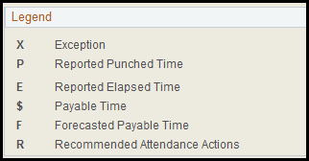
T&L Launch Pad – Calendar Summary View

Slide 18
Time & labor demo

Slide 19
High Level Process Flow

