Slide 1
Personal Finance
Spend, Spend, SPEND!
2. Invest in assets . . .
like purses
3. Travel (OUS)
4. Buy a fancy car
Saving for retirement is . . .
for Loooosers!!

Slide 2
5 Rules for the first 5 Years
You are here
Year 5
Stuff
Graduate
Law School
Graduate
Life

Slide 3
Net Worth = Assets + Liabilities
Some Math Stuff
Age
X Income
10

Slide 4
Some Tax Stuff
Payroll Taxes
Federal Income Taxes
State Income Taxes
Employee
7.7%
6.2% (Soc. Sec./Disability)
0.9% (Medicare)
0.6% (Unemployment)
35%
$388,350
33%
California
≈9.3% for taxable income over $50K
$178,650
Self-employed
15.3%
12.4% (Soc. Sec./Disability)
2.9% (Medicare)
28%
$85,650
25%
$35,350
15%
$8,700
10%

Slide 5
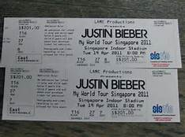
Rule #1 – Emergency fund (3 to 6 months / 6 to 12 months of living expenses)

Slide 6
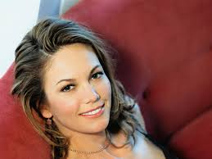
Rule #2 – Only Diane Lane doesn’t need to save for retirement

Slide 7
Behold . . . the power of compounding
Rate of Return
 | 8%
 |  | Year 1 | Year 2 | Year 3 | Year 4 | Year 5
 | Year 1 | $ 5,000
 | Year 2 | $ 5,400 | $ 5,000
 | Year 3 | $ 5,832 | $ 5,400 | $ 5,000
 | Year 4 | $ 6,299 | $ 5,832 | $ 5,400 | $ 5,000
 | Year 5 | $ 6,802 | $ 6,299 | $ 5,832 | $ 5,400 | $ 5,000
 | Year 6 | $ 7,347 | $ 6,802 | $ 6,299 | $ 5,832 | $ 5,400
 | Year 7 | $ 7,934 | $ 7,347 | $ 6,802 | $ 6,299 | $ 5,832
 | Year 8 | $ 8,569 | $ 7,934 | $ 7,347 | $ 6,802 | $ 6,299
 | Year 9 | $ 9,255 | $ 8,569 | $ 7,934 | $ 7,347 | $ 6,802
 | Year 10 | $ 9,995 | $ 9,255 | $ 8,569 | $ 7,934 | $ 7,347
 | Year 11 | $ 10,795 | $ 9,995 | $ 9,255 | $ 8,569 | $ 7,934
 | Year 12 | $ 11,658 | $ 10,795 | $ 9,995 | $ 9,255 | $ 8,569
 | Year 13 | $ 12,591 | $ 11,658 | $ 10,795 | $ 9,995 | $ 9,255
 | Year 14 | $ 13,598 | $ 12,591 | $ 11,658 | $ 10,795 | $ 9,995
 | Year 15 | $ 14,686 | $ 13,598 | $ 12,591 | $ 11,658 | $ 10,795
 | Year 16 | $ 15,861 | $ 14,686 | $ 13,598 | $ 12,591 | $ 11,658
 | Year 17 | $ 17,130 | $ 15,861 | $ 14,686 | $ 13,598 | $ 12,591
 | Year 18 | $ 18,500 | $ 17,130 | $ 15,861 | $ 14,686 | $ 13,598
 | Year 19 | $ 19,980 | $ 18,500 | $ 17,130 | $ 15,861 | $ 14,686
 | Year 20 | $ 21,579 | $ 19,980 | $ 18,500 | $ 17,130 | $ 15,861
 | Year 21 | $ 23,305 | $ 21,579 | $ 19,980 | $ 18,500 | $ 17,130
 | Year 22 | $ 25,169 | $ 23,305 | $ 21,579 | $ 19,980 | $ 18,500
 | Year 23 | $ 27,183 | $ 25,169 | $ 23,305 | $ 21,579 | $ 19,980
 | Year 24 | $ 29,357 | $ 27,183 | $ 25,169 | $ 23,305 | $ 21,579
 | Year 25 | $ 31,706 | $ 29,357 | $ 27,183 | $ 25,169 | $ 23,305
 | Year 26 | $ 34,242 | $ 31,706 | $ 29,357 | $ 27,183 | $ 25,169
 | Year 27 | $ 36,982 | $ 34,242 | $ 31,706 | $ 29,357 | $ 27,183
 | Year 28 | $ 39,940 | $ 36,982 | $ 34,242 | $ 31,706 | $ 29,357
 | Year 29 | $ 43,136 | $ 39,940 | $ 36,982 | $ 34,242 | $ 31,706
 | Year 30 | $ 46,586 | $ 43,136 | $ 39,940 | $ 36,982 | $ 34,242
30 Years Total
$566,416

Slide 8
Before Tax
After Tax
Types of Retirement
Accounts
(Matching?)
401K
403(b)
457
IRA
SEP-IRA
ROTH 401K
ROTH IRA
 | 401K |  | ROTH 401K
 | Before Tax |  | After Tax
Income | $ 10,000 |  | $ 10,000
Tax (33%) Before Contrib. | $ - |  | $ (3,300)
 | $ 10,000 |  | $ 6,700
Year 1 | $ 10,000 |  | $ 6,700
Year 2 | $ 10,800 |  | $ 7,236
Year 3 | $ 11,664 |  | $ 7,815
Year 4 | $ 12,597 |  | $ 8,440
Year 5 | $ 13,605 |  | $ 9,115
Tax (33%) @ Distrib. | $ (4,490) |  | $ -
Ending Amount | $ 9,115 |  | $ 9,115

Slide 9
Rule #3 – Debts are not pets
Chapman Law Student
Average Student Loan $133,000
Loan | Interest Rate | Monthly Payment (10 Years) | Total Paid Over 10 Years |  | Monthly Payment (25 Years) | Total Paid Over 25 Years
Federal Direct Stafford Loan ($60K) | 6.8% | $640.48 | $76,857 |  | $416.44 | $124,932
Federal Direct Graduate PLUS Loan ($73K) | 7.9% | $881.84 | $105,820 |  | $558.60 | $167,579
Total Paid |  |  | $182,677 |  | vs. | $292,511
Total Interest Paid |  |  | $49,677 |  |  | $159,511

Slide 10
Rule #4 – Save, save, save . . . ?
Drink more water.
Make a quadruple batch of a casserole.
Instead of throwing out damaged clothing, repair it instead.
Learn how to dress minimally.
Being cheap . . . Is for Looooosers!
Focus on making more money

Slide 11
Rule #5 – Investing
Money Market
Lower Risk
Lower “Return”
Bonds
People
Corporate
Gov’t
Purses
Real Estate
Higher Risk
Higher “Return”
Funds
(REITs)
Property
Stocks
Actively Managed
(80% fail to
beat the Index)
Value
Growth
Blend
Funds
Index
(S&P 500, Russell 3000, Wilshire 5000, etc.)
US
International
Blend
Small
Mid
Large

Slide 12
Leveraged Pyramid
Rule #5 – Investing in You
The Firm
Everyone
(Livelihood)
You
Billable hours
Bill per hour
Bill per year
Charge to clients
Collect from clients
What they pay you
Misc. costs of you
Profit to them
2,000
2,400 Hrs
$400
$800,000
$650,000
$600,000
($100,000)
$40/Hr
Competency = Hors d’oeuvres
($50,000)
($500,000)

Slide 13
Rule #5 – What for? For the 5th Year . . .
Opportunity
Interest
You
Resources
My first awesome “Dude” Venn Diagram

Slide 14
Personal Finance 5 for 5
Spend, Spend, SPEND!
Invest in assets . . . like purses
Buy a fancy car
Travel
Retirement saving is . . . for Looooosers
Emergency fund
Retirement
Pay off debts
Focus on income growth
Think equity
Spend prudently, invest wisely and live purposefully . . .

Slide 15
“The Claw chooses who will go and who will stay”
Finding a job . . .
1. 5 x 5
2. Narrative Thread
3. A word on shyness
4. Prioritize

Slide 16
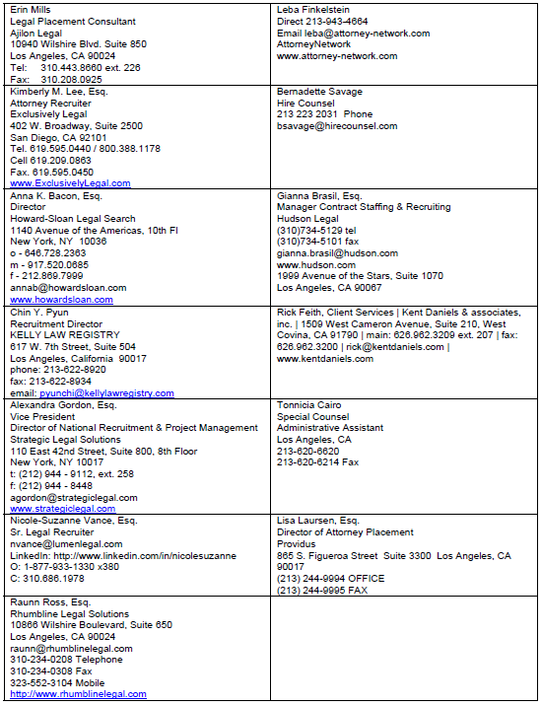
Finding a job . . .
Food for thought . . .

