Slide 1
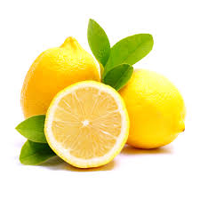
The Patent Market for Lemons

