Slide 1
Standing Sentinel Over Innovation: The Importance of a Balanced and Effective IP System
2015 Chapman Law Review Symposium
January 30, 2015
Orange, CA
Andrew C. Byrnes
Chief of Staff to the
Under Secretary of Commerce for IP & Director of the
U.S. Patent and Trademark Office

Slide 2
From Silicon Valley to Washington, DC

Slide 3
From Silicon Valley to DC

Slide 4
An “All Hands On Deck” Moment for Innovation & IP

Slide 5
Significant Changes in IP
Visibility
Filings
Economic Importance

Slide 6
The Importance of a Balanced and Effective IP System

Slide 7
Perspectives on the System
It’s important to see the system from many sides
Innovation is not a scarce resource or a zero sum game
No one has cornered the market on innovation
Notes:
The idea: a limited time, government-backed monopoly will incentivize innovation by giving you the full economic benefit of your invention

Slide 8
How do we know whether we’re standing sentinel over innovation or just standing in the way?

Slide 9
The Constitution, on IP
“Congress shall have the power . . .
To promote the Progress of Science and useful Arts, by securing for limited Times to Authors and Inventors the exclusive Right to their respective Writings and Discoveries”
- U.S. Const., Art. I, § 8
Notes:
The idea: a limited time, government-backed monopoly will incentivize innovation by giving you the full economic benefit of your invention

Slide 10
President Lincoln, on Patents
“The patent system added the fuel of interest to the fire of genius.”

Slide 11
The Importance of Enforcement
“Fuel of interest” =
“Right to exclude others” =
Right to enforce the patent

Slide 12
POTUS: Reward Innovation
“[Y]ou want to have sufficient IP . . . that you are continually encouraging and rewarding innovation and creativity. But you don't want those structures so tight, in terms of protecting that intellectual property, that that ends up being actually an inhibitor to people getting good information, folks coming up with new uses for existing information.”
– President Obama, L.A. Town Hall on Innovation (10/9/2014)

Slide 13
The USPTO: America’s “Innovation Agency”

Slide 14
USPTO Mission
Fostering innovation, competitiveness and economic growth, domestically and abroad by
delivering high quality and timely examination of patent and trademark applications,
guiding domestic and international IP policy, and
delivering IP information and education worldwide,
with a highly skilled, diverse workforce.
Source: 2014-2018 USPTO Strategic Plan

Slide 15
Recent Successes
AIA Implementation
Reduced Patent Pendency and Backlog
Maintained Optimum Trademark Pendency
One of the Best Places to Work in Federal Government (Partnership for Public Service)

Slide 16
Patent Enforcement: Benefits, Costs and Finding the Right Balance

Slide 17
Patent Litigation Costs
>$25M at risk: $5.5M
$1M - $25M at risk: $2.6M
<$1M at risk: $700,000
Defending vs. NPE suit modestly lower
Average total litigation costs across all varieties of patent infringement suits
Source: AIPLA Report of the Economic Survey 2013

Slide 18
Patent Litigation Costs
Responding to Complaint
Discovery
Experts
Trial

Slide 19
Strategic & Financial Asymmetry
Risk of patent counterclaims
Risk of disrupting relationships
Discovery burden and costs
Timing/amount of attorney’s fees

Slide 20
Asking the Right Question
What is the type of patent holder?
How does the patent holder intend to use the patent?
What is the type of accused infringer?

Slide 21
Asking the Right Question
Does the system prevent
abusive behavior
and facilitate innovation?

Slide 22
Ways To Achieve Balance
Legislation
Judicial Developments
Administrative/PTO Initiatives

Slide 23
USPTO Commitment to Quality

Slide 24
Aspects of Quality
Statutory Compliance
Accurate and Timely Examination
Encourages More Innovation

Slide 25
Enhanced Patent Quality Initiative
“All Hands On Deck”
Existing Initiatives
+
Additional Improvements Following Public Input

Slide 26
Quality: What We’re Doing Now
Improved patent claim clarity
Increased scrutiny
Targeted training/section 112(f)
Glossary pilot
Expanded technical training for examiners
International harmonization
Patent Prosecution Highway
Common Citation Document

Slide 27
Quality: What We’re Doing Now
Prior art crowdsourcing
Third-party prior art submission program
Non-patent literature
Guidance re using crowdsourced prior art
IT improvements
Patents End to End
Pro bono & pro se assistance

Slide 28
Quality: What’s Next?
Initiative Core Elements
Prosecution products and services
Customer service
Measurement of Quality
PTO is Looking At Quality From Every Angle

Slide 29
Quality: What’s Next?
Public Input
Quality Summit
Discussions Around the Country
Federal Register Notice Coming Soon
Deputy Commissioner for Patent Quality

Slide 30
Patent Trial & Appeal Board

Slide 31
Post-Grant Trial Proceedings
Faster
More Efficient
Less Expensive

Slide 32
AIA Progress (as of January 1, 2015)
AIA Monthly Filings
FY 2014: 1,494 total petitions
32

Slide 33
AIA Progress (as of January 1, 2015)
AIA Petition Dispositions
 |  | Trials Instituted | Joinders | Percent Instituted | Denials | Total No. of Decisions on Institution
IPR | FY13 | 167 | 10⁺ | 87% | 26 | 203
 | FY14 | 557 | 15⁺ | 75% | 193 | 765
 | FY15 | 207 | 67+ | 77% | 81 | 355
CBM | FY13 | 14 | 0 | 82% | 3 | 17
 | FY14 | 91 | 1⁺ | 75% | 30 | 122
 | FY15 | 18 | - | 81% | 4 | 22
DER | FY14 | 0 | 0 | 0% | 3 | 3
33

Slide 34
Inter Partes Review Petitions Terminated to Date (As of 1/15/2015)
20,206 Claims in 617 Petitions
9,048 Claims Challenged (617 Petitions)
11,158 Claims Not Challenged
2,934 Claims Challenged but Not Instituted (32% of Claims Challenged)
6,114 Claims Instituted
(68% of Claims Challenged)
(425 Petitions)
893 Claims Cancelled or Disclaimed (Non-PTAB)
(15% of Claims Instituted, 10% of Claims Challenged)
2,176 Claims Found Unpatentable
(36% of Claims Instituted,
24% of Claims Challenged)
(173 Petitions)
643 Claims Found Patentable by PTAB
(10% of Claims Instituted, 7% of Claims Challenged)
2,402 Claims Remaining Patentable
(39% of Claims Instituted, 27% of Claims Challenged)

Slide 35
Public Input & Next Steps
2014: Public feedback on post-grant review proceedings
Early 2015: Initial modifications
Later in 2015: More involved changes
Ensure proceedings are efficient and fair

Slide 36
APJ Hiring
FY2015 Goal: 60 additional APJs
Announcements on USAJOBS.gov
Locations
Alexandria, VA
Dallas
Denver
Detroit, MI
Silicon Valley

Slide 37
Promoting American Business Abroad

Slide 38
Promoting Exports
80% of world’s purchasing power overseas
PTO Efforts
IP attaches
Support trade negotiations
Trade Promotion Authority
New trade agreements, e.g., Trans-Pacific Partnership

Slide 39
Education and Outreach

Slide 40
Stakeholder Engagement
Seeking Public Input on Key Issues
Many Ways to Participate
Examples from recent months
PTAB AIA Post-Grant Review Proceedings
Subject Matter Eligibility Interim Guidelines
Trade Secret Symposium
Copyright Green Paper Convenings
Prior Art Crowdsourcing Roundtable

Slide 41
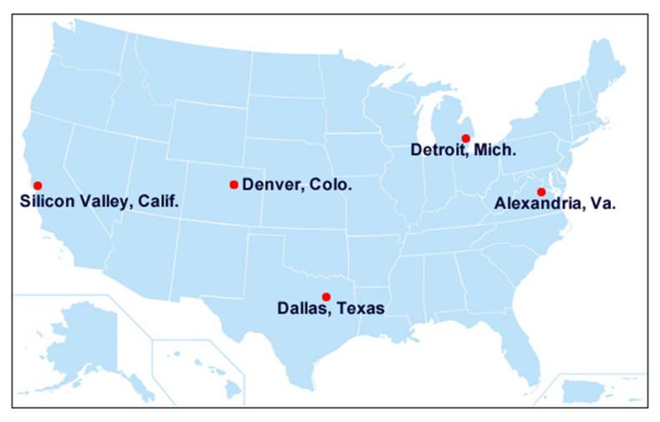
New Tools
Online Patent Litigation Toolkit
Regional Offices
Open in Permanent Locations (APJs + Examiners)
Denver
Detroit
Open in Temporary Locations/Permanent in 2015 (APJs only for now)
Dallas
Silicon Valley

Slide 42
Your Engagement Is Critical

Slide 43
Take Your Seat at the Table

Slide 44
Thank You
Andrew C. Byrnes
Chief of Staff, USPTO
Phone: (571) 272-3500
Andrew.Byrnes@uspto.gov

